Slide 1
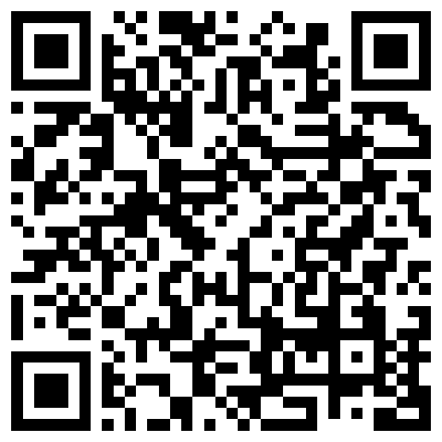
Distinguishing metalinguistic and occasional uncertainty
Aaron Steven White
University of Rochester
Colloquium Talk
University of Edinburgh
26 September 2024

Slide 2
Semantic Theories
Characterize inferences that NL expressions support and account for at least (some of) the necessary inferences.

Slide 3
Leo ran the race.
Leo ran in the race.

Slide 4
Semantic Theories
Characterize inferences that NL expressions support and account for at least (some of) the necessary inferences.
Challenge
Not always easy to distinguish the necessary inferences from the non-necessary inferences.

Slide 5
Stride quickly
Direct activity
Leo ran the race.
?
Leo ran in the race.

Slide 6
Semantic Theories
Characterize inferences that NL expressions support and account for at least (some of) the necessary inferences.
Challenge
Not always easy to distinguish the necessary inferences from the non-necessary inferences.
Source of Challenge
Both high-level (e.g. ambiguity, vagueness) and low-level factors (e.g. noise from method of reporting judgments).

Slide 7
Goal
Precisely model the sources of inferential uncertainty in order to quantitatively compare alternative theories of what that uncertainty is uncertainty about.
Two forms of uncertainty
Metalinguistic (type-level) uncertainty

Slide 8
Stride quickly
Direct activity
Leo ran the race.
?
Leo ran in the race.

Slide 9
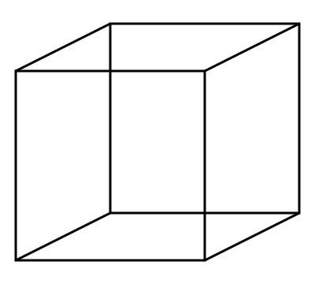
Multistable perception

Slide 10
Goal
Precisely model the sources of inferential uncertainty in order to quantitatively compare alternative theories of what that uncertainty is uncertainty about.
Two forms of uncertainty
Metalinguistic (type-level) uncertainty
Occasional (token-level) uncertainty

Slide 11
Leo ran a marathon in 3:40.
?
Leo’s marathon was fast.

Slide 12
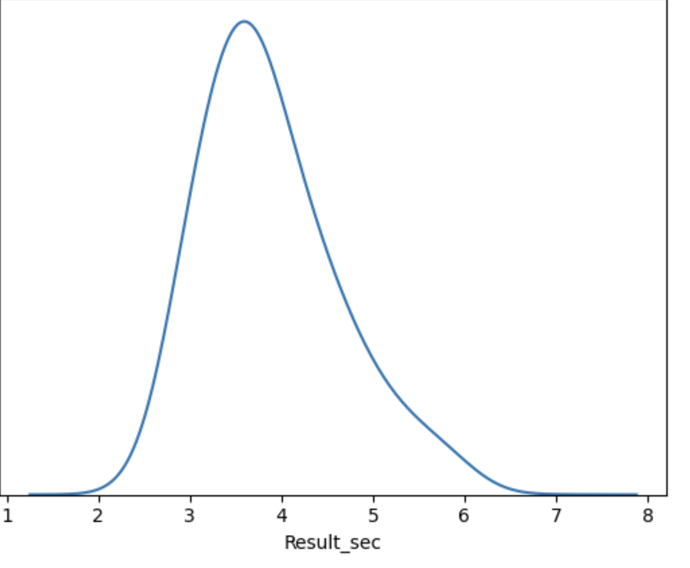
Leo’s marathon

Slide 13
Case Study White & Rawlins 2018, Tonhauser et al. 2018, Degen & Tonhauser 2021, 2022, i.a.
Apparent gradience in lexically triggered inferences–specifically, projective inferences.

Slide 14
Stacy didn’t love that Leo lost the race.
Leo lost the race.

Slide 15
Case Study
Apparent gradience in lexically triggered inferences–specifically, projective inferences.
Aim
Compare an Occasional Uncertainty account with a Metalinguistic Uncertainty account of gradience.

Slide 16
Approach
Develop framework for deriving statistical models of inference from compositional semantic analyses.
Finding
A metalinguistic uncertainty analysis of gradience in projective inference best explains inference judgment data aimed at capturing those inferences.

Slide 17
Part 1
Part 2
What I mean by apparent gradience.
A framework for expressing different kinds of uncertainty.
Part 4
Part 3
Implications for a theory of lexically triggered inferences.
An application of the framework to inference judgments displaying apparent gradience.

Slide 18
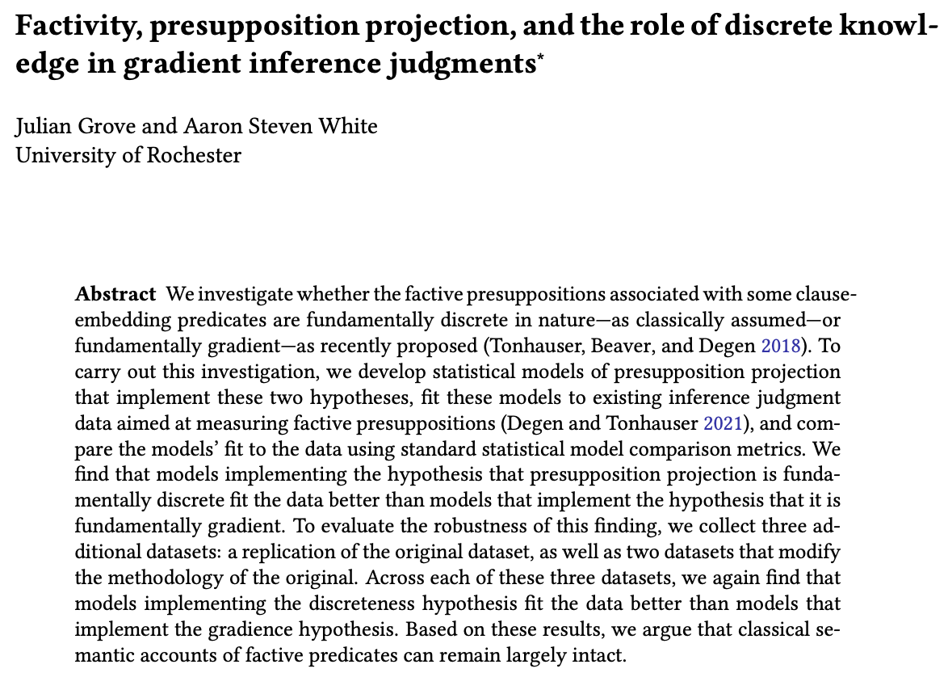
Julian Grove
University of Rochester
juliangrove.github.io/

Slide 19
Apparent Gradience

Slide 20
???
???
You had not told the truth.

Slide 21
Occasional Uncertainty
Uncertainty that is manifest on particular occasions of use and/or interpretation (e.g. vagueness).

Slide 22
.62
???
1
.75
???
You had not told the truth.

Slide 23
Occasional Uncertainty
Uncertainty that is manifest on particular occasions of use and/or interpretation (e.g. vagueness).
Metalinguistic Uncertainty
Uncertainty about possible kinds of occasions of use and/or interpretation (e.g. irresolvable ambiguity).

Slide 24
.62
???
1
.75
???
0
1
1
You had not told the truth.

Slide 25
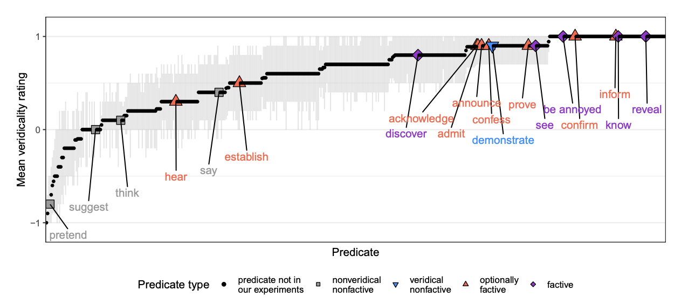
White & Rawlins 2018, White et al. 2018, Degen and Tonhauser 2022

Slide 26
Question 1 Tonhauser et al. 2018
What does the distribution of judgments indicate about the kind of uncertainty at play in projective inferences?
Question 2 Degen & Tonhauser 2022
What does the distribution of aggregated judgments indicate about whether certain predicate classes exist?

Slide 27
Question 1 Tonhauser et al. 2018
What does the distribution of judgments indicate about the kind of uncertainty at play in projective inferences?
These are importantly different questions. Today, we’re only looking at Question 1.
Question 2 Degen & Tonhauser 2022
What does the distribution of aggregated judgments indicate about whether certain predicate classes exist?

Slide 28
Goal
Compare a metalinguistic uncertainty analysis with a occasional uncertainty analysis on an equal playing field.
Approach
Develop framework for deriving statistical models of inference from compositional semantic analyses.

Slide 29
Modeling Uncertainty

Slide 30
Idea Grove and Bernardy 2023
Use monads to describe utterances as probabilistic programs that update (uncertainty about) contexts.
Why monads? Shan 2001, Asudeh & Giorgolo 2010, Charlow 2014
Provide modular way of modeling semantic phenomena by enriching compositional core w/o fundamentally altering it.

Slide 31
Part 1
Elementary example of a monad for modeling anaphora, with aim of demonstrating what we mean by modular.
Part 2
Develop a monad for modeling occasional uncertainty and give an example application to capturing vagueness.
Part 3
Extend the model of occasional uncertainty by composing an analogous model of metalinguistic uncertainty with it.

Slide 32
Modeling Uncertainty
An elementary example

Slide 33
Example: Anaphora Giorgolo & Unger 2009, Charlow 2014
Enrich the compositional procedure with a mechanism (a state) for representing active discourse referents.
see also classical dynamic approaches: Heim 1983, Kamp & Reyle 1993, i.a.

Slide 34
Composition Rule: Function Application
[[X Y]] = [[X]] [[Y]] if [[X]]: a -> b and [[Y]]: b
[[Y]] [[X]] if [[Y]]: a -> b and [[X]]: b
Appl [[X]] [[Y]]
angry c & leave y
Assignment function
λp.p & leave y
angry c
leave y
c
angry
λq.λp.p & q
y
leave
Cleo
was angry
and
she
left

Slide 35
Composition Rule: State-Sensitive Function Application
Extract the core semantic values and put them together normally.
Update the state with the first, then feed the updated state to the second to get a combined state.
Charlow 2014
[[X Y]] = λs.<Appl A B, s’’>
where <A, s’> := ([[X]] s)
<B, s’’> := ([[Y]] s’)
angry c & leave y
c
λs.<angry c & leave (head c::s), c::s>
λs.<λϕ.p & leave (head s), s’>
λp.p & leave y
where <p, s’> := ϕ(s)
λs.<angry c, c::s>
angry c
leave y
λs.<leave (head s), s>
λs.<c, c::s>
λs.<angry, s>
c
angry
λs.<λψ.λϕ.p & q, s’’>
λs.<head s, s>
y
leave
λs.<leave, s>
Cleo
was angry
and
she
left
where <p, s’> := ϕ(s)
<q, s’’> := ψ(s’)
Giorgolo & Unger 2009

Slide 36
Question
How do monads provide a modular way of modeling semantic phenomena by enriching a compositional core?
Answer
Monads satisfy metacompositional constraints that…
…ensure they don’t change how the core works.
…that allows different monadic enrichments of the compositional core to function independently.

Slide 37
Component #1: return
Some semantic values are monadic while others must be lifted into the monad in a way that doesn’t alter the core.

Slide 38
e
[[Cleo]] = λs.<c, c::s>
Fundamentally monadic because it introduces a discourse referent to be tracked.
[[was angry]] = angry
Not monadic because it doesn’t introduce a discourse referent.
e -> t
Composition Rule: State-Sensitive Function Application
[[X Y]] = λs.<Appl A B, s’’>
where <A, s’> := ([[X]] s)
<B, s’’> := ([[Y]] s’)
[[X]] = λs.<[[X]], s>
[[was angry]] = λs.<angry, s>: e -> t
Charlow 2014

Slide 39
Composition Rule: State-Sensitive Function Application
Charlow 2014
[[X Y]] = λs.<Appl A B, s’’>
where <A, s’> := ([[X]] s)
<B, s’’> := ([[Y]] s’)
angry c & leave y
c
λs.<angry c & leave (head c::s), c::s>
λs.<λϕ.p & leave (head s), s’>
λp.p & leave y
where <p, s’> := ϕ(s)
λs.<angry c, c::s>
angry c
leave y
λs.<leave (head s), s>
λs.<c, c::s>
λs.<angry, s>
c
angry
λs.<λψ.λϕ.p & q, s’’>
λs.<head s, s>
y
leave
λs.<leave, s>
Cleo
was angry
and
she
left
where <p, s’> := ϕ(s)
<q, s’’> := ψ(s’)

Slide 40
Component #1: return
Some semantic values are monadic while others must be lifted into the monad in a way that doesn’t add info.
Component #2: bind
We compose monadic semantic values by (roughly):
Combining core part of one with core part of another.
Wrapping the result back up as a monadic value.

Slide 41
ma >>= λx → (f(x) >>= g) ↔ (ma >>= f) >>= g
Composition Rule: State-Sensitive Function Application
[[X Y]] = λs.<Appl A B, s’’>
where <A, s’> := ([[X]] s)
<B, s’’> := ([[Y]] s’)
(>>=) : a -> (a -> b ) -> b
[[A B]] := [[A]] >>= λx [[B]] >>= λy Appl x y
Monad Laws
x >>= f = f x
f >>= λx x = f
h >>= λx (f(x) >>= g) = (h >>= f) >>= g

Slide 42
Modeling Uncertainty
Modeling occasional uncertainty

Slide 43
Idea Grove and Bernardy 2023
Use monads to describe utterances as probabilistic programs that update (uncertainty about) contexts.
Proximal Goal
Develop a monad for modeling occasional uncertainty and give an example application to capturing vagueness.

Slide 44
Assumption #1
Common grounds are probability distributions on contexts. (Think of contexts as possible worlds for now.)
Stalnaker 1978 et seq, see Lassiter 2011, Bergen et al. 2012, Lassiter & Goodman 2013, i.a.

Slide 45
c
c
c
c
c
κ
c
c
c
c
c
c
c

Slide 46
Assumption #1
Common grounds are probability distributions on contexts. (Think of contexts as possible worlds for now.)
Assumption #2
Utterances are ways of building probability distributions on truth values from contexts.
Stalnaker 1978 et seq, see Lassiter 2011, Bergen et al. 2012, Lassiter & Goodman 2013, i.a.

Slide 47
Leo’s marathon was fast.
c
c
c
c
c
c
c
c
c
c
c
c
κ
false
true
Barker 2002 Kennedy and McNally 2005, Kennedy 2007, Lassiter 2011; Lassiter and Goodman 2013; Bernardy et al. 2018, i.a.

Slide 48
Leo’s marathon was fast.
c
c
c
c
c
c
c
c
c
c
c
c
c
c
c
c
c
c
c
c
c
c
c
c
κ
false
true
Barker 2002 Kennedy and McNally 2005, Kennedy 2007, Lassiter 2011; Lassiter and Goodman 2013; Bernardy et al. 2018, i.a.

Slide 49
Formal Component #1
Common grounds as probabilistic programs (monadic values) from which we can sample (return) contexts.
Stalnaker 1978 et seq, see Lassiter 2011, Bergen et al. 2012, Lassiter & Goodman 2013, i.a.

Slide 50
Leo’s marathon was fast.
κ
κ
c
c
c
c
c
c
c
c
c
c
c
c
c
c
c
c
c
c
c
c
c
c
c
c
Barker 2002 Kennedy and McNally 2005, Kennedy 2007, Lassiter 2011; Lassiter and Goodman 2013; Bernardy et al. 2018, i.a.

Slide 51
Formal Component #1
Common grounds as probabilistic programs as monadic values randomly returning contexts.
Formal Component #2
Utterances as mappings from contexts to probabilistic programs (monadic vals) randomly returning truth values.
Stalnaker 1978 et seq, see Lassiter 2011, Bergen et al. 2012, Lassiter & Goodman 2013, i.a.

Slide 52
Leo’s marathon was fast.
κ
κ
c
c
c
c
c
c
c
c
c
c
c
c
c
c
c
c
c
c
c
c
c
c
c
c
κ ->
t
λc speed(c)(m) > θ(c)
Barker 2002 Kennedy and McNally 2005, Kennedy 2007, Lassiter 2011; Lassiter and Goodman 2013; Bernardy et al. 2018, i.a.

Slide 54
Formal Component #3
Utterances (at least assertions) are constructed from a normal proposition.
Stalnaker 1978 et seq, see Lassiter 2011, Bergen et al. 2012, Lassiter & Goodman 2013, i.a.

Slide 55
Leo’s marathon was fast.
κ
κ
λc.speed(c)(m) > θ(c)
c
c
c
c
c
c
c
c
c
c
λf.λc f(c)
c
c
c
c
c
c
c
c
c
c
c
c
c
c
κ ->
t
λc speed(c)(m) > θ(c)
Barker 2002 Kennedy and McNally 2005, Kennedy 2007, Lassiter 2011; Lassiter and Goodman 2013; Bernardy et al. 2018, i.a.

Slide 56
Formal Component #3
Utterances (at least assertions) are constructed from a normal proposition
Formal Component #4
Updating a common ground involves sequencing the common ground program with an utterance program.
Stalnaker 1978 et seq, see Lassiter 2011, Bergen et al. 2012, Lassiter & Goodman 2013, i.a.

Slide 57
Extract core semantic value type a from probabilistic program by sampling from it.
Feed extracted value of type a to this to get probabilistic program returning b.
(>>=) : a -> (a -> b ) -> b
New probabilistic program returning b.
update : κ -> (κ -> t ) -> κ
New common ground.
Extract context from common ground by sampling from it.
Feed context to utterance to get distribution on truth values.

Slide 58
Leo’s marathon was fast.
κ
κ
c
c
c
c
c
c
c
c
c
c
c
c
c
c
c
c
c
c
c
c
c
c
c
c
κ ->
t
λc speed(c)(m) > θ(c)
Update by keeping only the contexts that evaluate to true and renormalize.
Barker 2002 Kennedy and McNally 2005, Kennedy 2007, Lassiter 2011; Lassiter and Goodman 2013; Bernardy et al. 2018, i.a.

Slide 59
(>>=) : a -> (a -> b ) -> b
update : κ -> (κ -> t ) -> κ
update uses >>= but it’s not the same thing!

Slide 60
Formal Component #5
Gradience can be derived by defining a way of mapping probabilistic programs returning truth vals to probabilities.
Stalnaker 1978 et seq, see Lassiter 2011, Bergen et al. 2012, Lassiter & Goodman 2013, i.a.

Slide 61
(>>=) : a -> (a -> b ) -> b
update : κ -> (κ -> t ) -> κ
prob : t -> r
What proportion of the truth values returned by the program are true.

Slide 62
Leo’s marathon was fast.
κ
κ
c
c
c
c
c
c
c
c
c
c
c
c
c
c
c
c
c
c
c
c
c
c
c
c
κ ->
t
λc speed(c)(m) > θ(c)
Barker 2002 Kennedy and McNally 2005, Kennedy 2007, Lassiter 2011; Lassiter and Goodman 2013; Bernardy et al. 2018, i.a.

Slide 63
Leo’s marathon was fast.
κ
r
c
c
c
c
c
.546
c
c
c
c
c
c
c
κ ->
t
prob(_ >>= _)
λc speed(c)(m) > θ(c)
Barker 2002 Kennedy and McNally 2005, Kennedy 2007, Lassiter 2011; Lassiter and Goodman 2013; Bernardy et al. 2018, i.a.

Slide 64
Challenge
Only represents occasional uncertainty (e.g. vagueness). No handling of metalinguistic uncertainty (e.g. ambiguity).
Goal
Enrich monad for modeling occasional uncertainty and give an example application to capturing ambiguity.

Slide 65
Modeling Uncertainty
Composing uncertainty

Slide 66
Idea see Lassiter 2011, Bergen et al. 2012
Embed probabilistic programs for occasional uncertainty in probabilistic programs for metalinguistic uncertainty.
Upshot
Possible because monads are composable in the way we need them to be (because they are functors).

Slide 67
Formal Component #1
Common grounds as probabilistic programs that return probabilistic programs returning contexts.

Slide 68
κ
c
c
c
c
c
c
c
c
c
c
c
c
c
c
c
c
c
c
c
c
c
c
c
c
c
c
c
c
c
c
c
c
c
c
c
c
c
c
c
c
c
c
c
c
c
c
c
c
c
c
c
c
c
c
c
c
c
c
c
c

Slide 69
Formal Component #1
Common grounds as probabilistic programs that return probabilistic programs returning contexts.
Formal Component #2
Utterances as mappings from contexts to probabilistic programs that return probabilistic programs returning truth values.

Slide 70
κ
Leo’s marathon was fast.
κ
c
c
c
c
c
c
c
c
c
c
c
c
c
c
c
c
c
c
c
c
c
c
c
c
c
c
c
c
c
c
c
c
c
c
c
c
c
c
c
c
c
c
c
c
c
c
c
c
c
c
c
c
c
c
c
c
c
c
c
c
c
c
c
c
c
c
c
c
c
c
c
c
c
c
c
c
c
c
c
c
c
c
c
c
c
c
c
c
c
c
c
c
c
c
c
c
c
c
c
c
c
c
c
c
c
c
c
c
c
c
c
c
c
c
c
c
c
c
c
c
c
c
c
c
c
c
κ ->
t
c
c
c
c
c
c
λc speed(c)(x) > θ(c)

Slide 71
κ
Leo ran the race.
κ
c
c
c
c
c
c
c
c
c
c
c
c
c
c
c
c
c
c
c
c
c
c
c
c
c
c
c
c
c
c
c
c
c
c
c
c
c
c
c
c
c
c
c
c
c
c
c
c
c
c
c
c
c
c
c
c
c
c
c
c
c
c
c
c
c
c
c
c
c
c
c
c
c
c
c
c
c
c
c
c
c
c
c
c
c
c
c
c
c
c
c
c
c
c
c
c
c
c
c
c
c
c
c
c
c
c
c
c
c
c
c
c
c
c
c
c
c
c
c
c
c
c
c
c
c
c
κ ->
t
c
c
c
c
c
c
λc ran(c) r l
sense of run in c

Slide 72
.62
???
1
.75
???
0
1
1
You had not told the truth.

Slide 73
Idea #1
We have a single context-sensitive formal core.

Slide 74
φ(p): realize x p if 𝜏_{realize}(c)
[[realize]] = λx.λp.λc.
realize x p if ¬𝜏_{realize}(c)
where φ(p) -> p
Nothing depends on context-sensitivity in the verb. It could be some other element (e.g. a complementizer) and the model we derive will be the same.

Slide 75
Idea #1
We have a single context-sensitive formal core.
Idea #2
Different kinds of uncertainty correspond to the level at which a context-sensitive parameter is fixed.

Slide 76
Assumption #1
The inner level is always collapsed to a probability on any judgment. (Necessary to retain explanation of vagueness.)
Assumption #2
The outer level is never collapsed to a probability on any judgment. (This assumption yields discreteness.)

Slide 77
Multistable perception

Slide 78
Question
How do we empirically distinguish between these two possibilities for particular kinds of inferences?

Slide 79
Quantifying Uncertainty

Slide 80
Idea
Derive statistical models of judgment data by composing a common ground + utterance with a response model.
Approach
Fit different statistical models to the data and assess which fits the best.

Slide 81
Part 1
Introduce the datasets.
Part 2
What a response model looks like.
Part 3
Results of fitting the different models to data.

Slide 82
Quantifying Uncertainty
Data

Slide 83
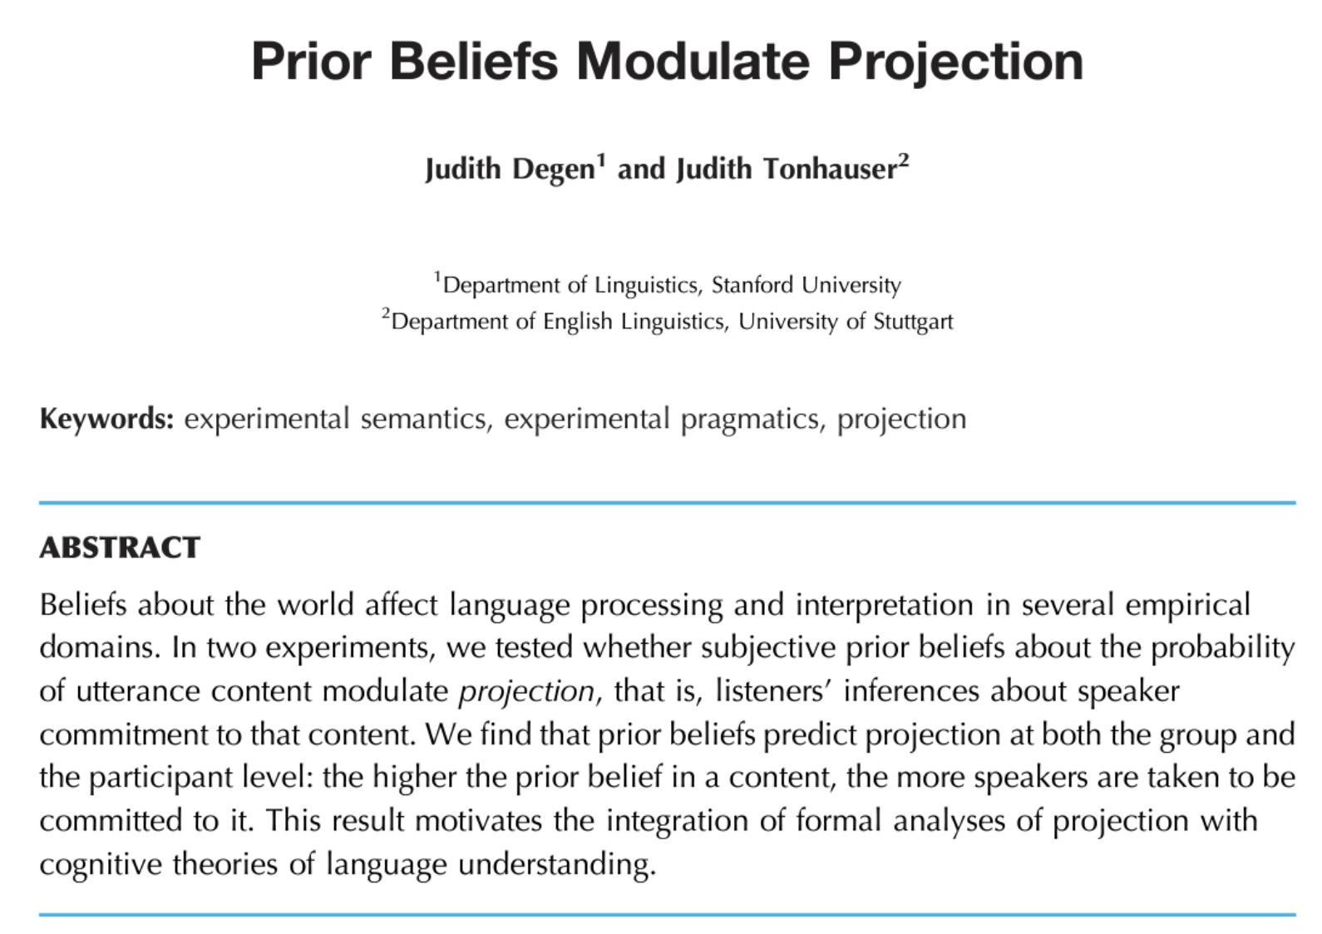

Slide 84
Norming Dataset
Measure prior knowledge: rate likelihood of proposition P given fact F.

Slide 85
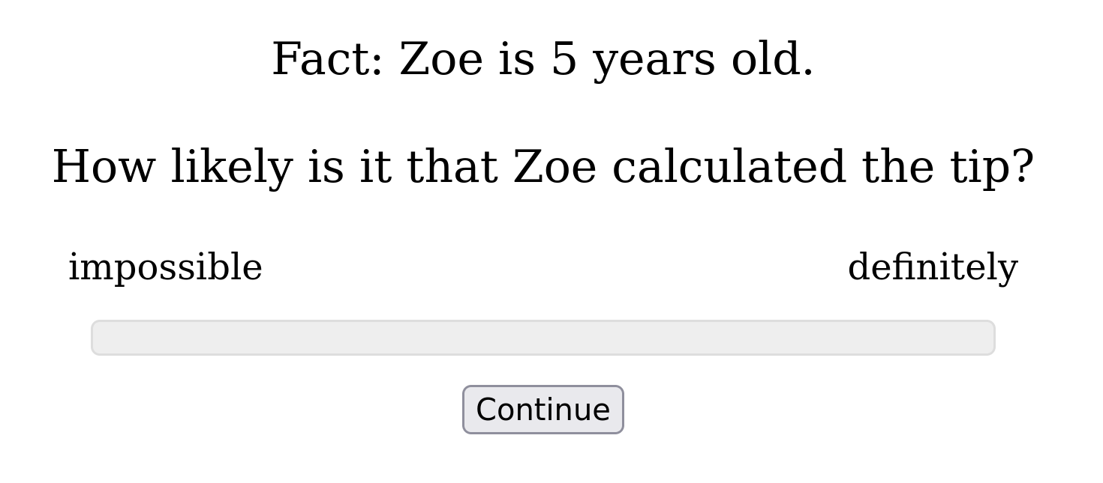

Slide 86
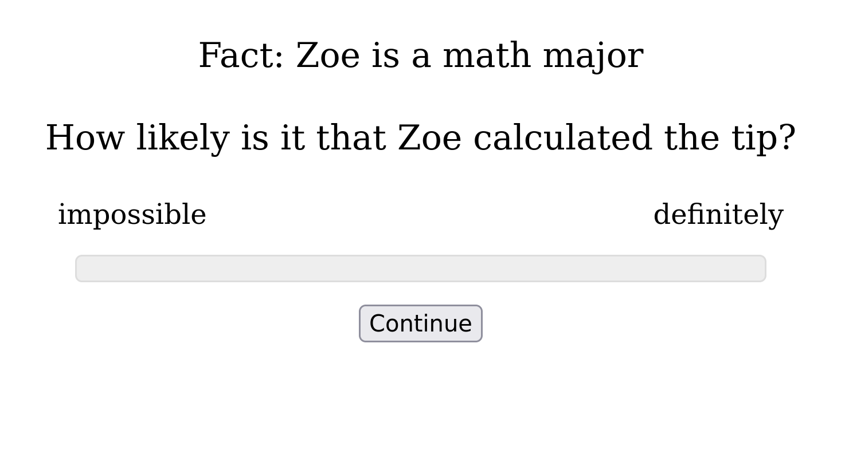

Slide 87
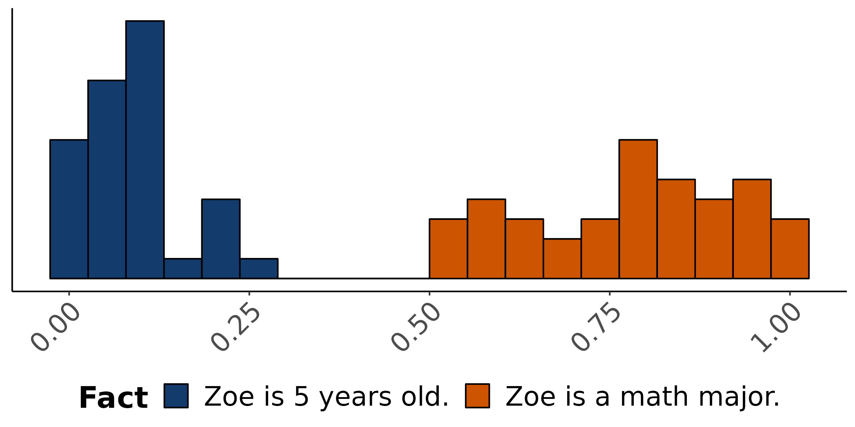
Empirical distribution of norming response
How likely is is that Zoe calculated the tip?

Slide 88
Norming Dataset
Measure prior knowledge: rate likelihood of proposition P given fact F.
Projection Dataset
Measure veridicality inferences: rate X’s certainty that P given F and a context where X asks Did/Does Y V that P?

Slide 89
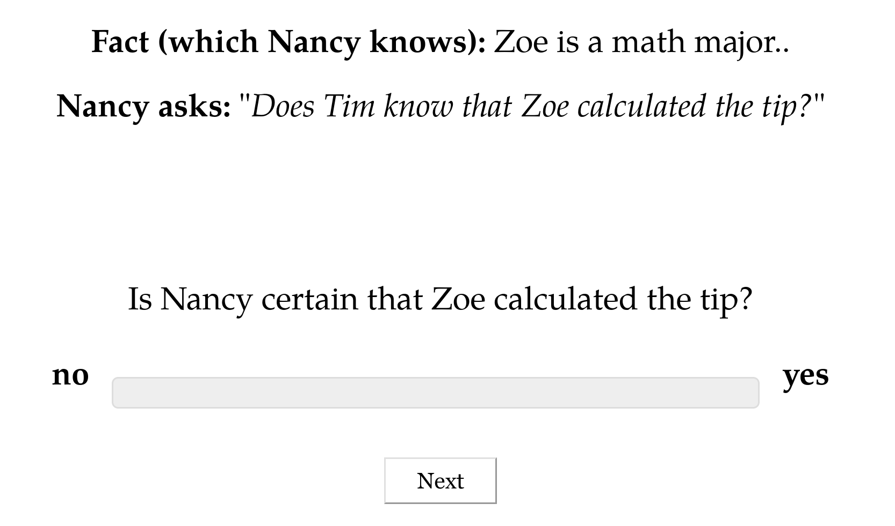

Slide 90
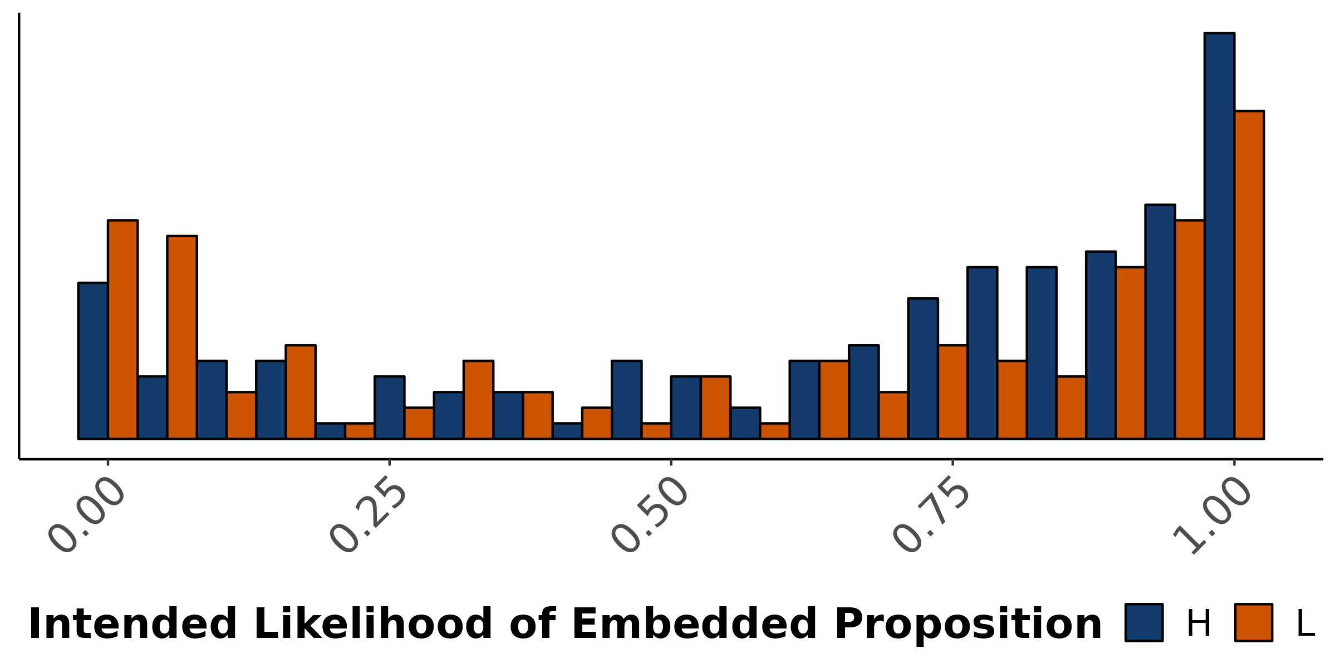
Empirical distribution of projection response
X asks: Does Y know that P?
Is X certain that P?

Slide 91
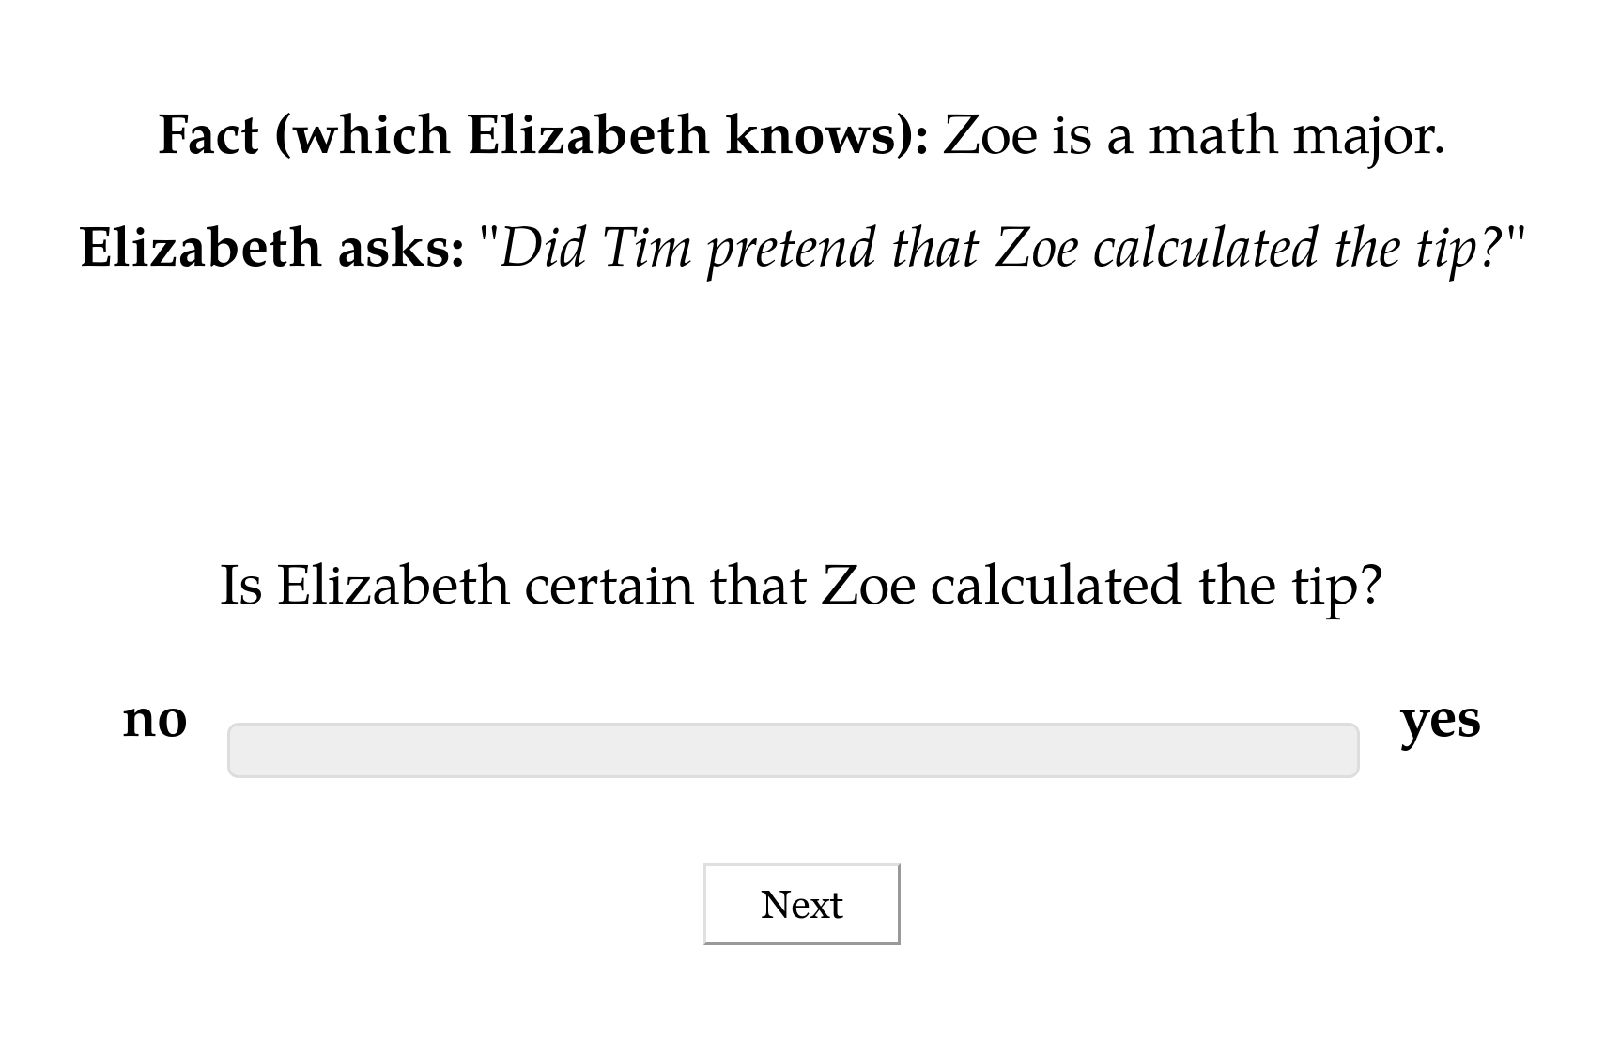

Slide 92
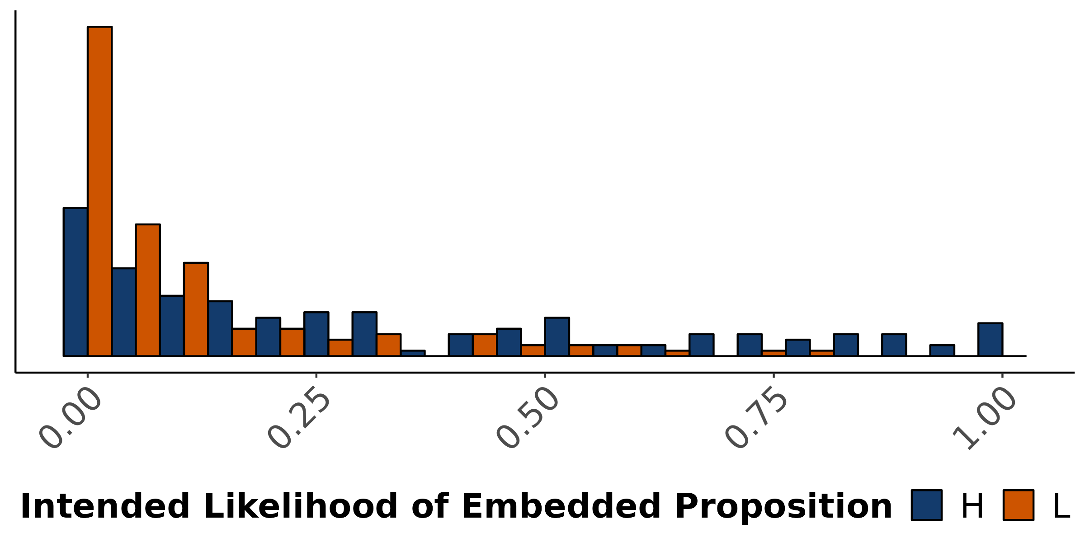
Empirical distribution of projection response
X asks: Did Y pretend that P?
Is X certain that P?

Slide 93
Norming Model
Assess whether prior beliefs are better modeled as occasional or metalinguistic uncertainty.
Projection Model
Assess whether projection is better modeled as occasional or metalinguistic uncertainty given model of prior beliefs.

Slide 94
Quantifying Uncertainty
Response model

Slide 95
Idea #1
A response model links the probabilistic program derived by composing a common ground with an utterance to judgments given using some response instrument.

Slide 96
κ
κ -> t
Vary whether the sentence is evaluated against inner or outer context.
Response model
Sample an outer context from the common ground.
Compute the probability of the proposition across inner contexts, weighting by their probability.

Slide 97
Idea #1
A response model links the probabilistic program derived by composing a common ground with an utterance to judgments given using some response instrument.
Idea #2
A response model is a probabilistic program and therefore may introduce additional randomness into response.

Slide 98
κ
κ -> t
Mixed effects model
Vary whether the sentence is evaluated against inner or outer context.
Response model
Sample an outer context from the common ground.
Compute the probability of the proposition across inner contexts, weighting by their probability.

Slide 99
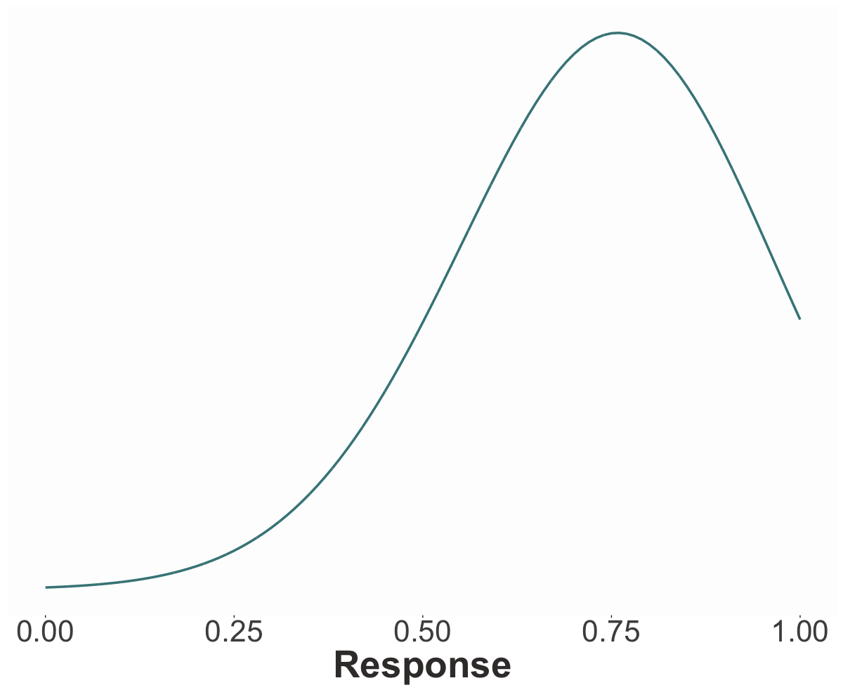

Slide 100
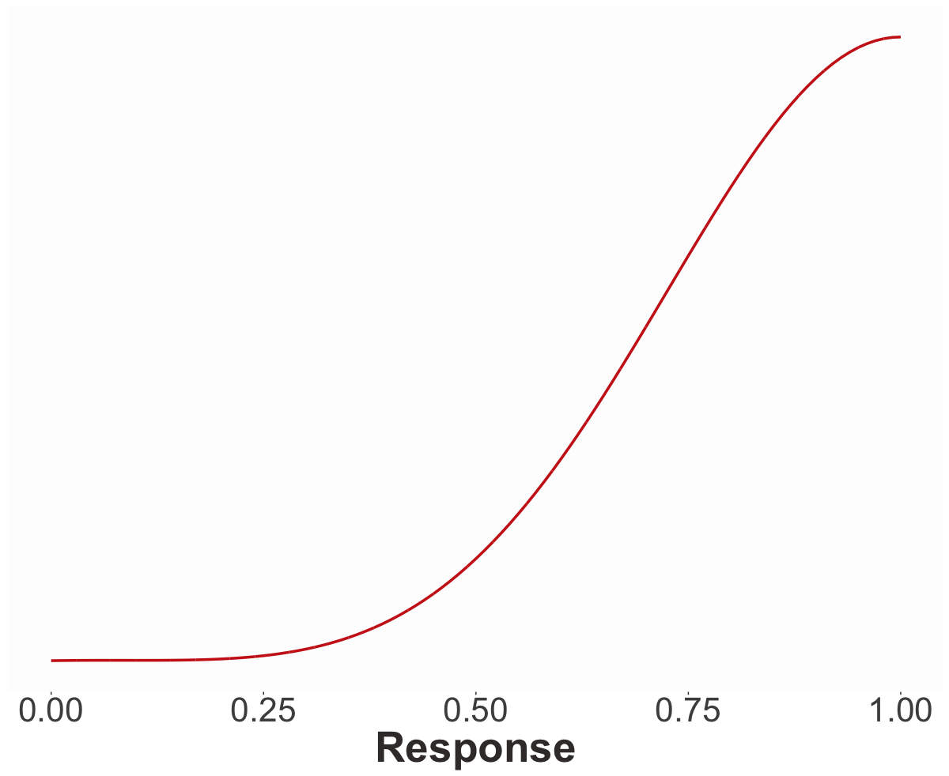

Slide 101
κ
κ -> t
Response model

Slide 102
Quantifying Uncertainty
Results

Slide 103
Question #1
Do prior beliefs display occasional or metalinguistic uncertainty?

Slide 104
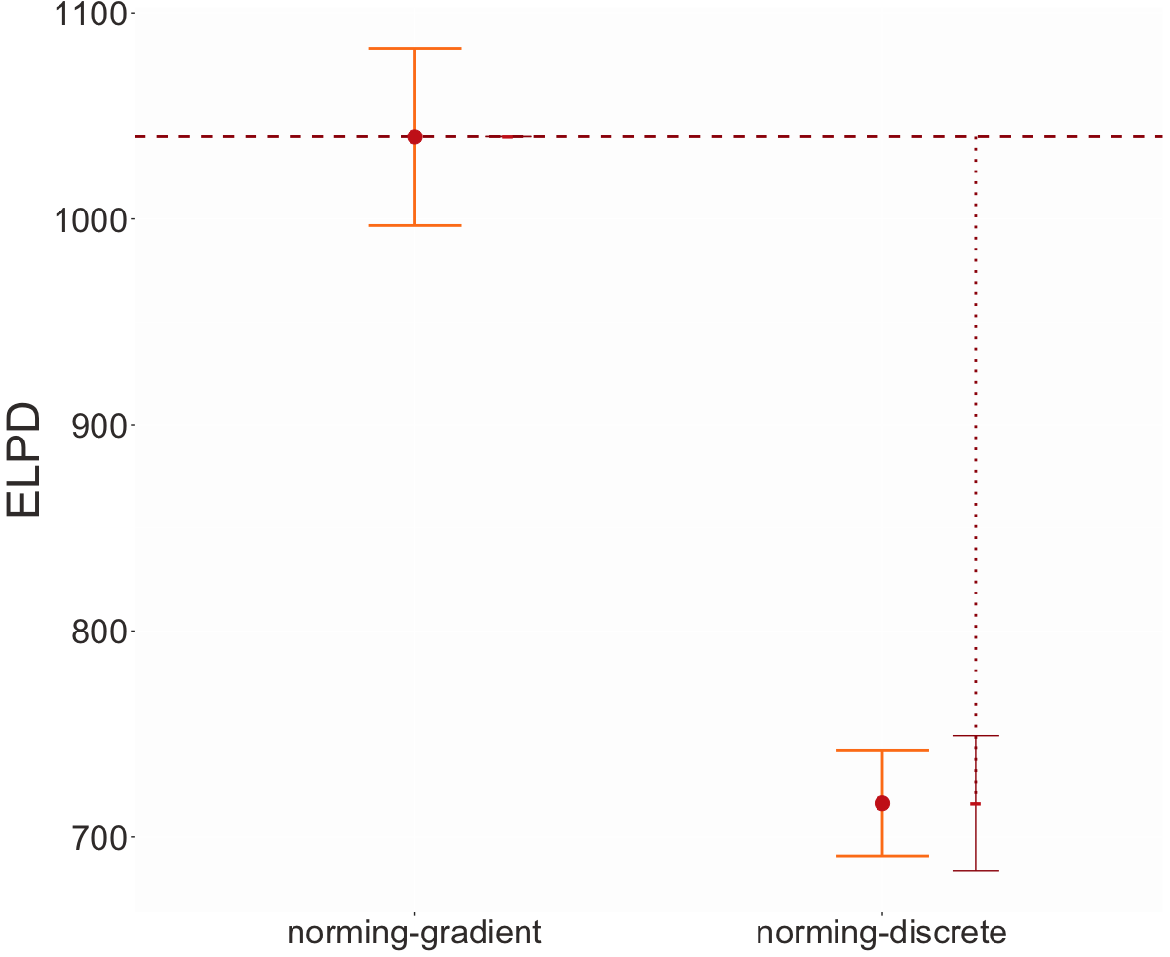
Higher means better fit
Prior beliefs display occasional uncertainty.

Slide 105
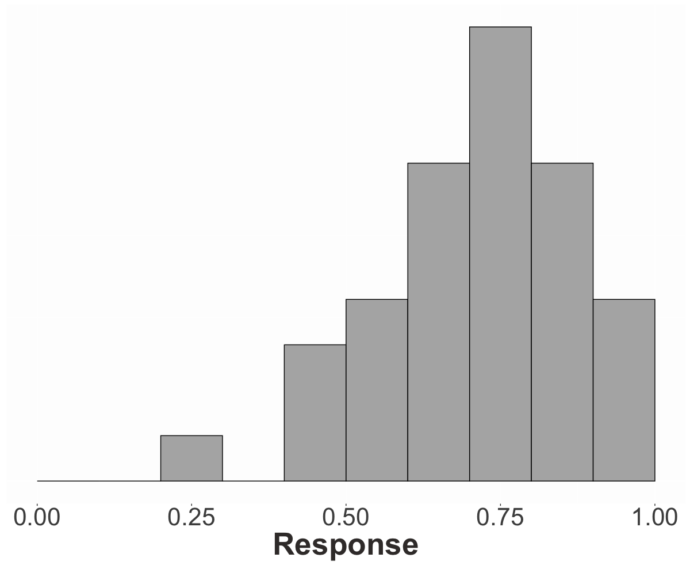
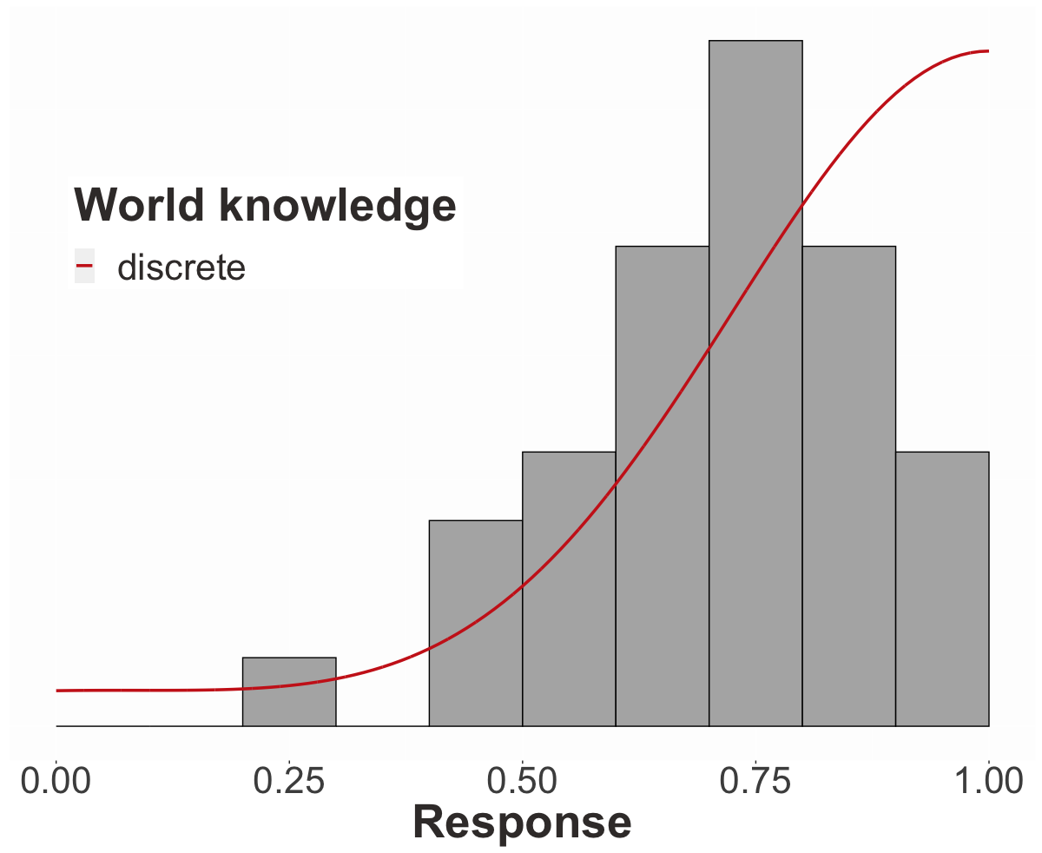
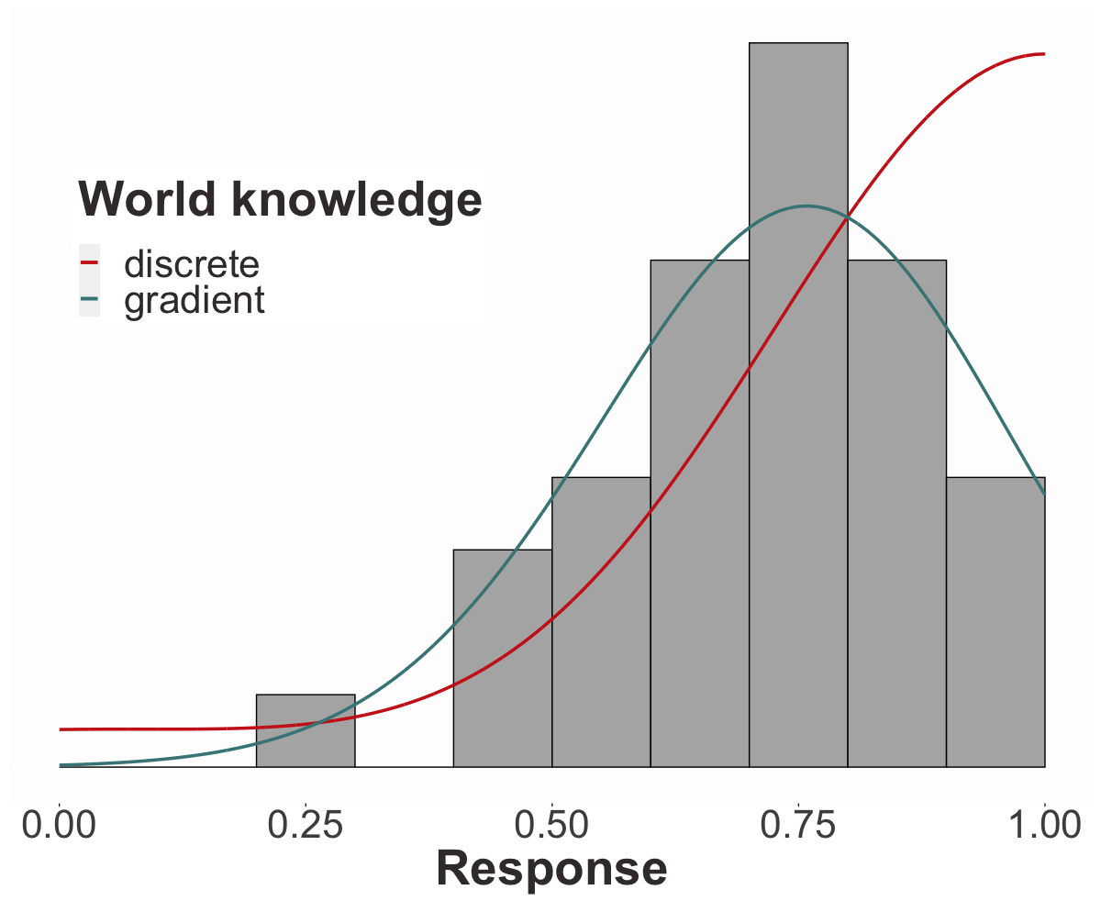

Slide 106
Question #1
Do prior beliefs display occasional or metalinguistic uncertainty?
Question #2
Do projective inferences display occasional or metalinguistic uncertainty?

Slide 107
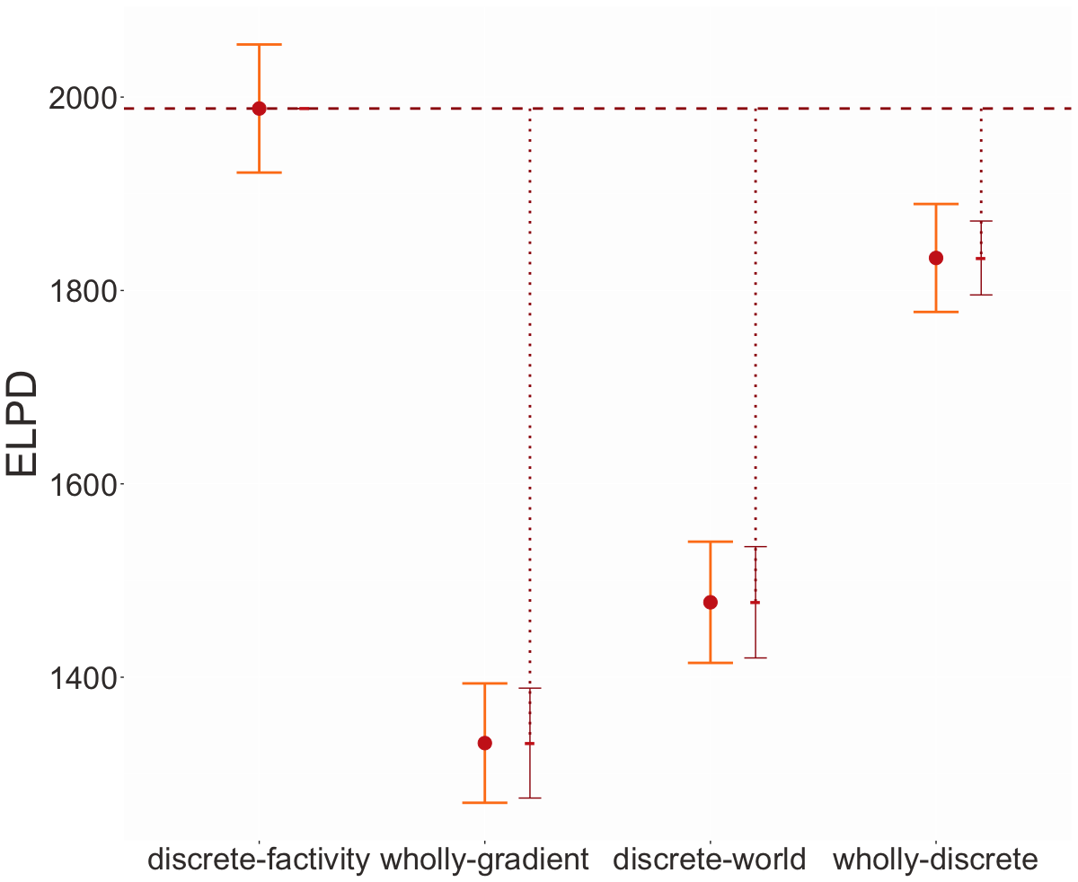
Projective inferences display metalinguistic uncertainty.

Slide 108
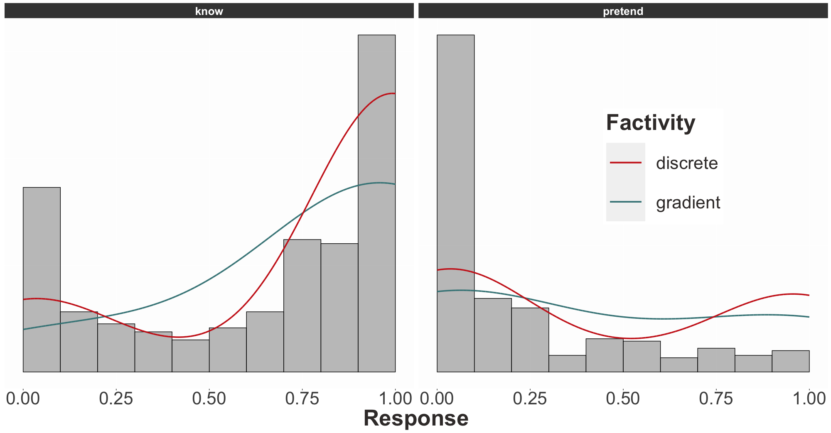
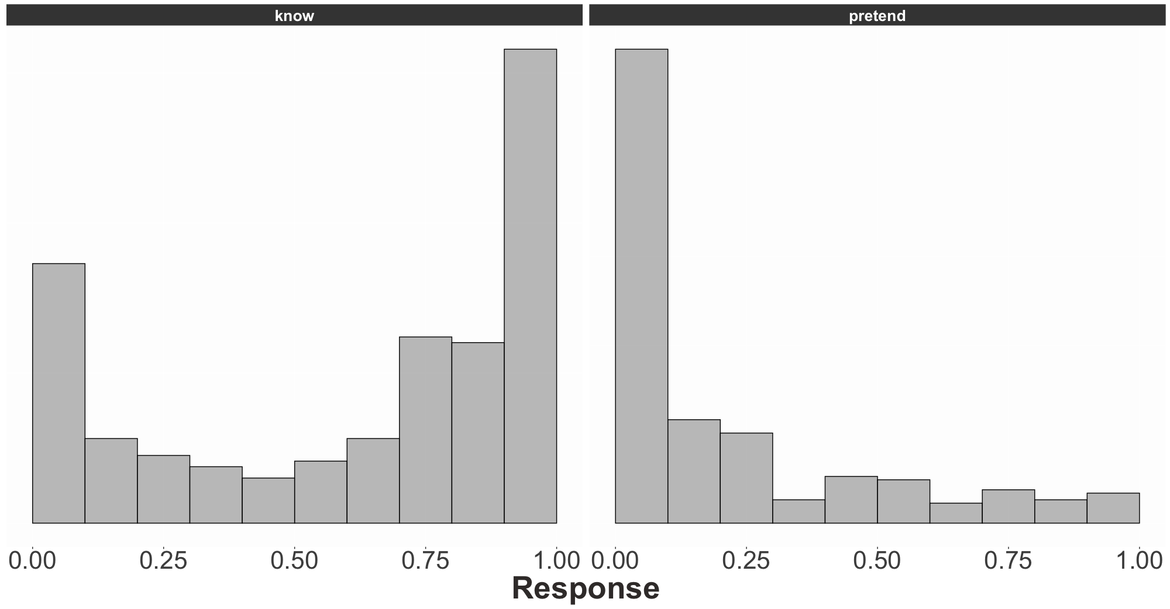
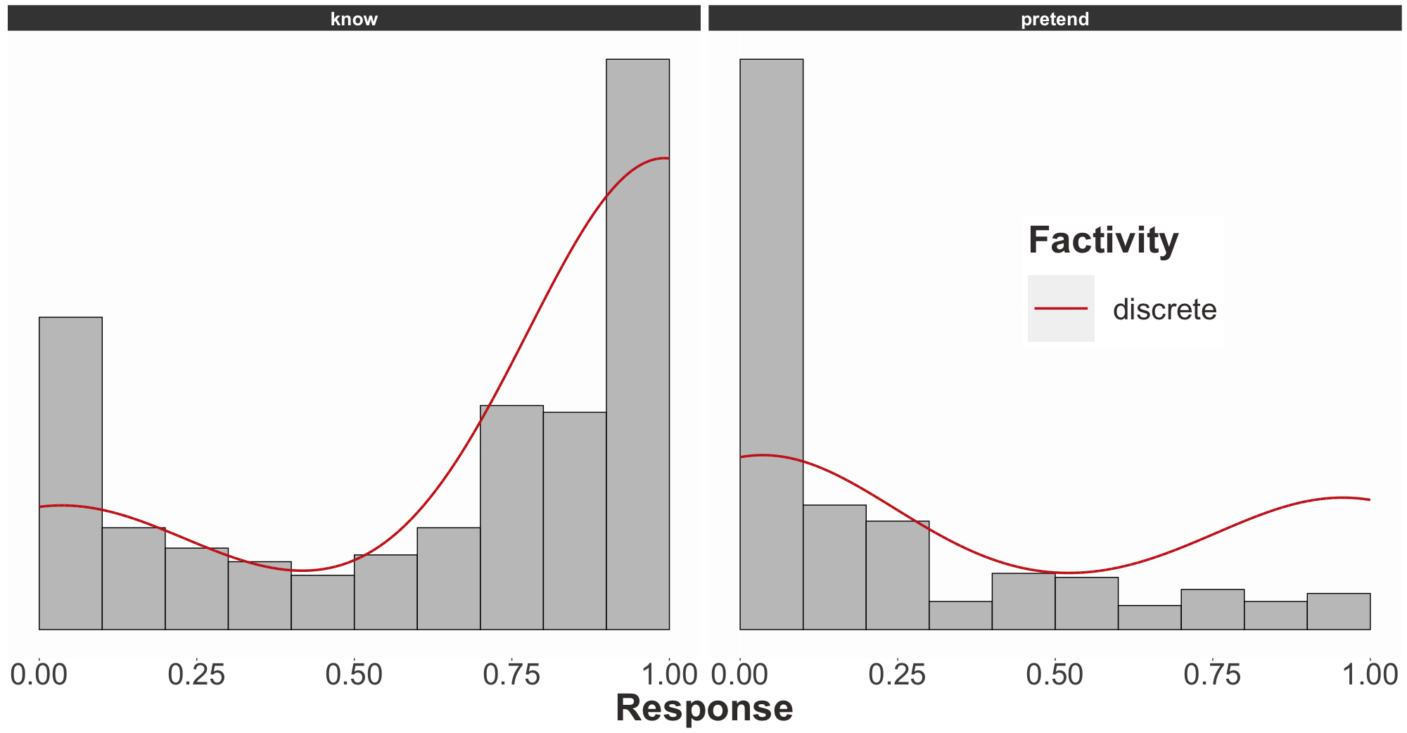

Slide 109
Question #3 see Appendix B
Does the prompt encourage participants to “respond more discretely” because the prompt is a polar question?

Slide 111
Question #3 see Appendix B
Does the prompt encourage participants to “respond more discretely” because the prompt is a polar question?
Question #4 see Appendix C
Do contents biased for high or likelihood cause people to “respond more discretely”?

Slide 112
Quantifying Uncertainty
Discussion

Slide 113
Question
Do projective inferences display occasional or metalinguistic uncertainty?
Answer
They unequivocally display the sort of discreteness we expect from metalinguistic uncertainty.

Slide 114
Question
What does this discreteness tell us about the nature of lexically triggered projective inferences?

Slide 115
Semantic Discreteness
There is a discrete property of a sense of a lexical item or its linguistic context that necessarily triggers an inference.
X
Pragmatic Discreteness
There is a discrete property of the discourse contexts a lexical item occurs in that necessarily triggers an inference.

Slide 116
Question
What does this discreteness tell us about the nature of lexically triggered projective inferences?
Approach #1
Enrich the model by introducing additional discourse constructs to differentiate semantic v. pragmatic discreteness.

Slide 117
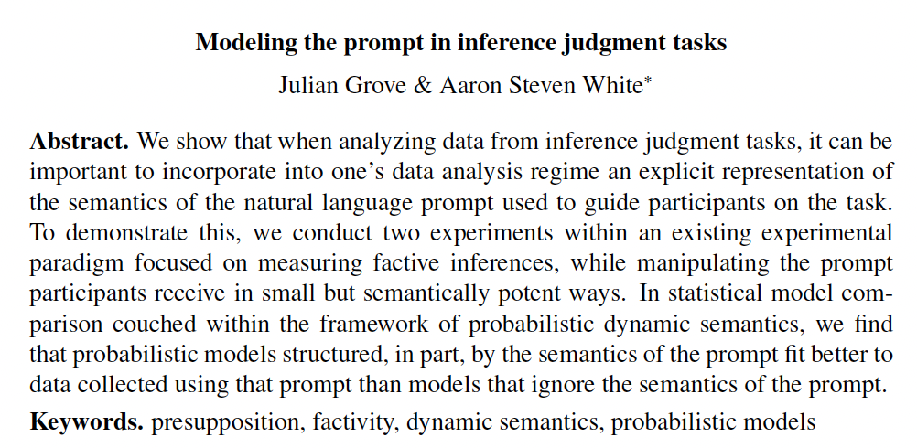
Julian Grove
juliangrove.github.io/

Slide 118
Question
What does this discreteness tell us about the nature of lexically triggered projective inferences?
Approach #2
Look for evidence that metalinguistic uncertainty is correlated with predicates’ syntactic distribution.

Slide 119
Idea
If metalinguistic uncertainty is correlated with predicates’ syntactic distribution, it may be semantically determined.
MGRG seminar (next Tuesday)
Strong correlations between distribution and semantically derived classes defined in terms of projective inferences.

Slide 120
Conclusion

Slide 121
Semantic Theories
Characterize inferences that NL expressions support and account for at least (some of) the necessary inferences.
Challenge
Not always easy to distinguish the necessary inferences from the non-necessary inferences.
Source of Challenge
Both high-level (e.g. ambiguity, vagueness) and low-level factors (e.g. noise from method of reporting judgments).

Slide 122
Goal
Precisely model the sources of inferential uncertainty in order to quantitatively compare alternative theories of what that uncertainty is uncertainty about.
Two forms of uncertainty
Metalinguistic uncertainty
Occasional uncertainty

Slide 123
Occasional Uncertainty
Uncertainty that is manifest on particular occasions of use and/or interpretation (e.g. vagueness).
Metalinguistic Uncertainty
Uncertainty about possible kinds of occasions of use and/or interpretation (e.g. irresolvable ambiguity).

Slide 124
Approach
Develop framework for deriving statistical models of inference from compositional semantic analyses.
Finding
A metalinguistic uncertainty analysis of gradience in projective inference best explains inference judgment data aimed at capturing those inferences.

Slide 125
Thanks!

Slide 126
Supported by NSF-BCS-1748969
The MegaAttitude Project: Investigating selection and polysemy at the scale of the lexicon

Slide 127
Appendix A
Posterior distributions

Slide 128
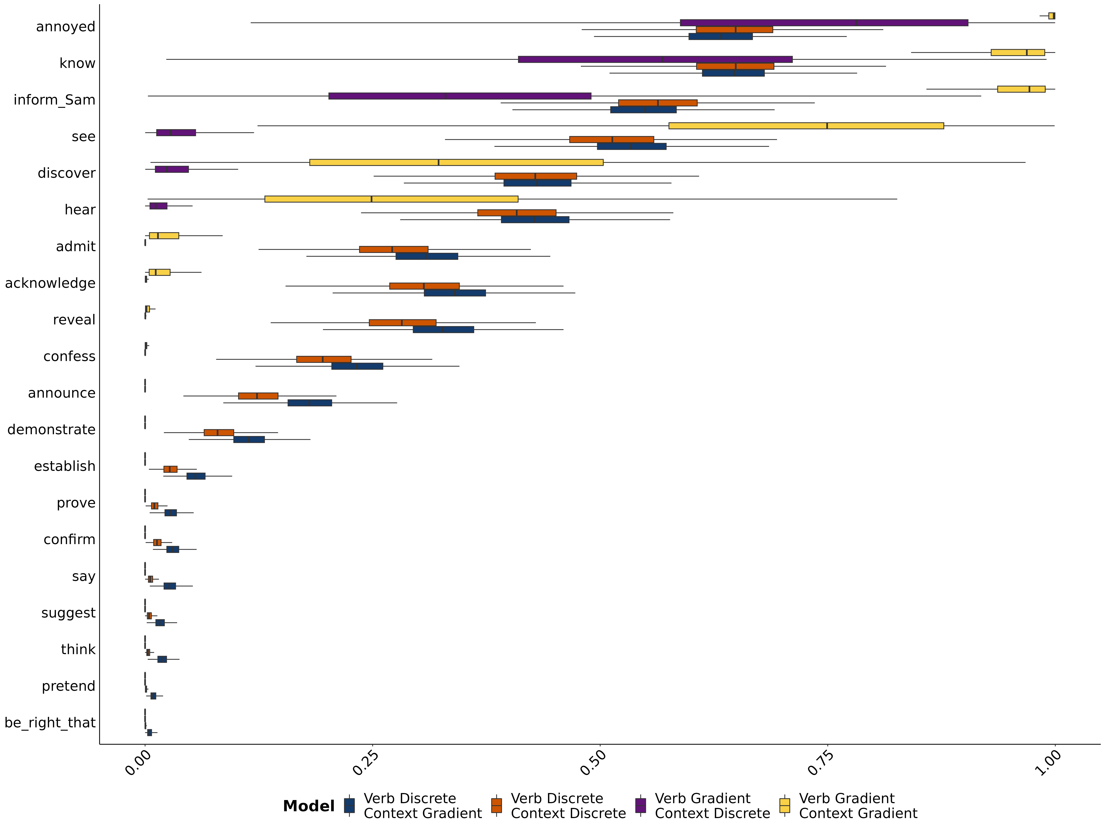
Posterior distribution of mean response

Slide 129
Appendix B
Prompt manipulation

Slide 130
Question #3
Does the prompt encourage participants to “respond more discretely” because the prompt is a polar question?

Slide 132
Question #3
Does the prompt encourage participants to “respond more discretely” because the prompt is a polar question?
Approach
Modify the prompt to query for the level of likelihood or certainty the speaker has.

Slide 133
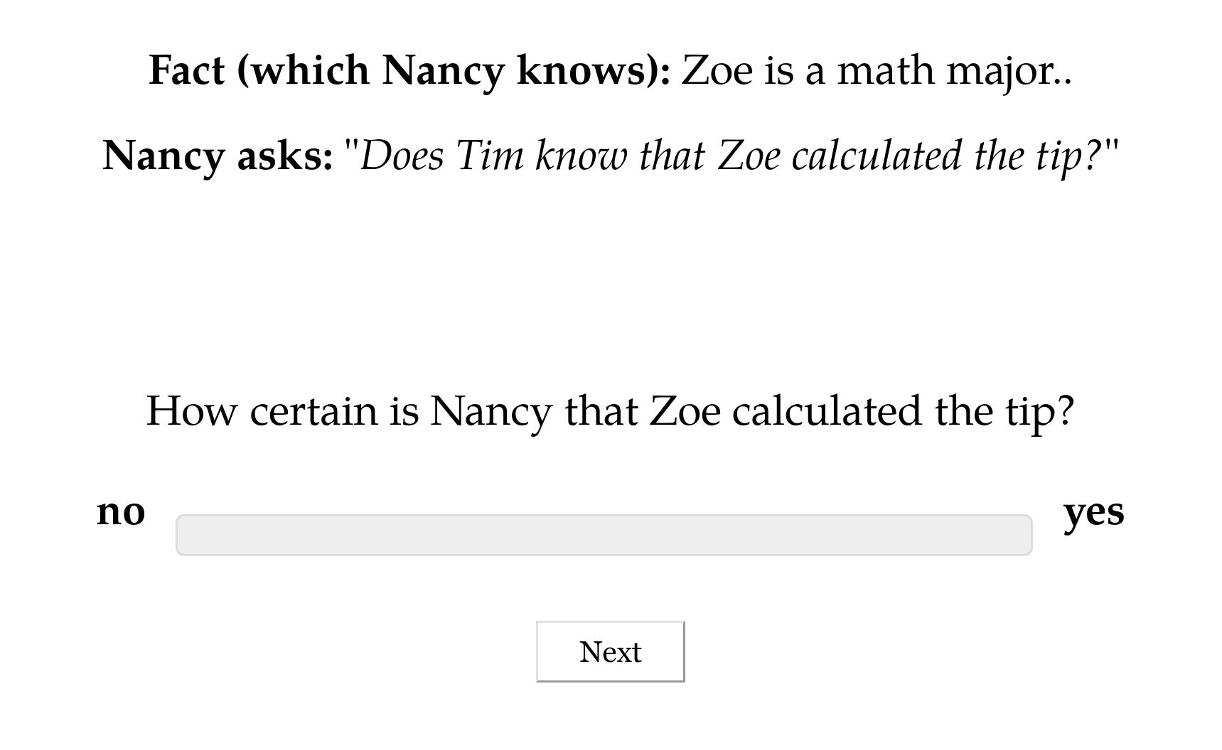

Slide 134
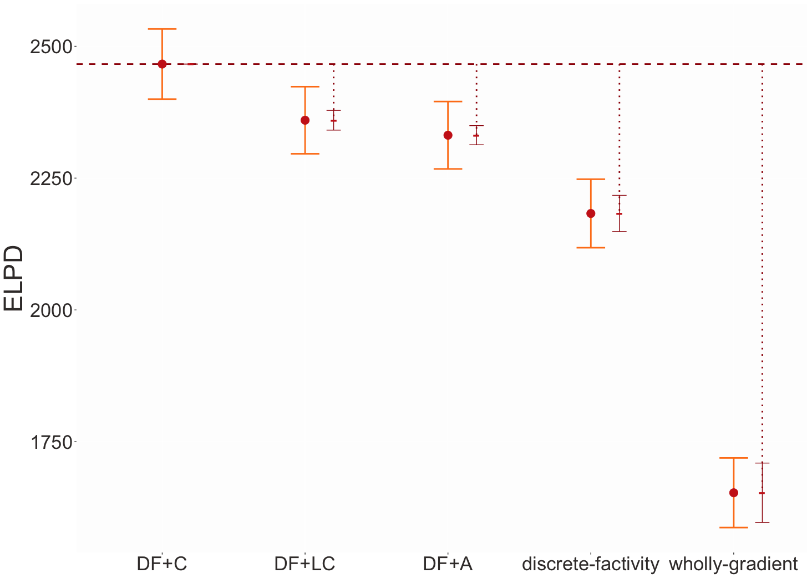

Slide 137
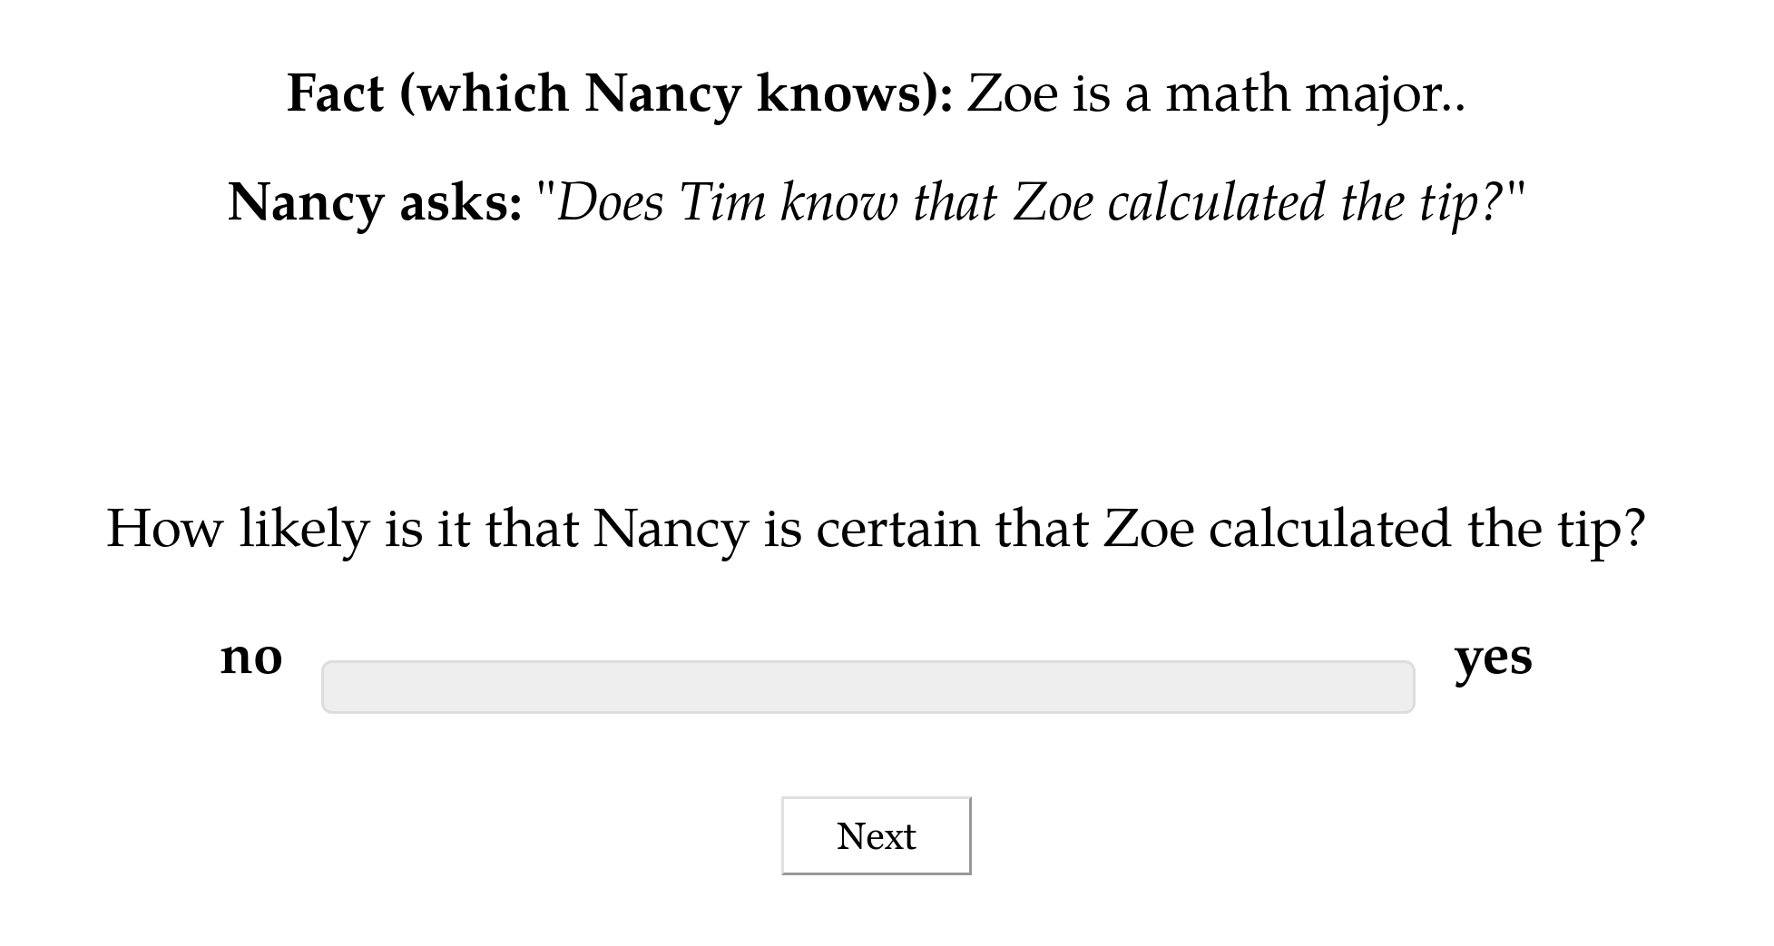

Slide 138
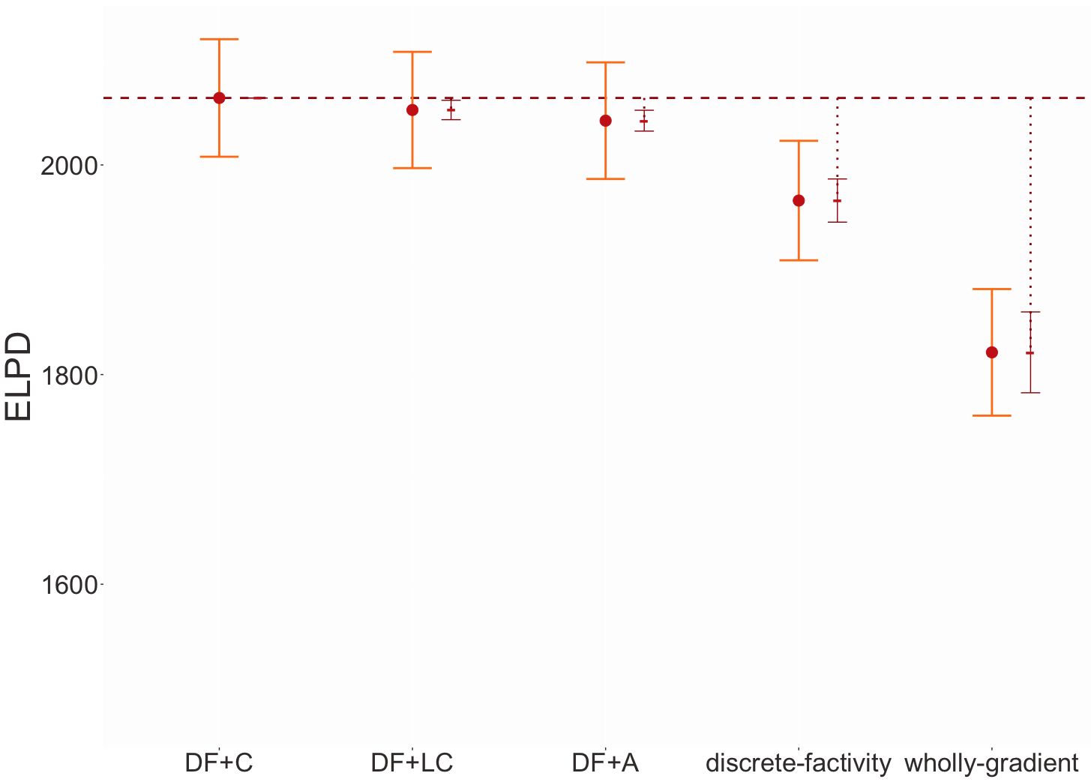

Slide 139
Appendix C
Content manipulation

Slide 140
Question #4
Do contents biased for high or likelihood cause people to “respond more discretely”?
Approach
Remove the possibility that people can rely on prior beliefs by bleaching the content of the sentence.

Slide 141
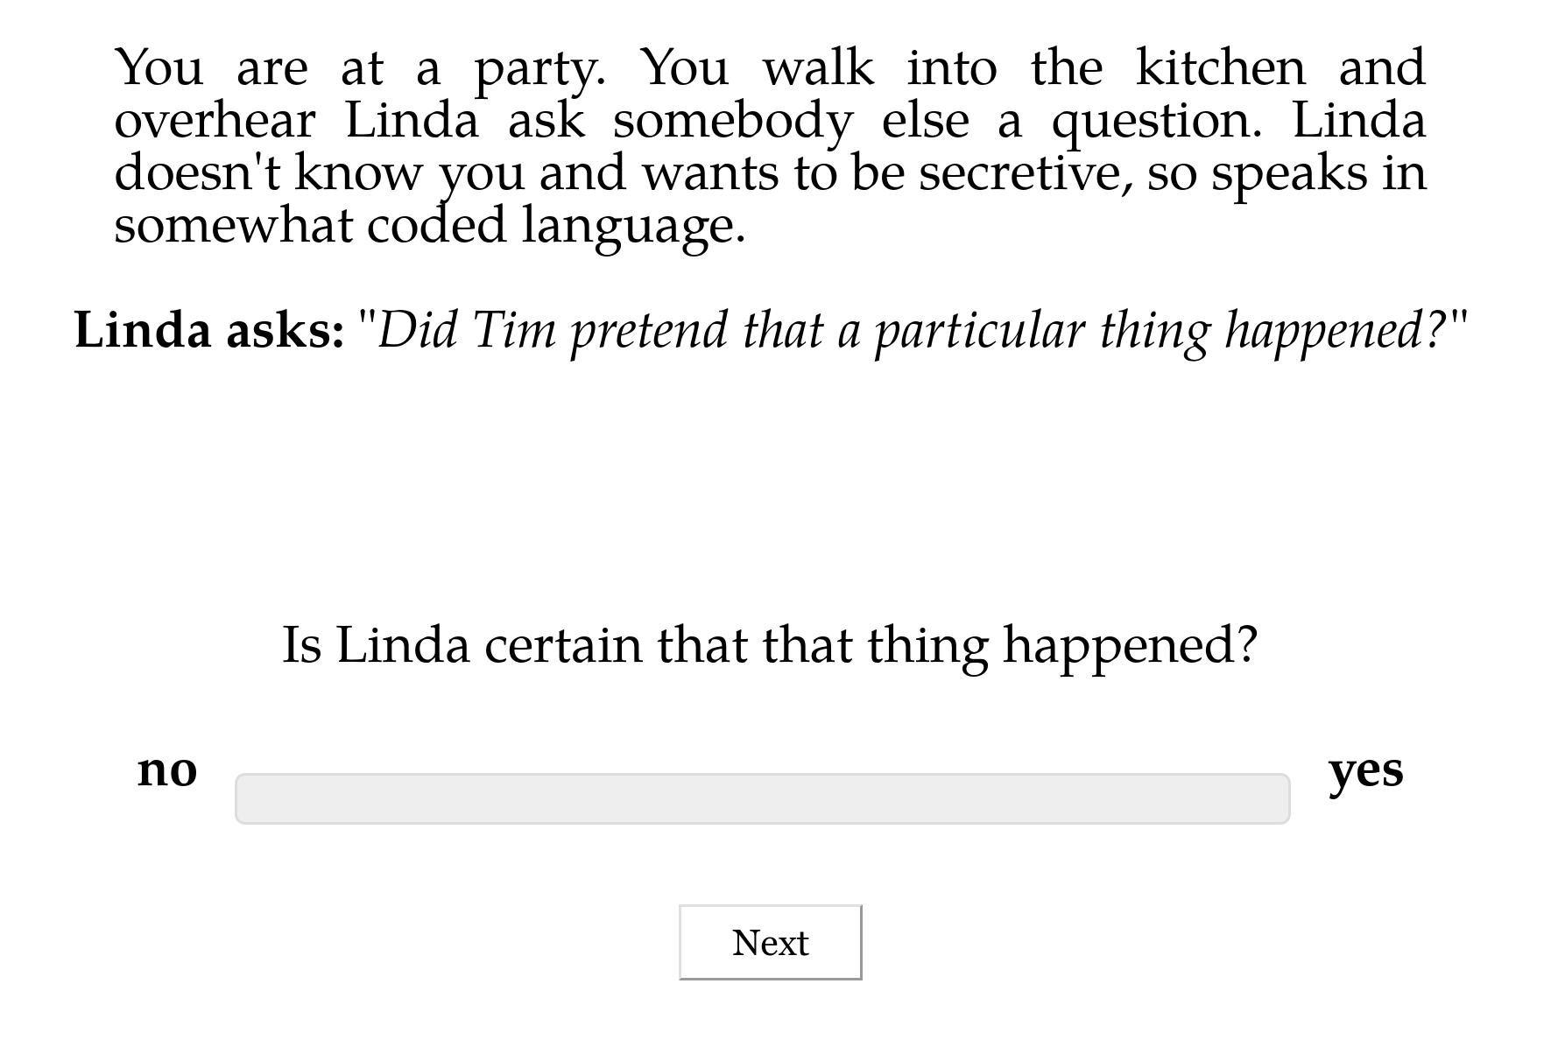

Slide 142
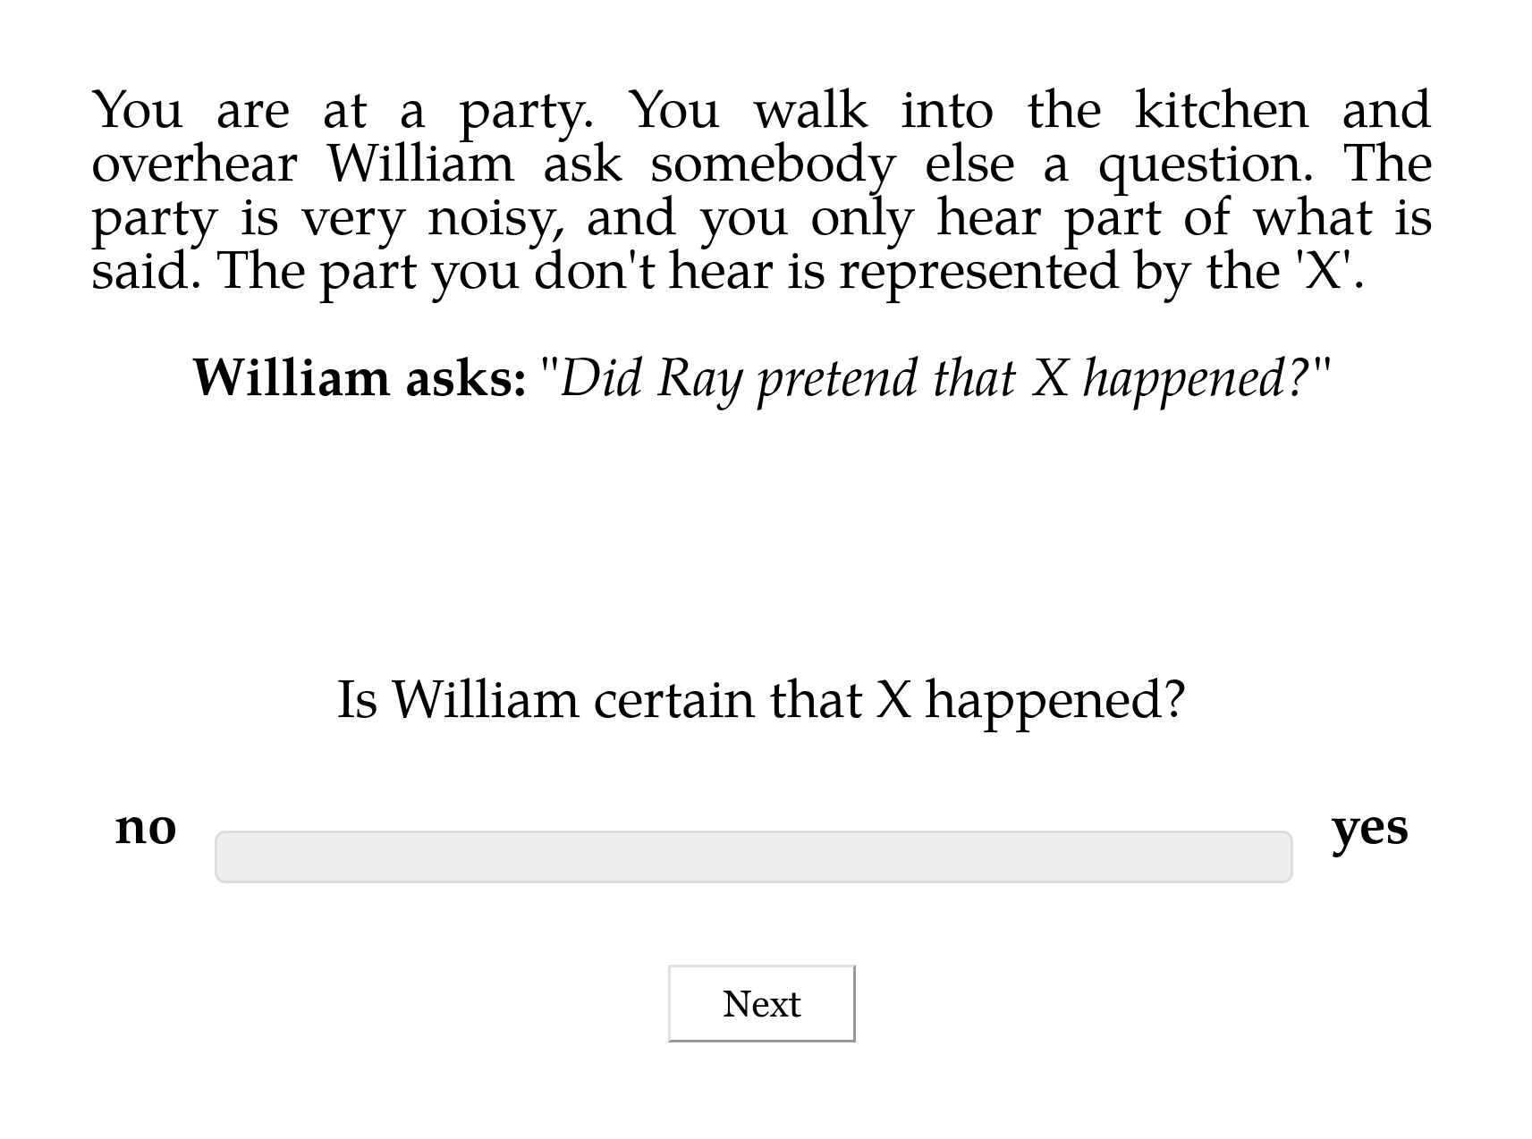

Slide 143
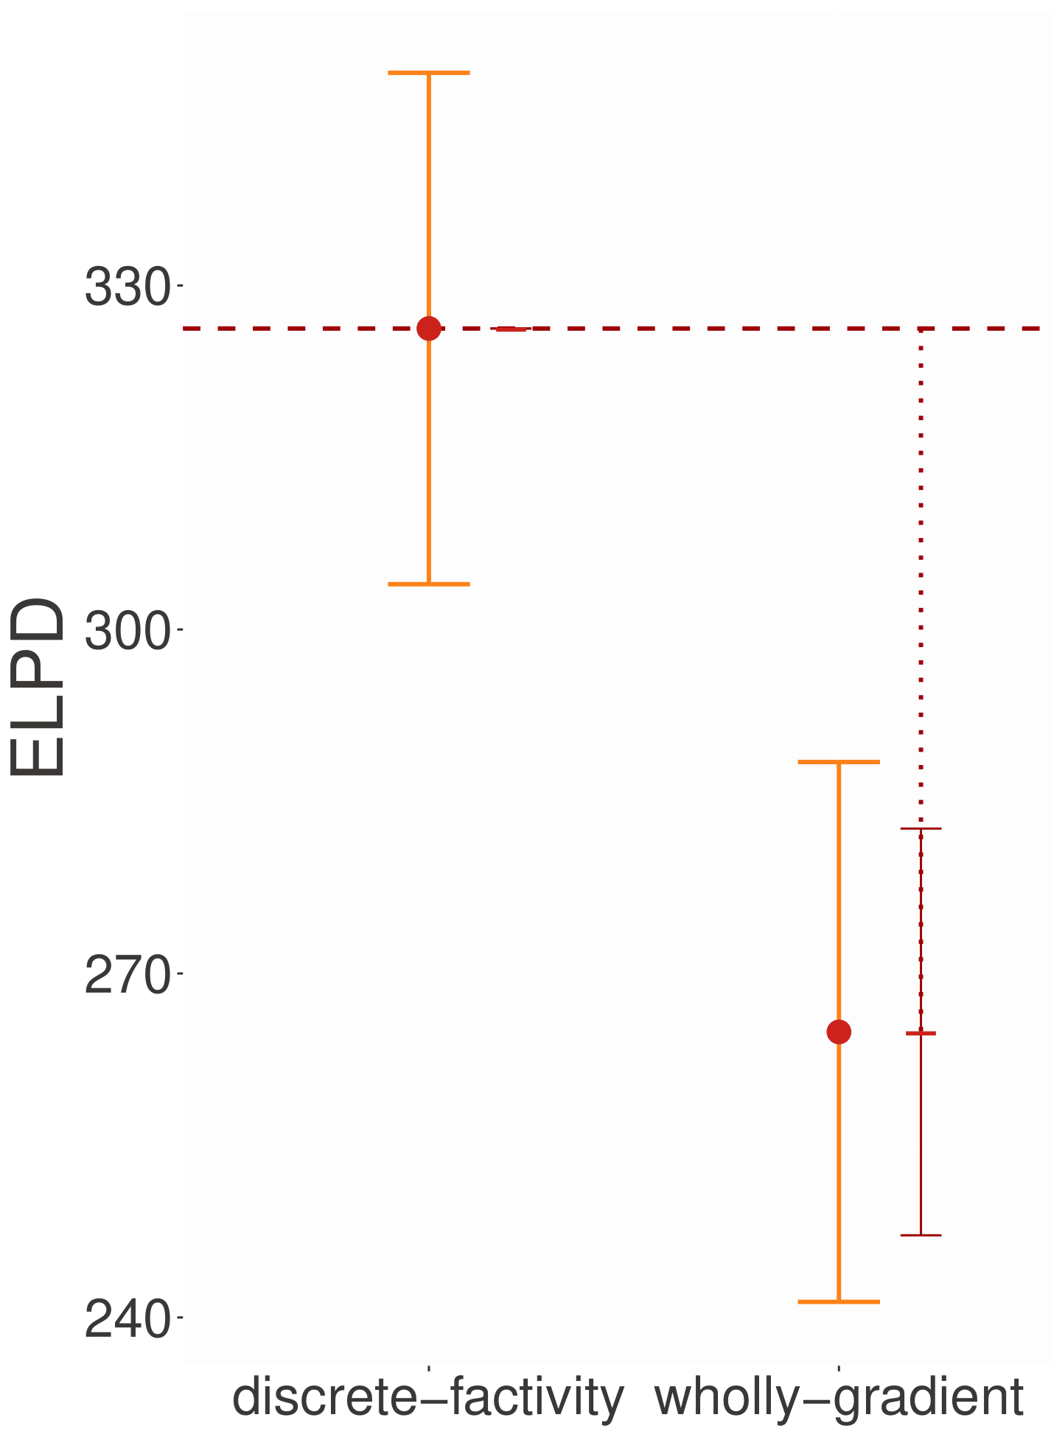
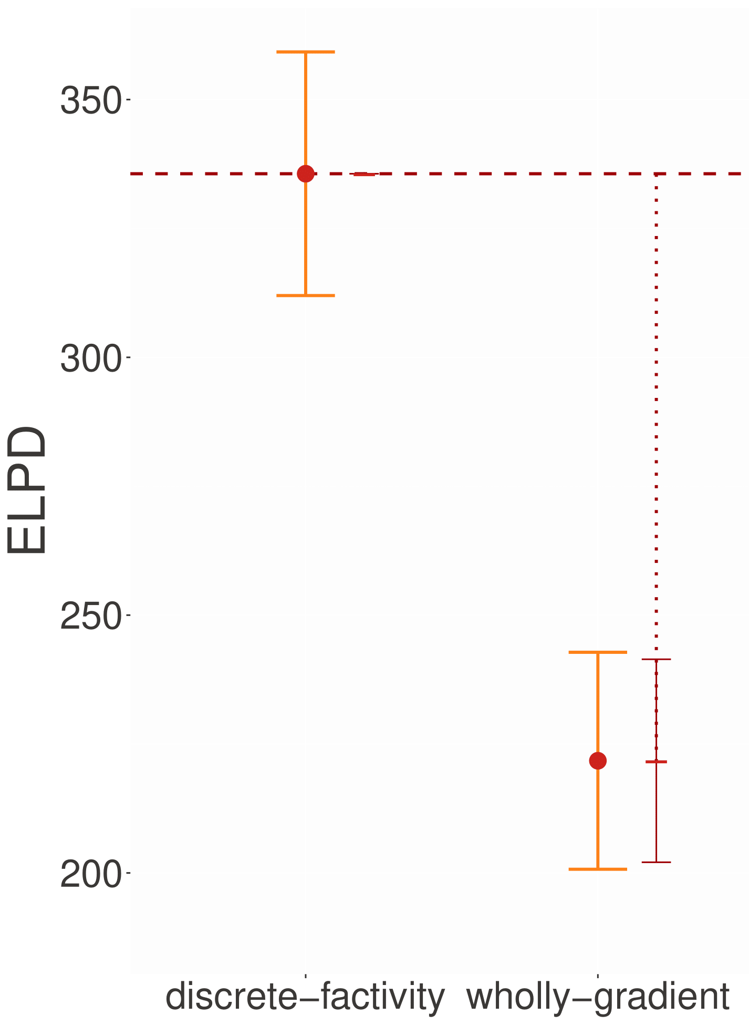
Bleached
Templatic

Slide 144
