Slide 1

Chive
Decentralized eprints on ATProto
chive.pub
Aaron Steven White
Department of Linguistics
University of Rochester
ATScience 2026
Vancouver, BC
27 March 2026

Slide 2
Data sovereignty and discoverability have historically been in tension for scholarly work.
Notes:
Data sovereignty and discoverability have historically been opposed for scholarly work. This is of course true for traditional journal- or conference-based publishing, where we still frequently give up our rights to control our scholarly products in perpetuity for the sake of reaching a wider audience and gaining an endorsement based on our peers’ expert reviews.

Slide 3



Homepage
Platform
Notes:
But it’s also true in the context of more modern methods of sharing work: I can put my papers, data, code, etc. up on my website, over which I can full control.
But the only way people are going to discover them is if they know who I am and furthermore think to go to my website to check up on what I’ve been up to.
So we often turn to platforms like arXiv or more bespoke, field-specific repositories to enable discoverability.

Slide 4
ATProto helps resolve this tension by enabling discoverability without loss of sovereignty.
Notes:
ATProto can help resolve this tension by enabling discoverability without loss of data sovereignty.

Slide 5


PDS
appview
firehose
Content
Metadata
Notes:
We can retain the benefits of the sort of full control we have over our scholarly websites, in the form of our personal data servers, but also support the kind of rich metadata and interoperability that ATProto supports.

Slide 6
The challenge is designing a metadata system flexible enough for arbitrary scholarly work.
Notes:
The challenge is designing a metadata system flexible enough for arbitrary scholarly products.

Slide 7
ideal
Genericity
Richness
Notes:
The tension we have to resolve here is that we want rich metadata systems to support discoverability, but the metadata needs to be generic enough that any scholarly field could use it. Part and parcel of this genericity is that the metadata system needs to be able to evolve as fields split and merge and as new entities and concepts are discovered in disparate fields.

Slide 8
Chive supports rich metadata for discovery extensible through community governance.
Notes:
This is the tension Chive aims to resolve. The idea is to develop a combination of lexicons and Appview that supports discoverability while also being extensible through a community governance system.

Slide 9
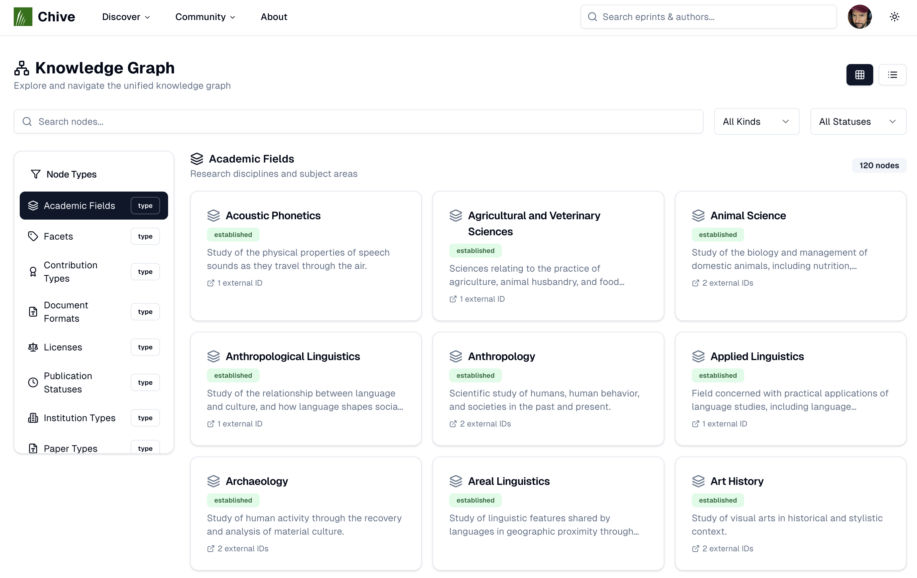
Notes:
The backbone of this approach is a self-describing knowledge graph that itself lives in a community editable PDS that the appview makes it straightforward to clone. This graph has nodes both for every metadata value that the system works with and every metadata field that takes on those values.

Slide 10
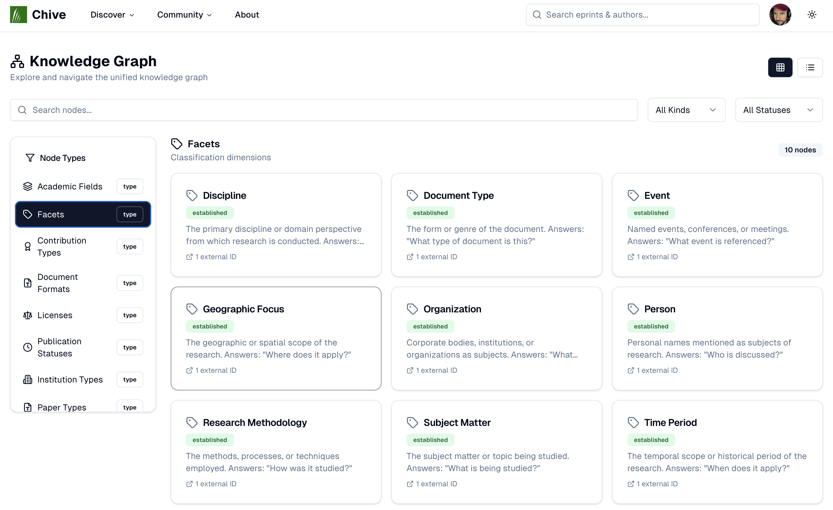
Notes:
What this means in practice is that the community can expand the set of values that some field takes on–for instance, one use case is deleting, merging, or splitting academic fields and connecting them to each other via various kinds of relations. But it can also expand the dimension along which scholarly products are themselves categorized.

Slide 11
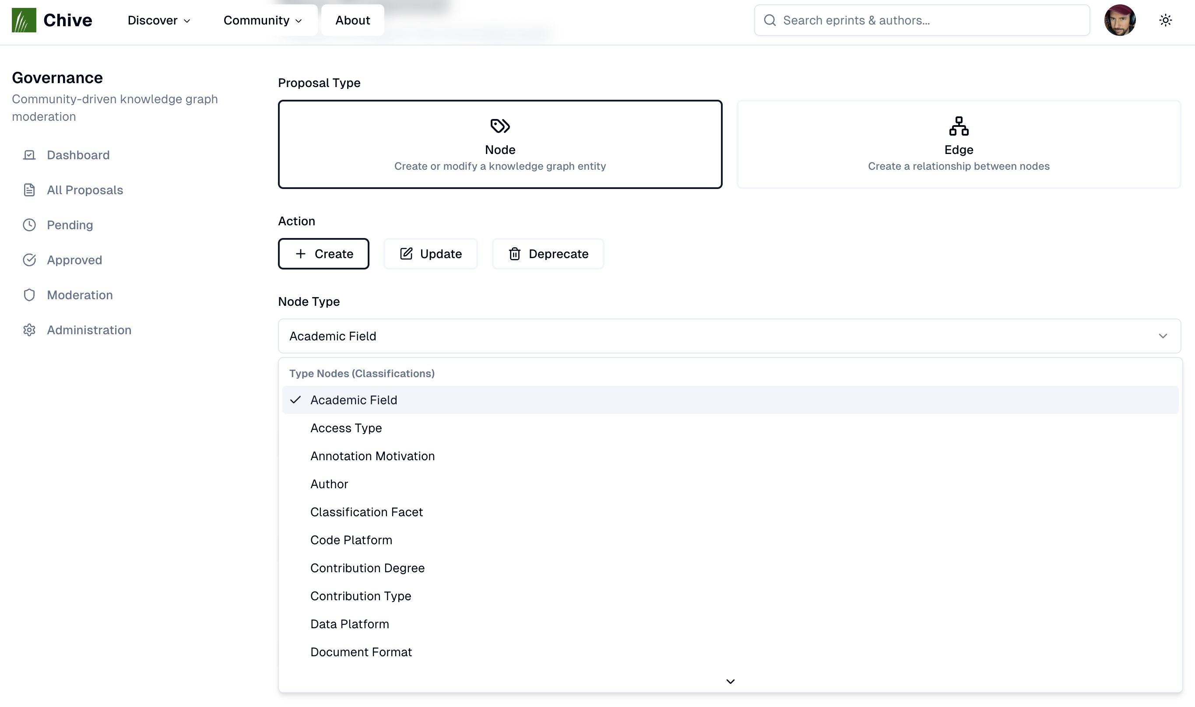
Notes:
This is done using a governance system that allows both node proposals that can introduce arbitrary node types and edge proposals that can link existing nodes through typed edges.

Slide 12
Chive relates scholarly products to the extensible KG via rich text and annotations.
Notes:
This extensible knowledge graph is related to scholar products in two main ways: rich text and annotations.

Slide 13
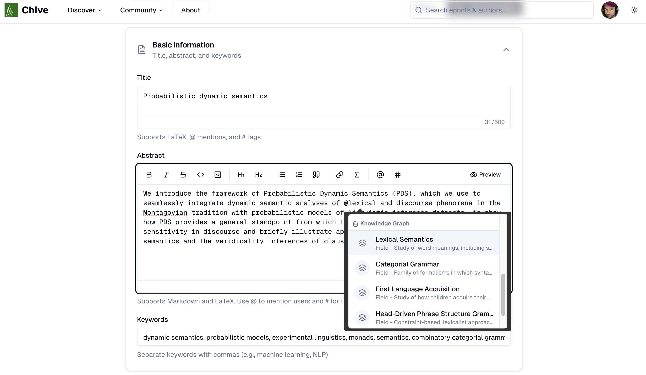
Notes:
Rich text is an enriched version of the rich text you’re familiar with from Bluesky, where in addition to allowing things user mentions and hash tags, we can additionally refer to knowledge graph nodes, such as fields. It also supports arbitrary markdown, including code blocks and inline and display LaTeX math.

Slide 14
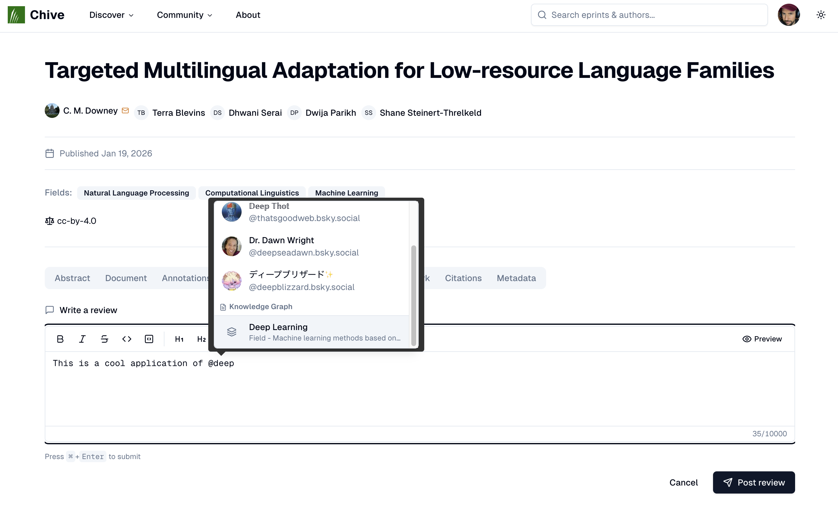
Notes:
Rich text is available in most places that provide textual inputs, including reviews and even titles.

Slide 15
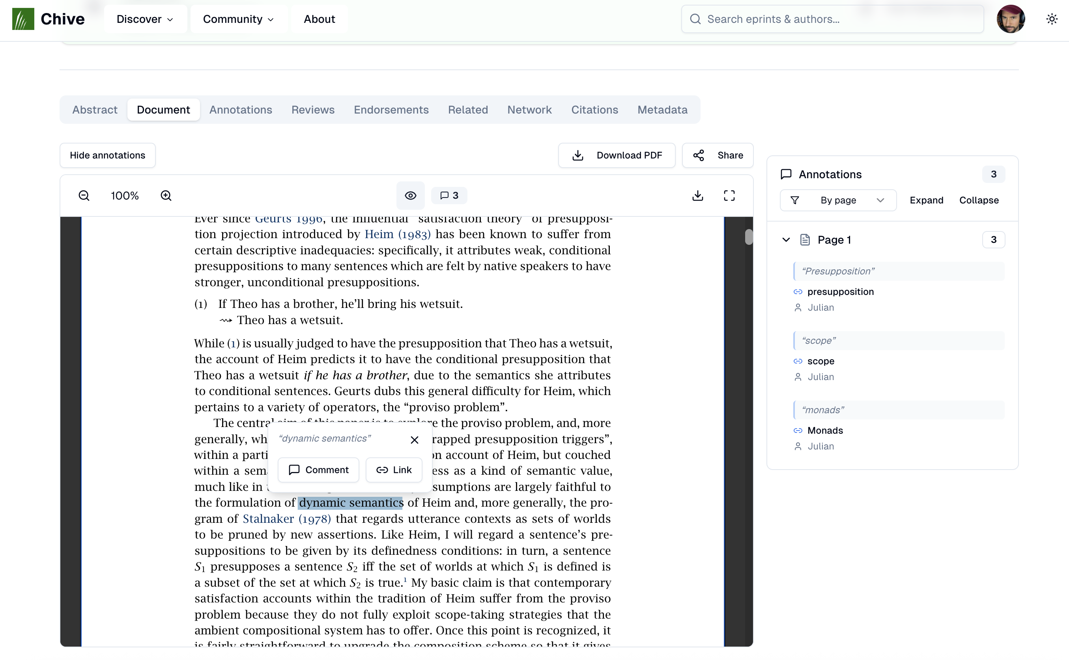
Notes:
So that’s rich text. Annotations are the other way we can connect a product to the knowledge graph by linking a span with either a line-level comment, that can itself contain rich text, or by providing a link from the span to the knowledge graph (or other external knowledge graphs) directly.

Slide 16
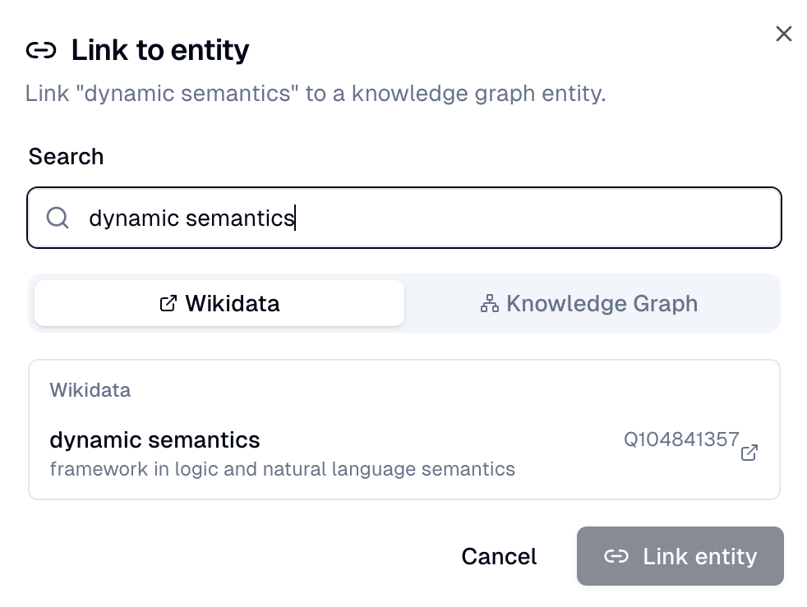
Notes:
So that’s rich text. Annotations are the other way we can connect a product to the knowledge graph by linking a span with either a line-level comment, that can itself contain rich text, or by providing a link from the span to the knowledge graph (or other external knowledge graphs) directly.

Slide 17

Layers
Linguistic annotations on ATProto
layers.pub
Notes:
I’m currently thinking about ways to integrate richer annotation structures from the layers lexicons, so stay tuned for that.

Slide 18
Chive supports discoverability by allowing different kinds of queries against the KG.
Notes:
There are a few ways we actually use these links to support discovery, all of which can be thought of as different ways of querying against the knowledge graph and its links.

Slide 19
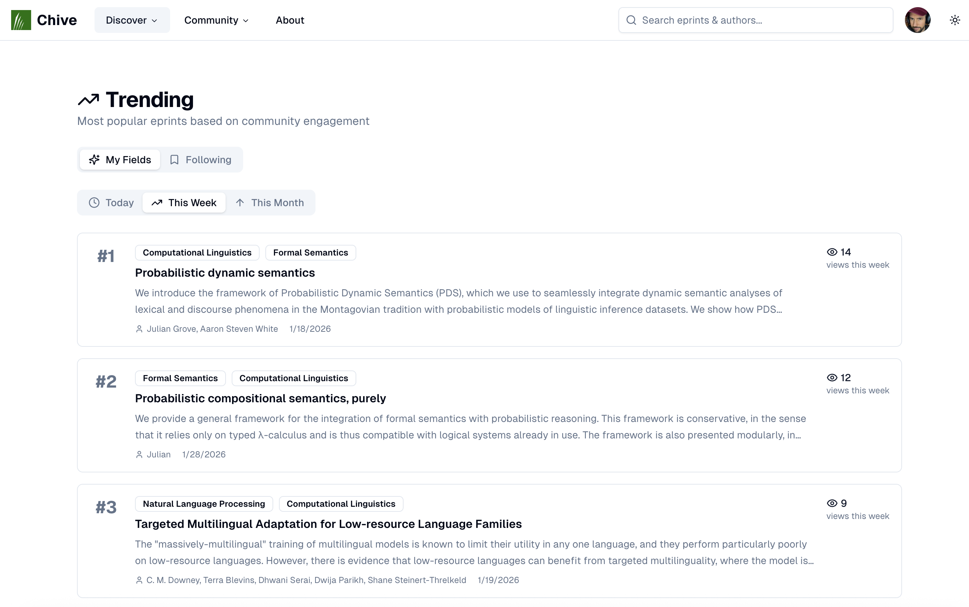
Notes:
The most basic case of this is that the appview automatically populates a trending page with fields you publish in. This trending page is computed directly from the fields associated with a researcher’s papers. It also shows a separate set of “followed fields” that can be added in the profile settings.

Slide 20
Notes:
The most basic case of this is that the appview automatically populates a trending page with fields you publish in. This trending page is computed directly from the fields associated with a researcher’s papers. It also shows a separate set of “followed fields” that can be added in the profile settings.

Slide 21
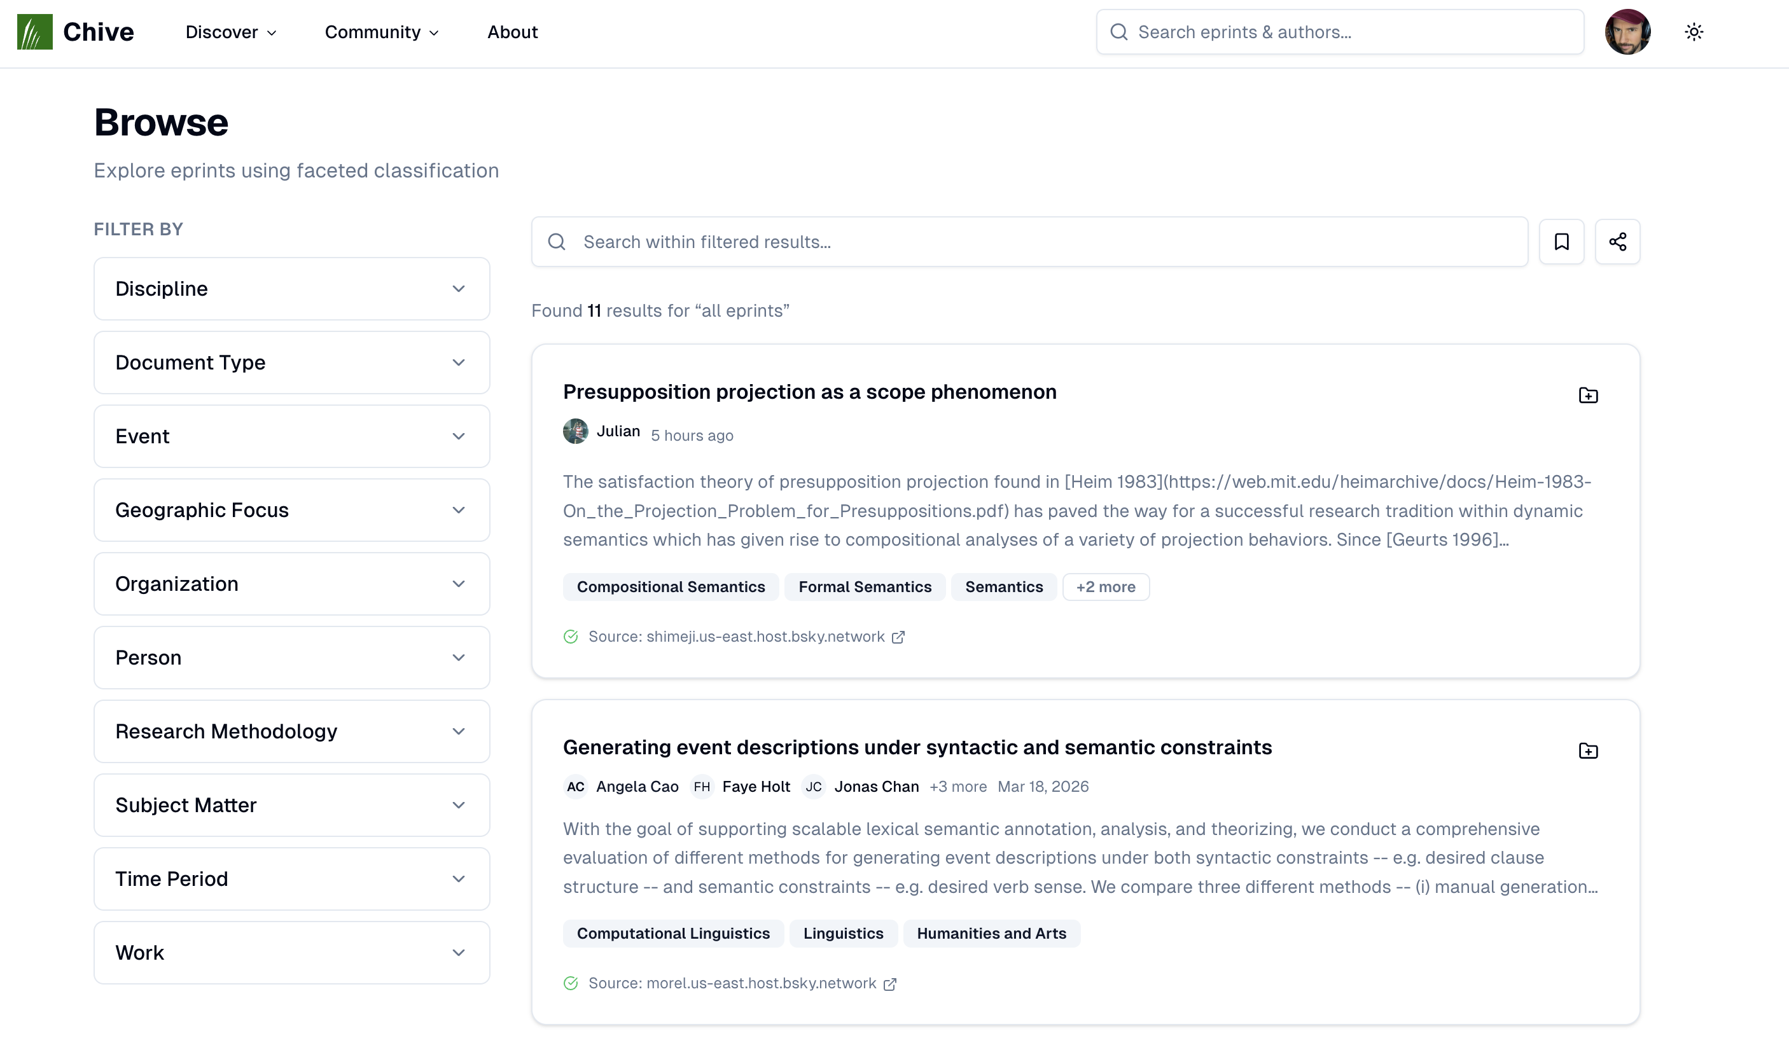
Notes:
A more controlled way to use the knowledge for querying graph is using faceted search, which allows you to select values from a set of facets…

Slide 22
Notes:
…where both the facet values and the facets themselves are extensible by the community because they are both kinds of knowledge graph nodes.

Slide 23
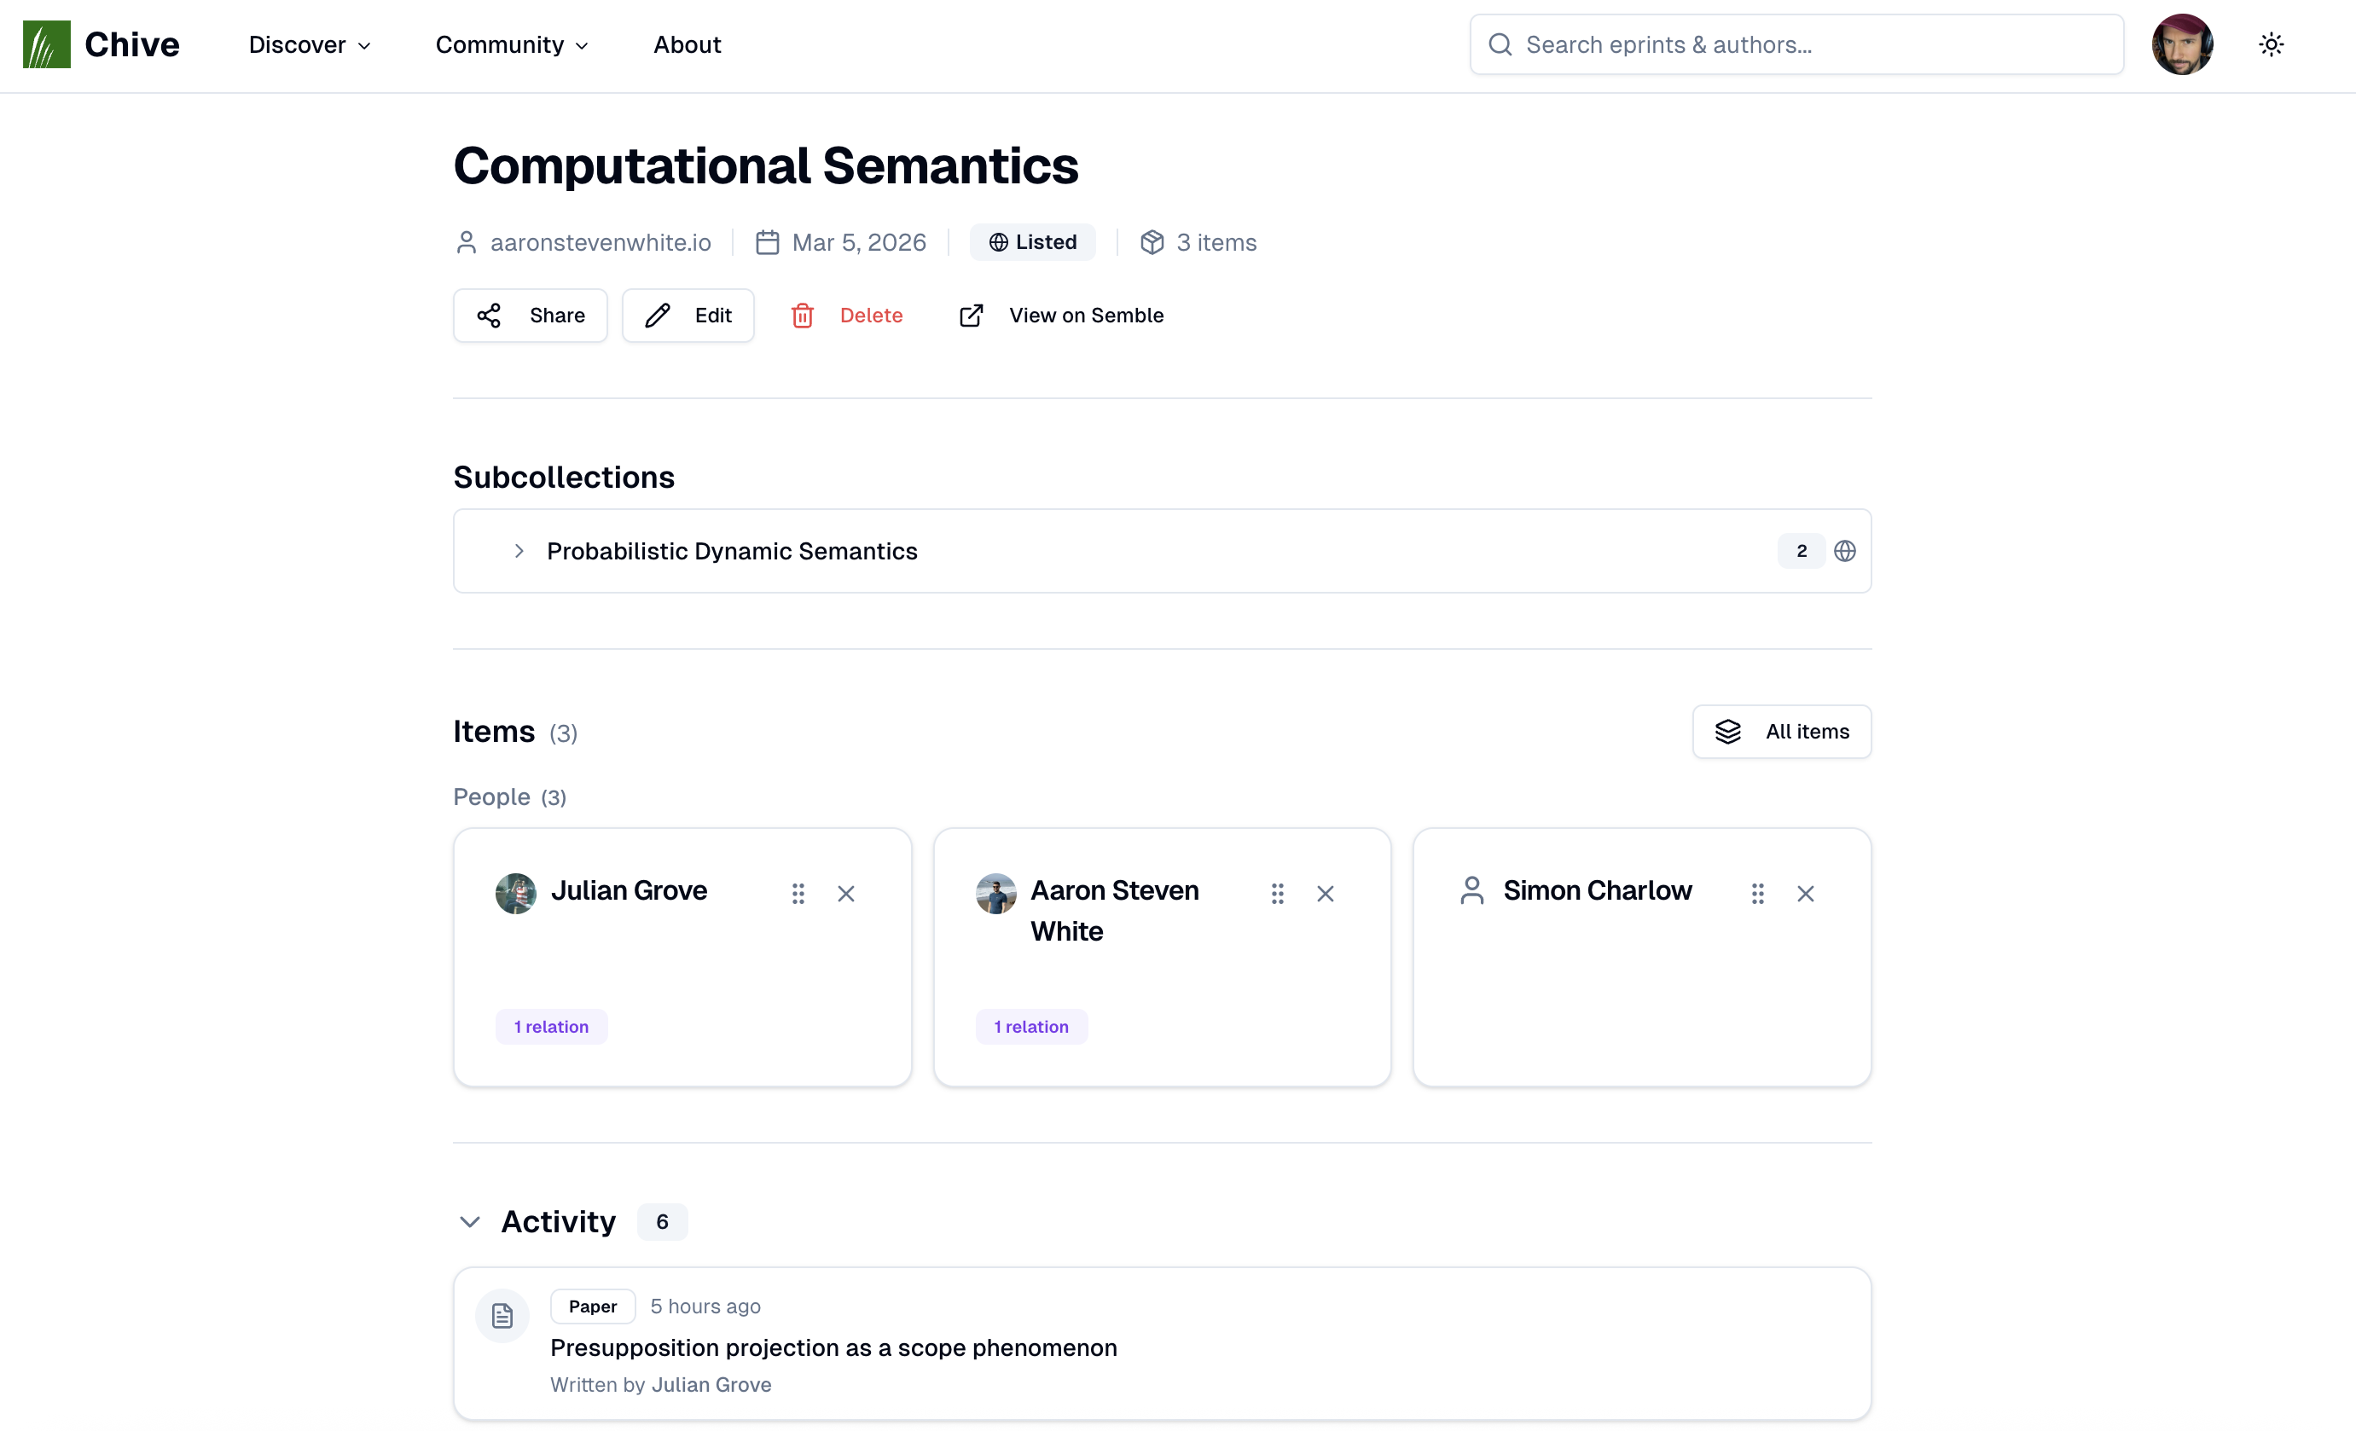
Notes:
The final way is via the collections feature…

Slide 24
Notes:
…which allows you to put arbitrary knowledge graph nodes, authors, institutions, etc. into a collection…

Slide 25
Notes:
…and then follow all of the activity related to those nodes.

Slide 26
Chive
Decentralized eprints on ATProto
chive.pub
Please join the alpha!

