Slide 1
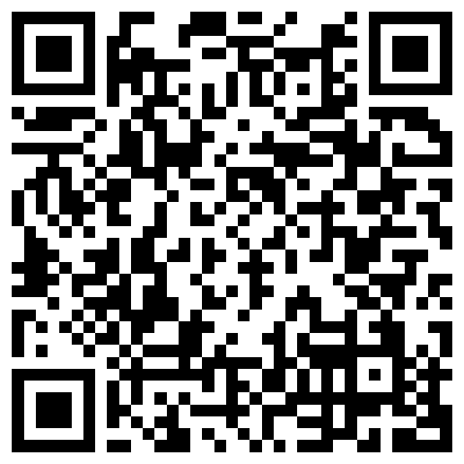
Identifying lexical semantic categories from noisy inference judgments
Aaron Steven White
University of Rochester
LEAP Workshop Talk
University of Chicago
23 February 2024

Slide 2
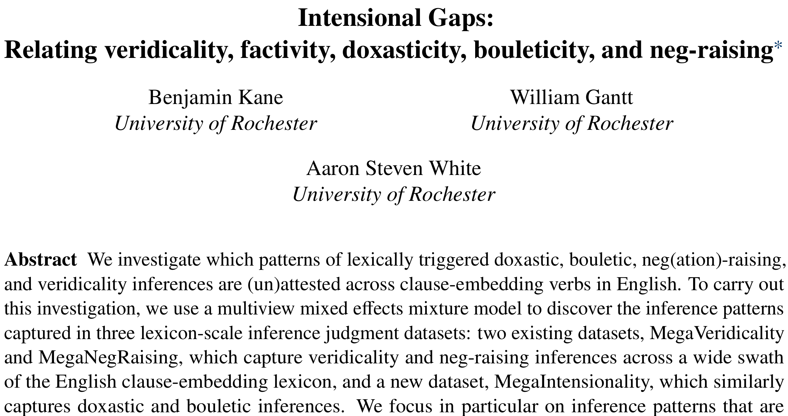
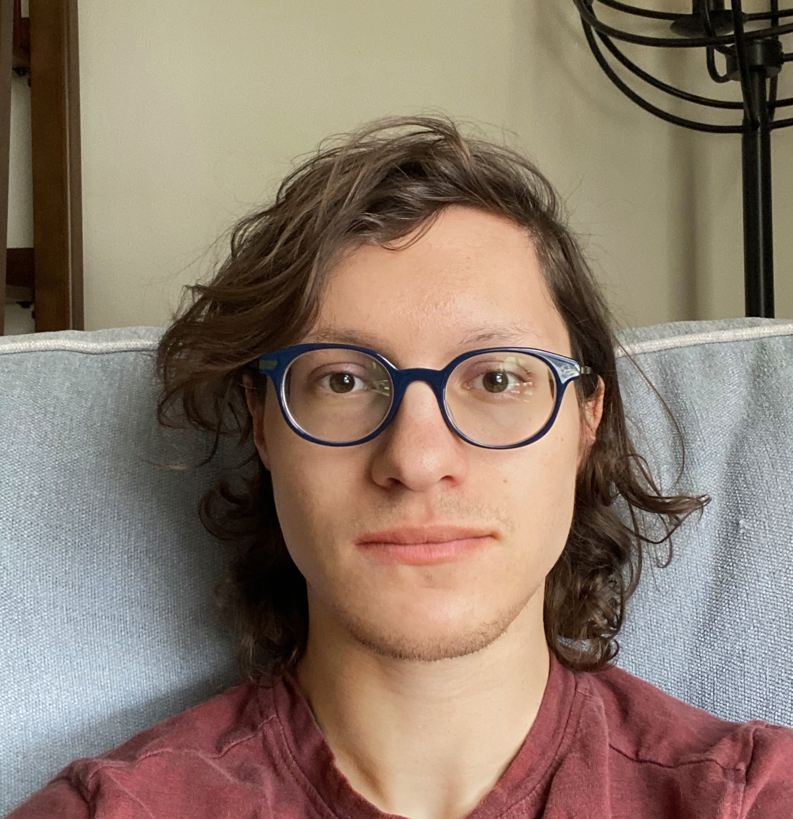
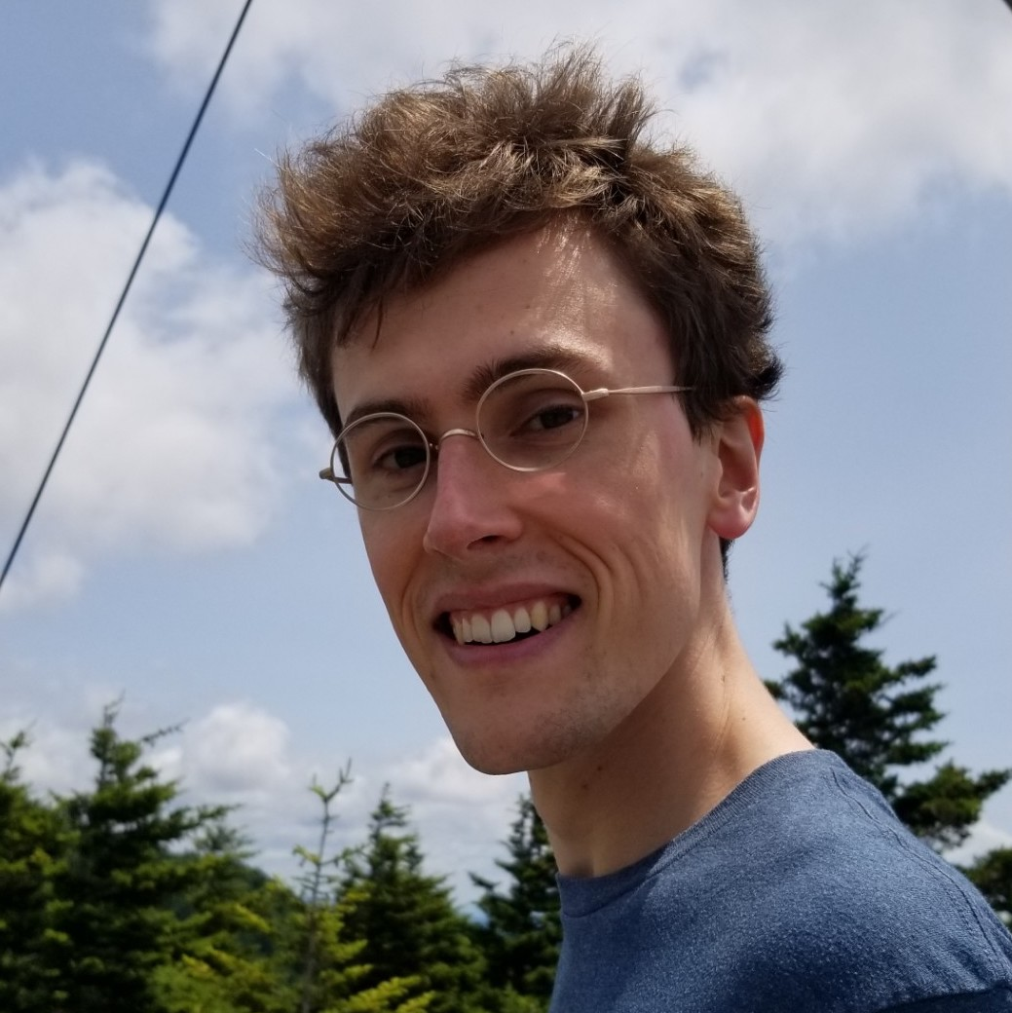
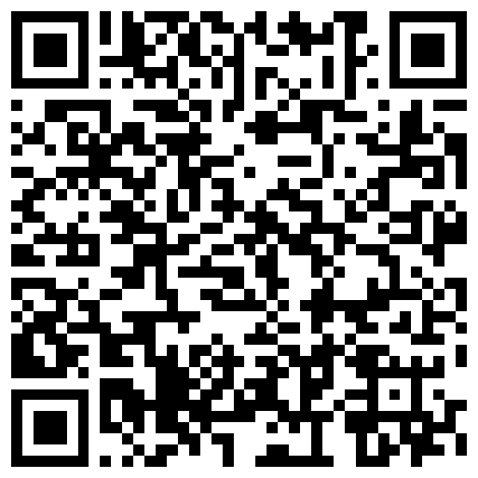
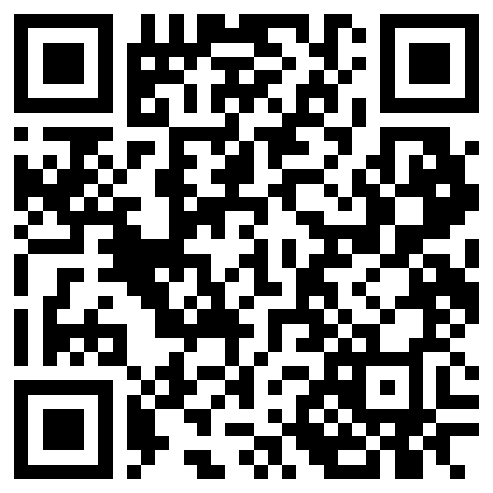
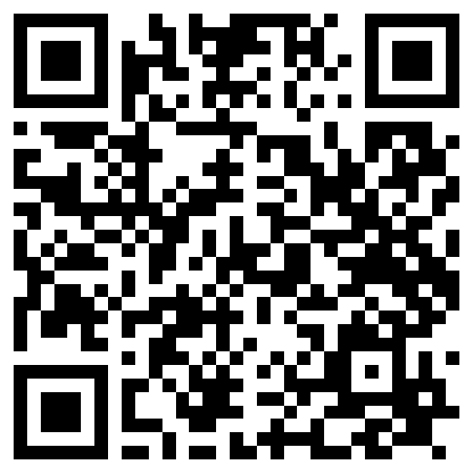
Ben Kane
Paper
Data
Code
Will Gantt

Slide 3
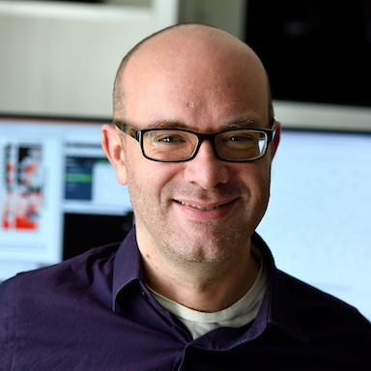
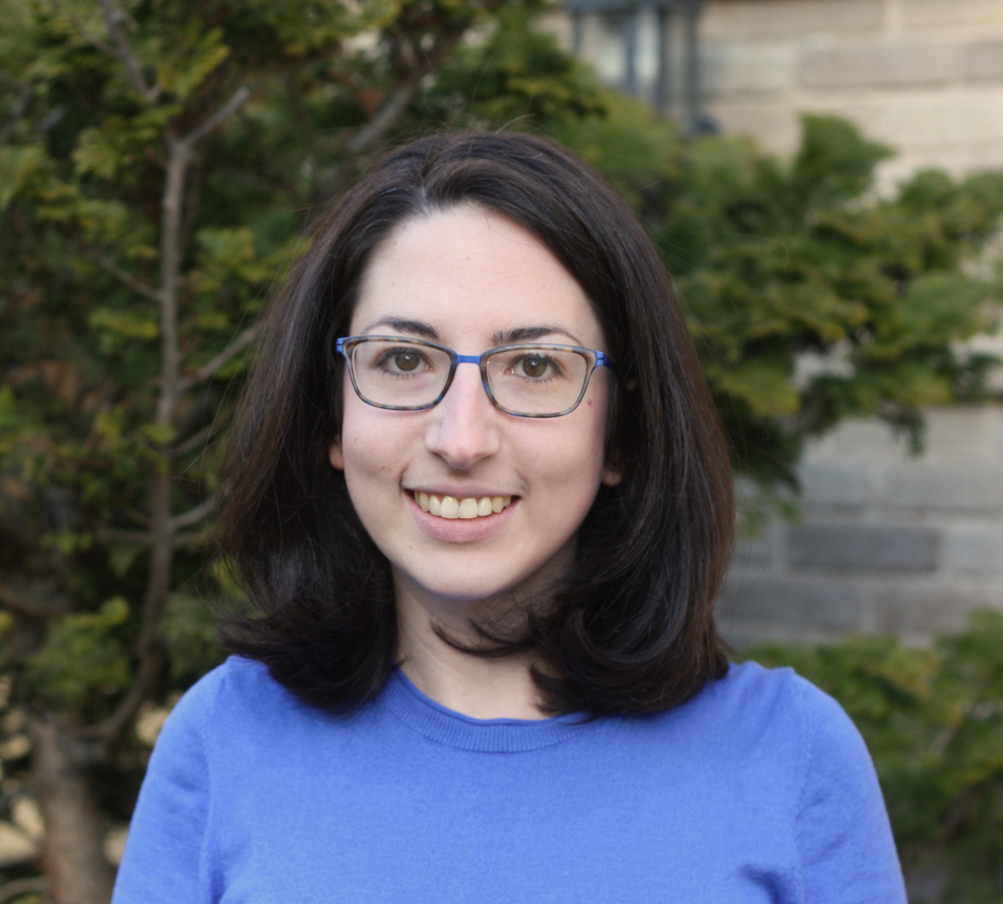
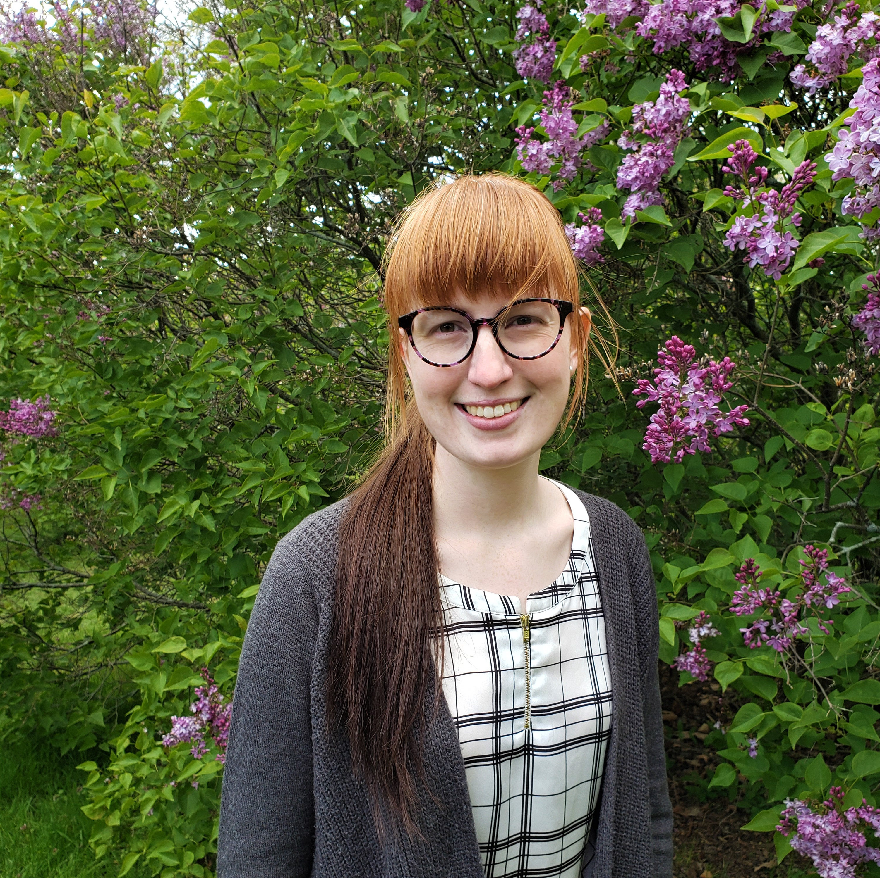
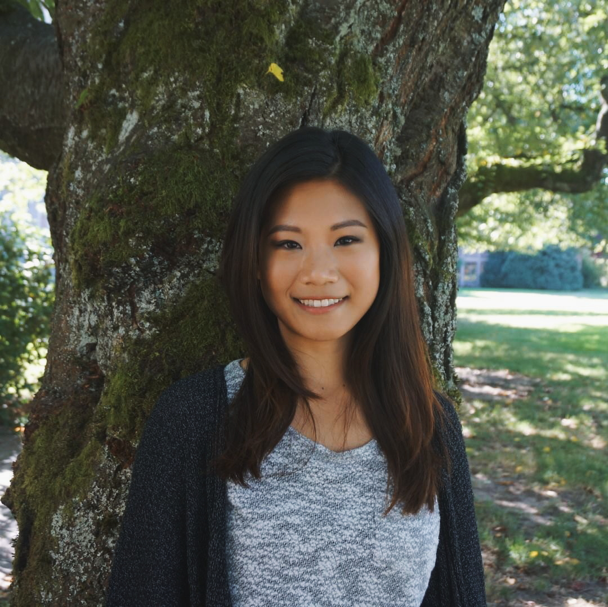
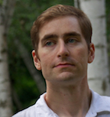
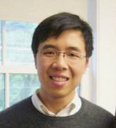
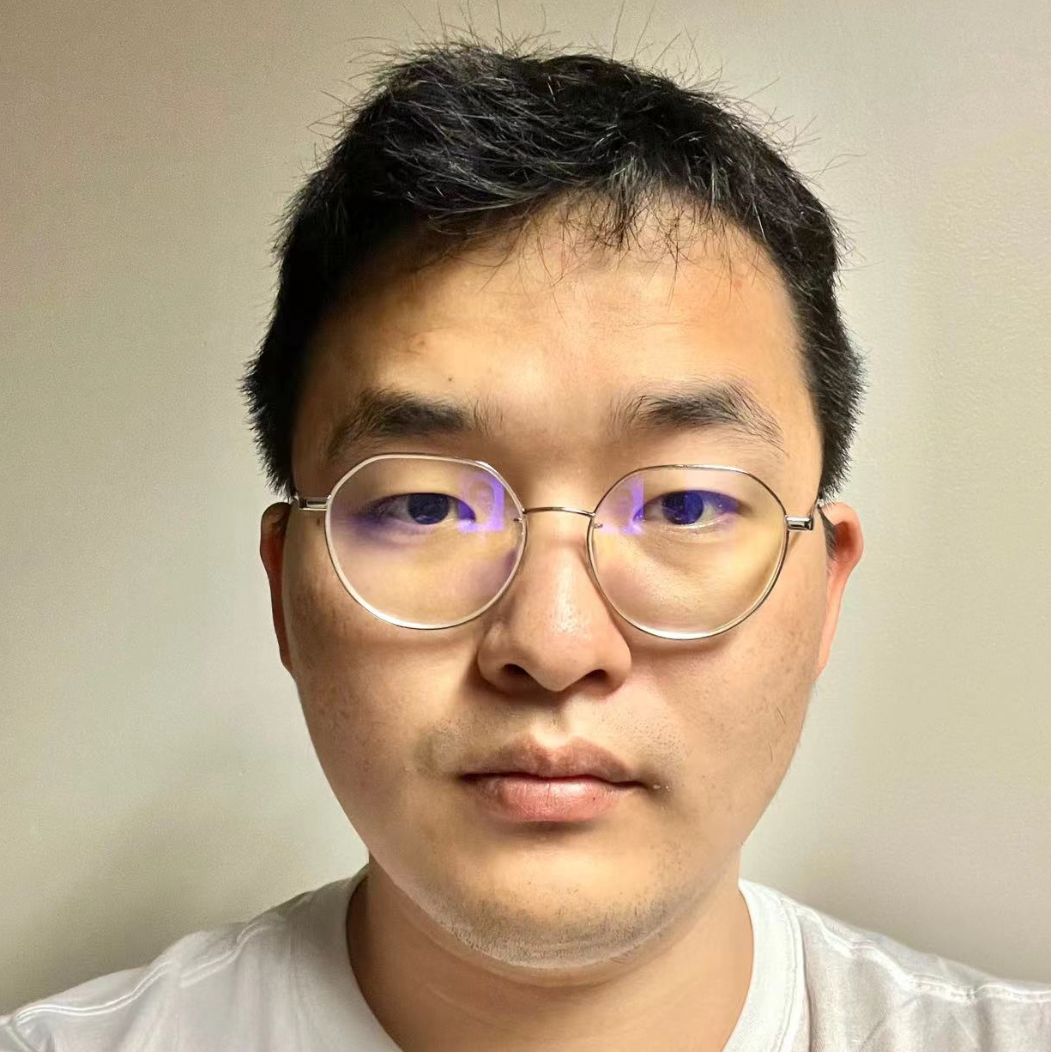
Kyle Rawlins
Johns Hopkins University
Rachel Rudinger
University of Maryland
Ellise Moon
University of Rochester
Hannah An
University of Rochester
Yu’an Yang
Amazon
Ben Van Durme
Johns Hopkins University
Nick Huang
National University of Singapore
Ben Kane
University of Rochester
Will Gantt
University of Rochester
Zhendong Liu
University of Southern California

Slide 4
Overarching Question In using a particular linguistic expression, what can we mean and what must we mean?

Slide 5
Bo no longer thinks that Jo is heading out to get groceries.
⇝
Cessation inference
Bo:
[to Jo] I thought you were heading out to get groceries.
Jo:
I remembered that I went a few days ago, but I’m now realizing I forgot to grab beer.
⇝
Veridicality inferences
Jo went to get groceries a few days before.
Jo did not grab beer.

Slide 6
Observation What we can mean in using an expression is constrained by lexical knowledge.

Slide 7
Bo no longer thinks that Jo is heading out to get groceries.
⇝
Cessation inference
Bo:
[to Jo] I thought you were heading out to get groceries.
Jo:
I remembered that I went a few days ago, but I’m now realizing I forgot to grab beer.
describes a mental event grounded in experience
⇝
Veridicality inferences
Jo went to get groceries a few days before.
Jo did not grab beer.

Slide 8
Observation What we can mean in using an expression is constrained by lexical knowledge.
in conjunction with structural knowledge

Slide 9
Bo no longer thinks that Jo is heading out to get groceries.
⇝
Cessation inference
Bo:
[to Jo] I thought you were heading out to get groceries.
Jo:
I remembered that I went a few days ago, but I’m now realizing I forgot to grab beer.
⇝
Veridicality inferences
Jo went to get groceries a few days before.
Jo did not grab beer.

Slide 10
Bo no longer thinks that Jo is heading out to get groceries.
⇝
Cessation inference
Bo:
[to Jo] I thought you were heading out to get groceries.
Jo:
I remembered that I went a few days ago, and I’m now realizing I forgot that I even grabbed beer already.
⇝
Veridicality inferences
Jo went to get groceries a few days before.
Jo did not grab beer.

Slide 11
Question What knowledge undergirds what we must mean in using an utterance?

Slide 12
Concepts
Language
NP
forget
to VP
⇝
NP not VP

Slide 13
Concepts
Language
NP
forget
that S
⇝
S

Slide 14
Concepts
Language
NP
forget
that S
⇝
S

Slide 15
Question What types of concepts does language “see”?
Prior Work For some areas of the lexicon, we have a solid understanding what language ”sees”.

Slide 16
Generalization #1 Barwise & Cooper 1981 Determiners are conservative: if D is a determiner then D expresses a relation R between sets A and B s.t. R(A, B) iff R(A, A ∩ B).

Slide 17
Every greyhound is happy.
Every greyhound is a happy greyhound.
Some greyhound is happy.
Some greyhound is a happy greyhound.
Most greyhounds are happy.
Most greyhounds are happy greyhounds.

Slide 18
Generalization #1 Barwise & Cooper 1981 Determiners are conservative: if D is a determiner then D expresses a relation R between sets A and B s.t. R(A, B) iff R(A, A ∩ B).
Language only “sees” relational concepts of this form.

Slide 19
Generalization #2 Gärdenfors 2000, Jäger 2010 Color terms express convex regions in color space.

Slide 20
Language only “sees” convex color concepts.

Slide 21
Challenge As we expand to larger and more open classes of words, generalizations tend to be harder to find.
Reason Standard methodologies for discovering lexical generalizations do not always scale well because we don’t have good sampling methodologies.

Slide 22
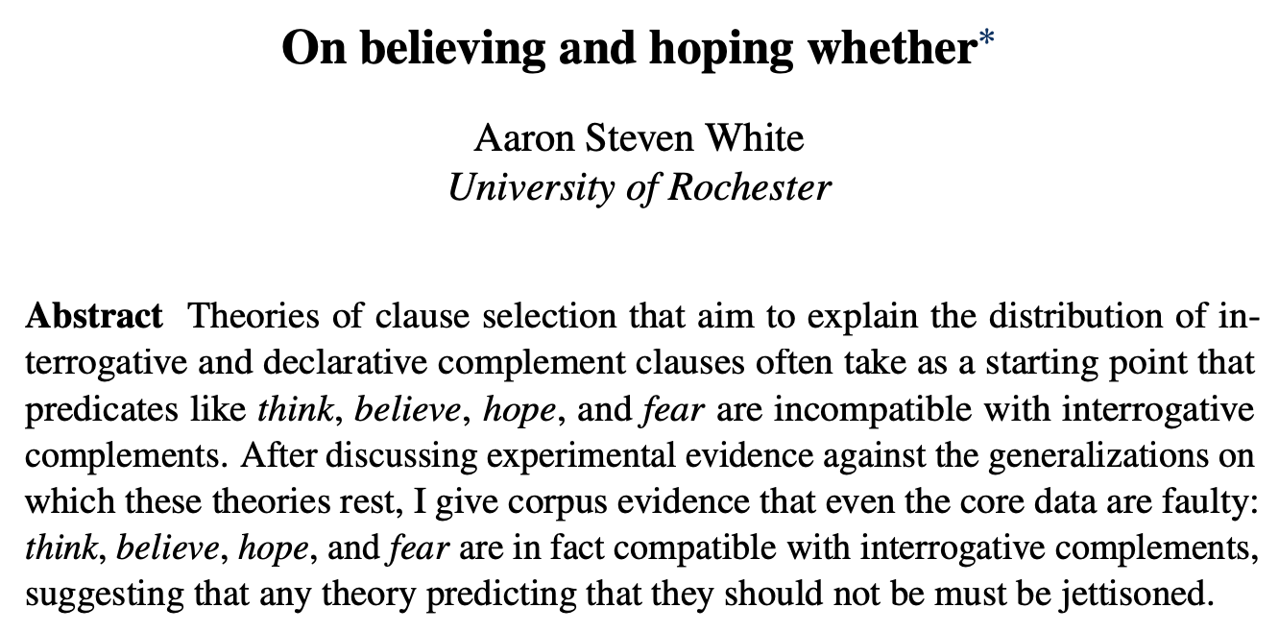
White, Aaron Steven. 2021. On Believing and Hoping Whether. Semantics and Pragmatics 14 (6): 1–18.

Slide 23
Proposed Generalization #1 Egre 2008 see also Hintikka 1975 A predicate triggers veridicality inferences…

Slide 24
Bo no longer thinks that Jo is heading out to get groceries.
⇝
Cessation inference
Bo:
[to Jo] I thought you were heading out to get groceries.
Jo:
I remembered that I went a few days ago, but I’m now realizing I forgot to grab beer.
⇝
Veridicality inferences
Jo went to get groceries a few days before.
Jo did not grab beer.

Slide 25
Proposed Generalization #1 Egre 2008 see also Hintikka 1975 A predicate triggers veridicality inferences iff it takes both declarative and interrogative clauses.

Slide 26
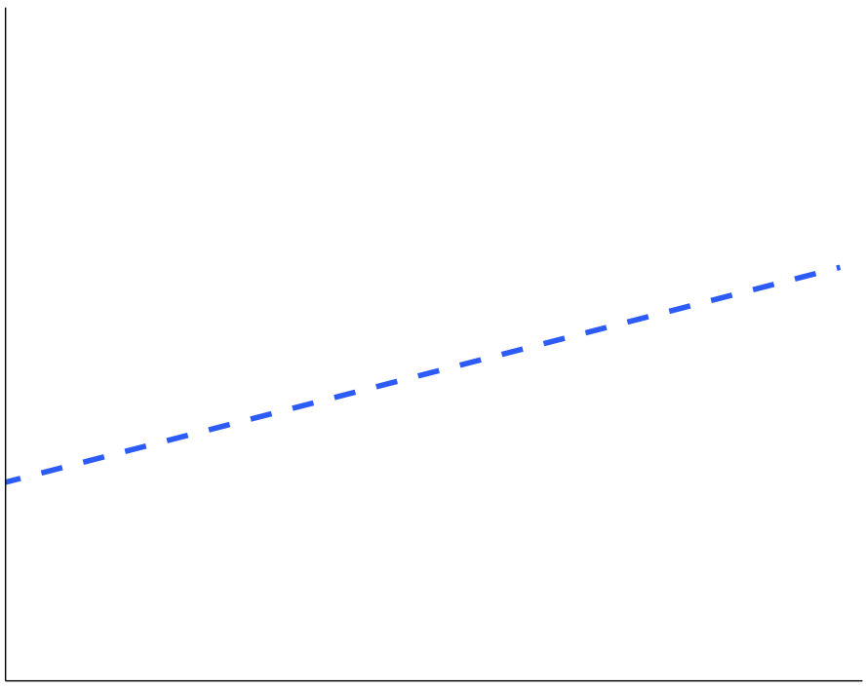
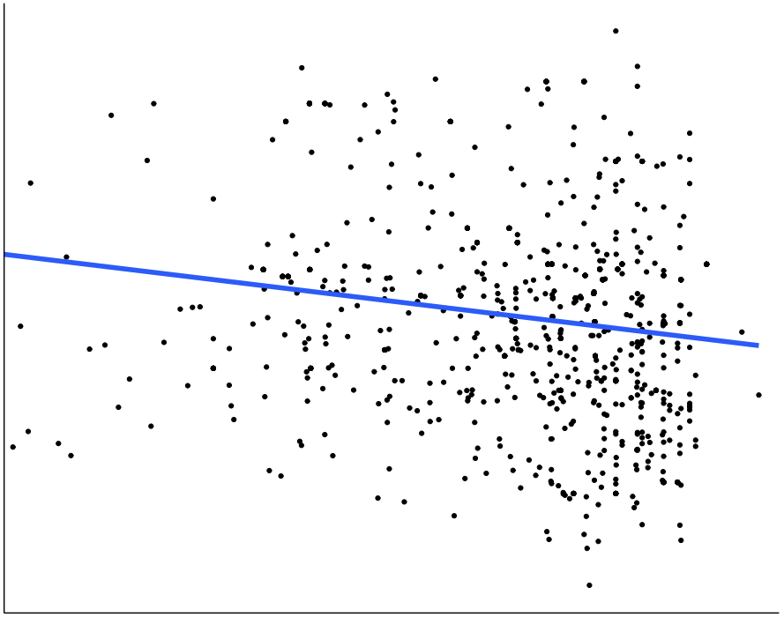
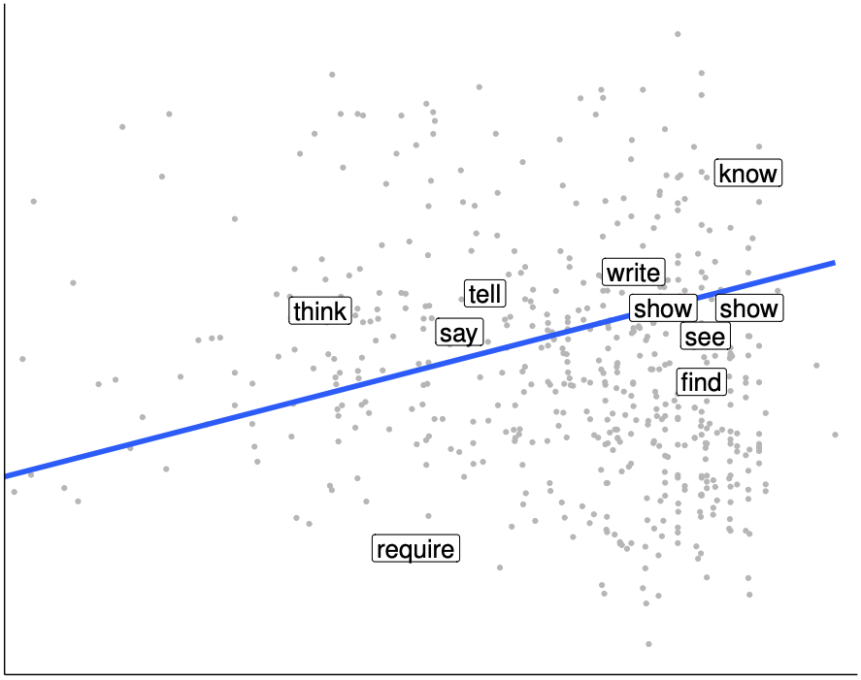
Takes both declaratives and interrogatives
Triggers veridicality inferences
White & Rawlins 2018, White 2021

Slide 27
Proposed Generalization #2 Zuber 1983, Theiler et al. 2017, 2019 If a predicate triggers neg-raising inferences, it does not take interrogative clauses.

Slide 28
Question Could this be because there are no lexical generalizations to be had for these inferences?
Possibility #1 see Degen & Tonhauser 2022 on veridicality inferences There is no discrete classification of concepts that determines these inferences. It’s all pragmatics.
Simons et al. 2010, 2017

Slide 29
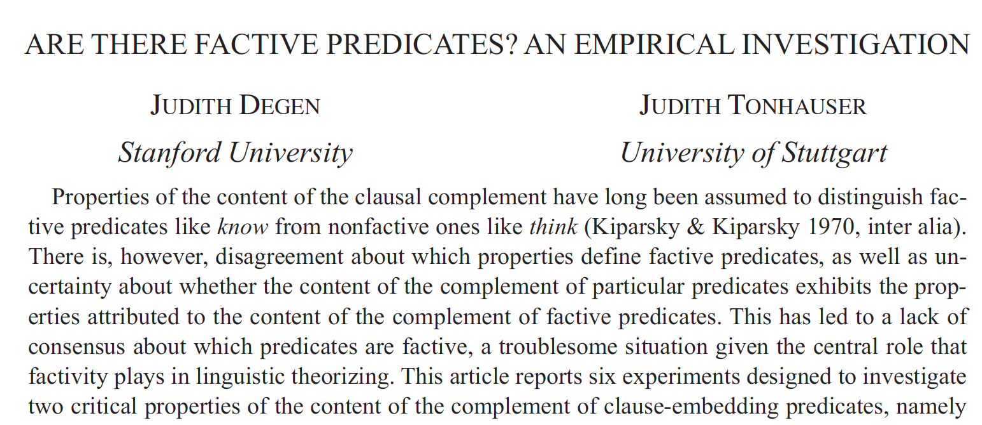

Slide 30
Question Could this be because there are no lexical generalizations to be had for these inferences?
Possibility #1 see Degen & Tonhauser 2022 on veridicality inferences There is no discrete classification of concepts that determines these inferences. It’s all pragmatics.
Simons et al. 2010, 2017
Evidence
No clear separation in inference judgments.

Slide 31
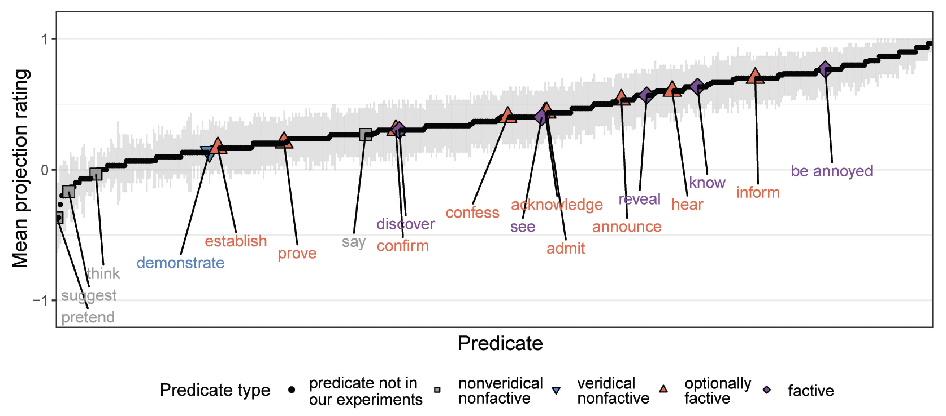
This evidence is extremely weak!
This gradience may arise from noise in the measurement that obscures discrete classes.
Degen & Tonhauser 2022, Fig. 7, derived from White & Rawlins’ (2016) MegaVeridicality dataset

Slide 32
Question Could this be because there are no lexical generalizations to be had for these inferences?
Possibility #1 see Degen & Tonhauser 2022 on veridicality inferences There is no discrete classification of concepts that determines these inferences. It’s all pragmatics.
Simons et al. 2010, 2017
Evidence
No clear separation in inference judgments.
Almost all inferences appear defeasible.

Slide 33
Few predicates up here!
Degen & Tonhauser 2022, Fig. 7, derived from White & Rawlins’ (2018) MegaVeridicality dataset

Slide 34
Question Could this be because there are no lexical generalizations to be had for these inferences?
Possibility #1 (see Degen & Tonhauser 2022 on veridicality inferences) There is no discrete classification of concepts that determines these inferences. It’s all pragmatics.
Simons et al. 2010, 2017
Possibility #2 There is such a classification. It’s just obscured by noise in the measurement.
Possibility #2 There is such a classification. It’s just obscured by noise in the measurement.
Pursued in this talk!

Slide 35
Question Do we find recurring, distributionally correlated patterns of inference when filtering noise?

Slide 36
Jo hated that Bo left. ⇝ Bo left.
Veridicality inference
NP V S ⇝ S
Doxastic inference
Jo hated that Bo left. ⇝ Jo believed Bo left.
NP V S ⇝ NP believe S
Bouletic inference
Jo hated that Bo left. ⇝ Jo didn't want Bo to have left.
NP V S ⇝ NP not want S

Slide 37
Predicate | NP V S ⇝ S | NP V S ⇝ NP believe S | NP V S ⇝ NP want S
think | 0 | + | 0
doubt | 0 | - | 0
hope | 0 | 0 | +
hate | + | + | -

Slide 38
Approach
Cluster predicates based on measures of their inferential properties.

Slide 39
Predicate | NP V S ⇝ S | NP V S ⇝ NP believe S | NP V S ⇝ NP want S
think | 0 | + | 0
doubt | 0 | - | 0
hope | 0 | 0 | +
hate | + | + | -

Slide 40
Veridicality inference
(not)
NP V S ⇝ S
NP not V S ⇝ (not) S
Doxastic inference
NP V S ⇝ NP believe S
NP not V S ⇝ NP (not) believe S
(not)
Bouletic inference
NP V S ⇝ NP want S
NP not V S ⇝ NP (not) want S
(not)
Neg-raising inference
NP not V S ⇝ NP V not S

Slide 41
Approach
Cluster predicates based on measures of their inferential properties.
Determine optimal # of clusters based on how well particular clusterings predict syntactic distribution.

Slide 42
Takeaway There are recurring, distributionally correlated patterns of inference when filtering noise!

Slide 43
Roadmap
Measuring distribution
Measuring inference
Discovering inference patterns
Investigating inference patterns

Slide 44
Measuring Distribution

Slide 45
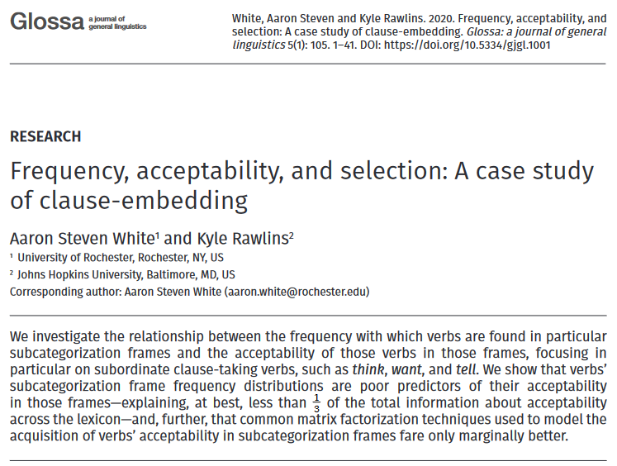
Kyle Rawlins
Johns Hopkins University

Slide 46
MegaAcceptability dataset
Acceptability for 1,000 verbs in 50 syntactic frames focused on clause-embedding.
White & Rawlins 2016, 2020

Slide 47
Verbs
think
know
wonder
love
surprise
tell
say
start
stop
...

Slide 48
Bleaching method
Frame templates (e.g. NP __ that S) instantiated by semantically bleached fillers.

Slide 49
Verbs
Frames
think
Someone __ed something happened
know
Someone __ed that something happened
wonder
Someone __ed whether something happened
love
Someone __ed which someone something happened
x
surprise
Someone __ed someone that something happened
tell
Someone __ed someone whether something happened
say
Someone __ed to someone that something happened
start
Someone __ed to do something
stop
Someone __ed someone to do something
...
...

Slide 50
MegaAcceptability dataset
Acceptability for 1,000 verbs in 50 syntactic frames focused on clause-embedding.
White & Rawlins 2016, 2020
50,000 total items x 5 judgments per item

Slide 51
Question
Is bleaching a valid method for capturing the acceptability of a verb in a frame?
Validation Strategy #1
Compare judgments for bleached items against judgments from trained linguists.

Slide 52
Validation data
Select 30 verbs from across Hacquard & Wellwood's (2012) classification
Gather judgments for these verbs in all 50 syntactic frames from:
trained linguists
naïve speakers

Slide 53
Comparison
Correlation between judgments from LI and Sprouse et al.'s (2013) dataset

Slide 54
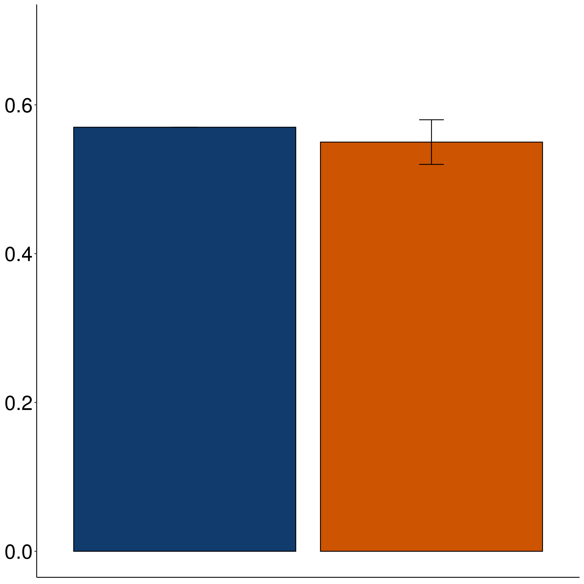
Correlation
Sprouse Linguistic Inquiry
MegaAcceptability

Slide 55
Question
Is bleaching a valid method for capturing the acceptability of a verb in a frame?
Validation Strategy #2
Assess generalization drawn from linguist hand-coding of acceptability across many predicates.

Slide 56
Case Study The vast majority of about-PPs are adjuncts.
Rawlins 2013, 2014

Slide 57
XP₁ V (XP₂) (XP₃) about XP₄
is acceptable
X
XP₁ V (XP₂) (XP₃)
is acceptable

Slide 58
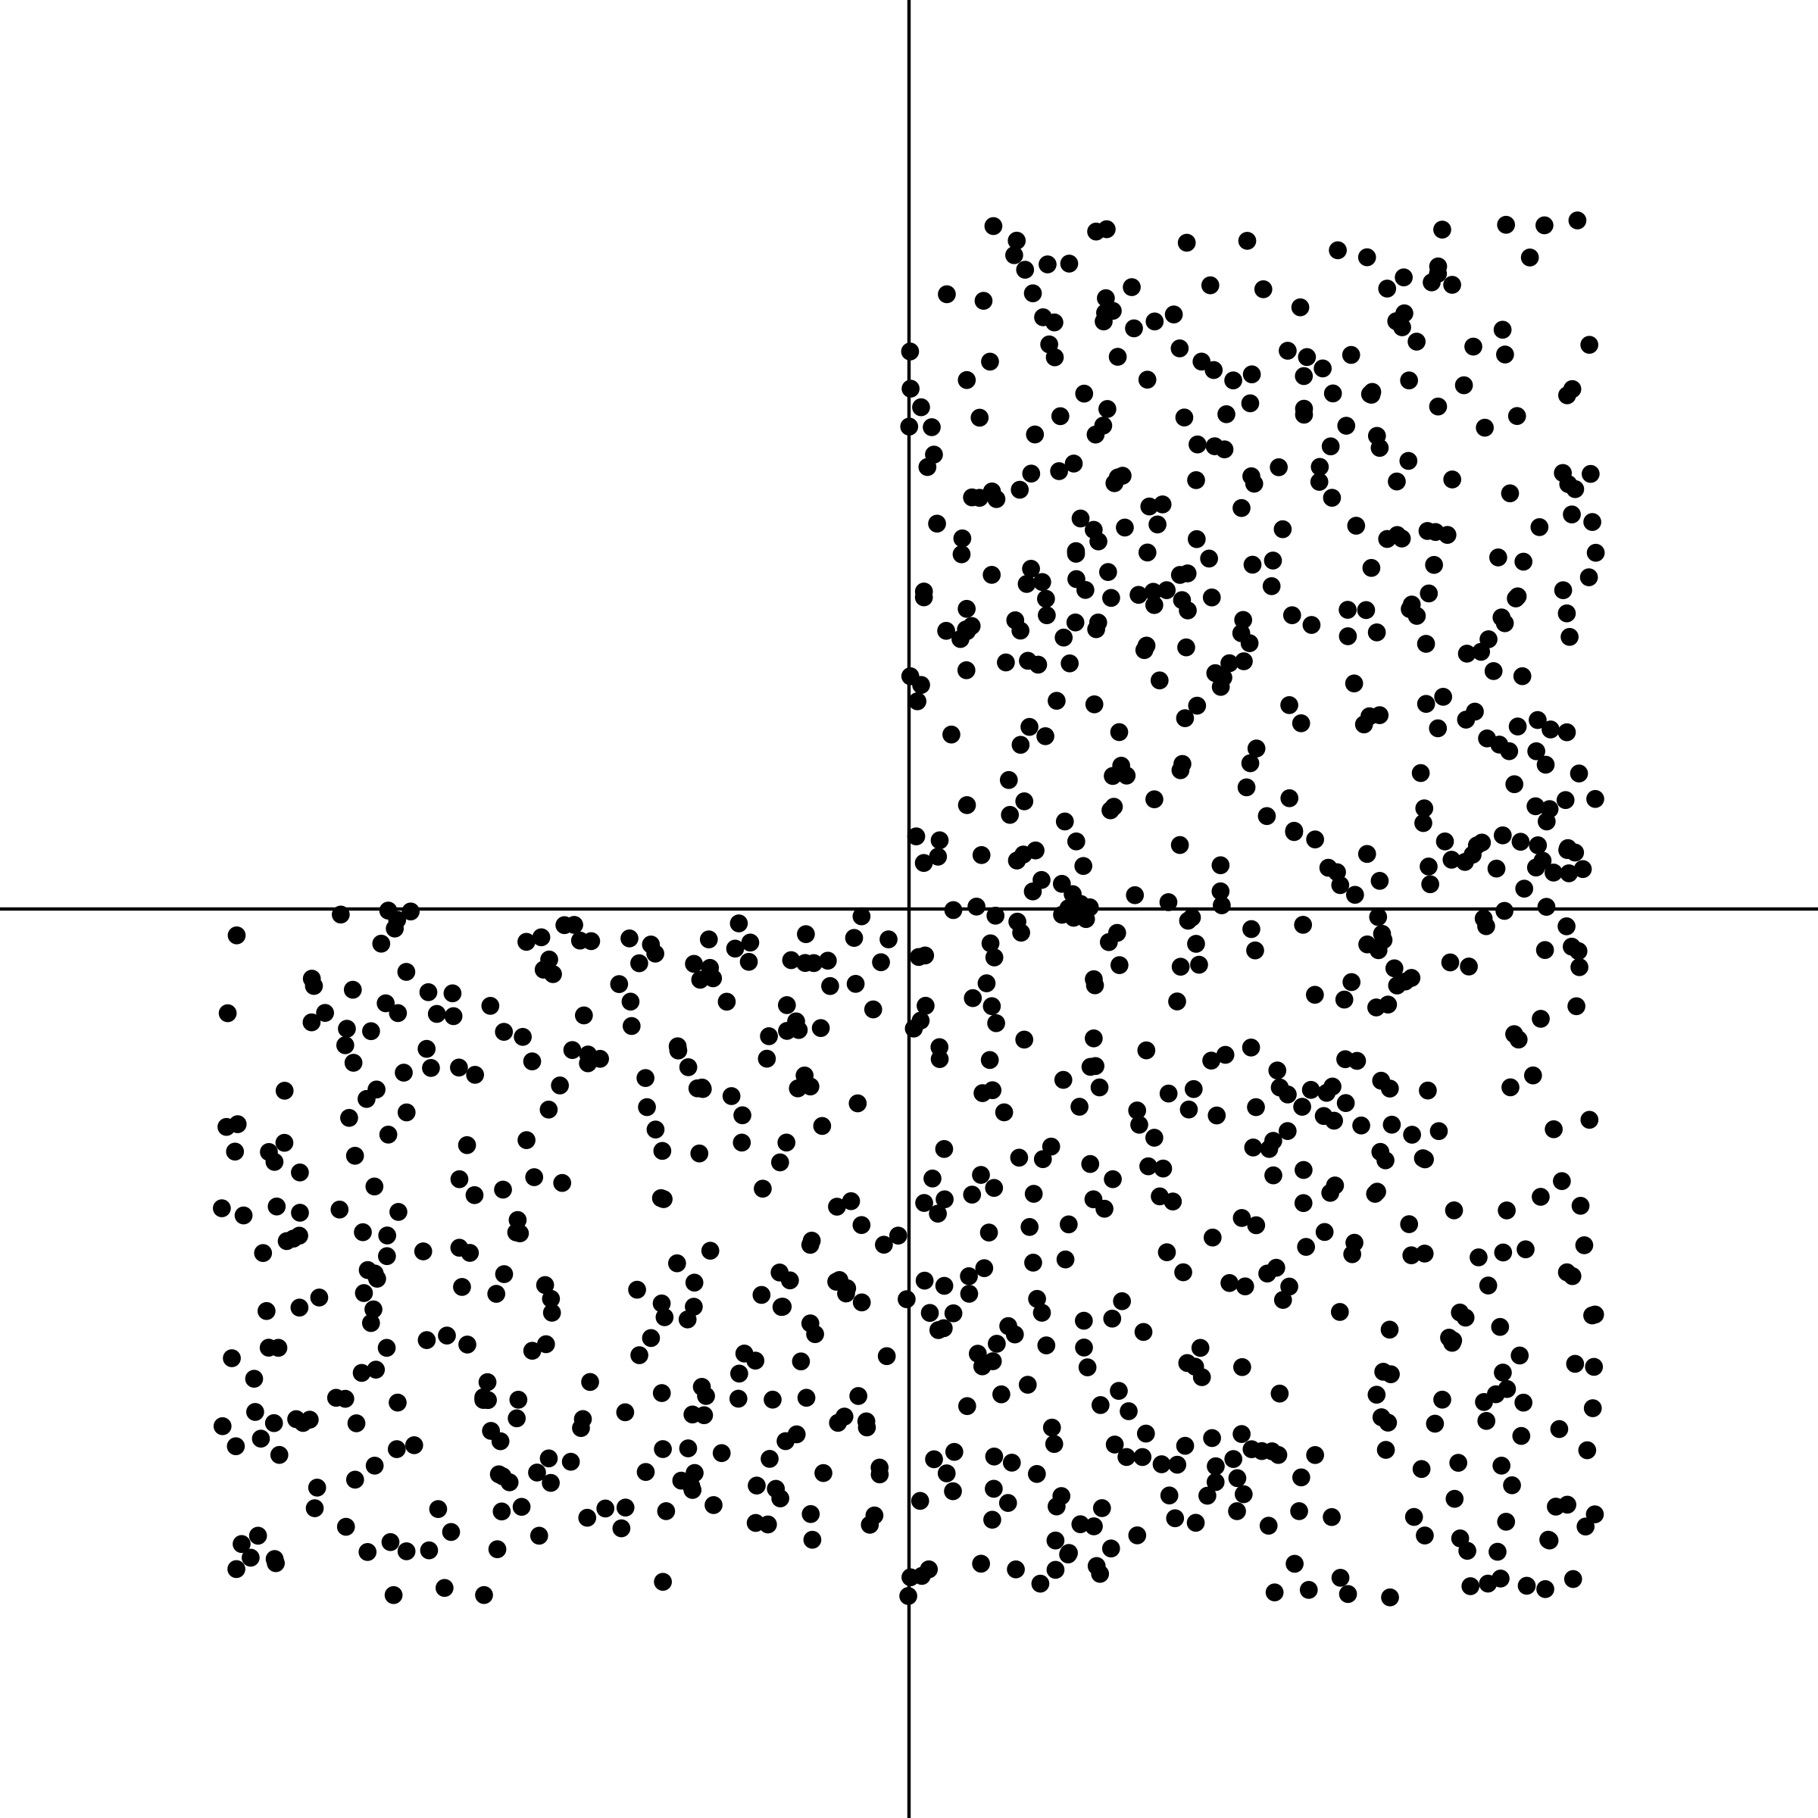
NP _ed about XP
NP _ed

Slide 59
Rawlins 2014

Slide 60
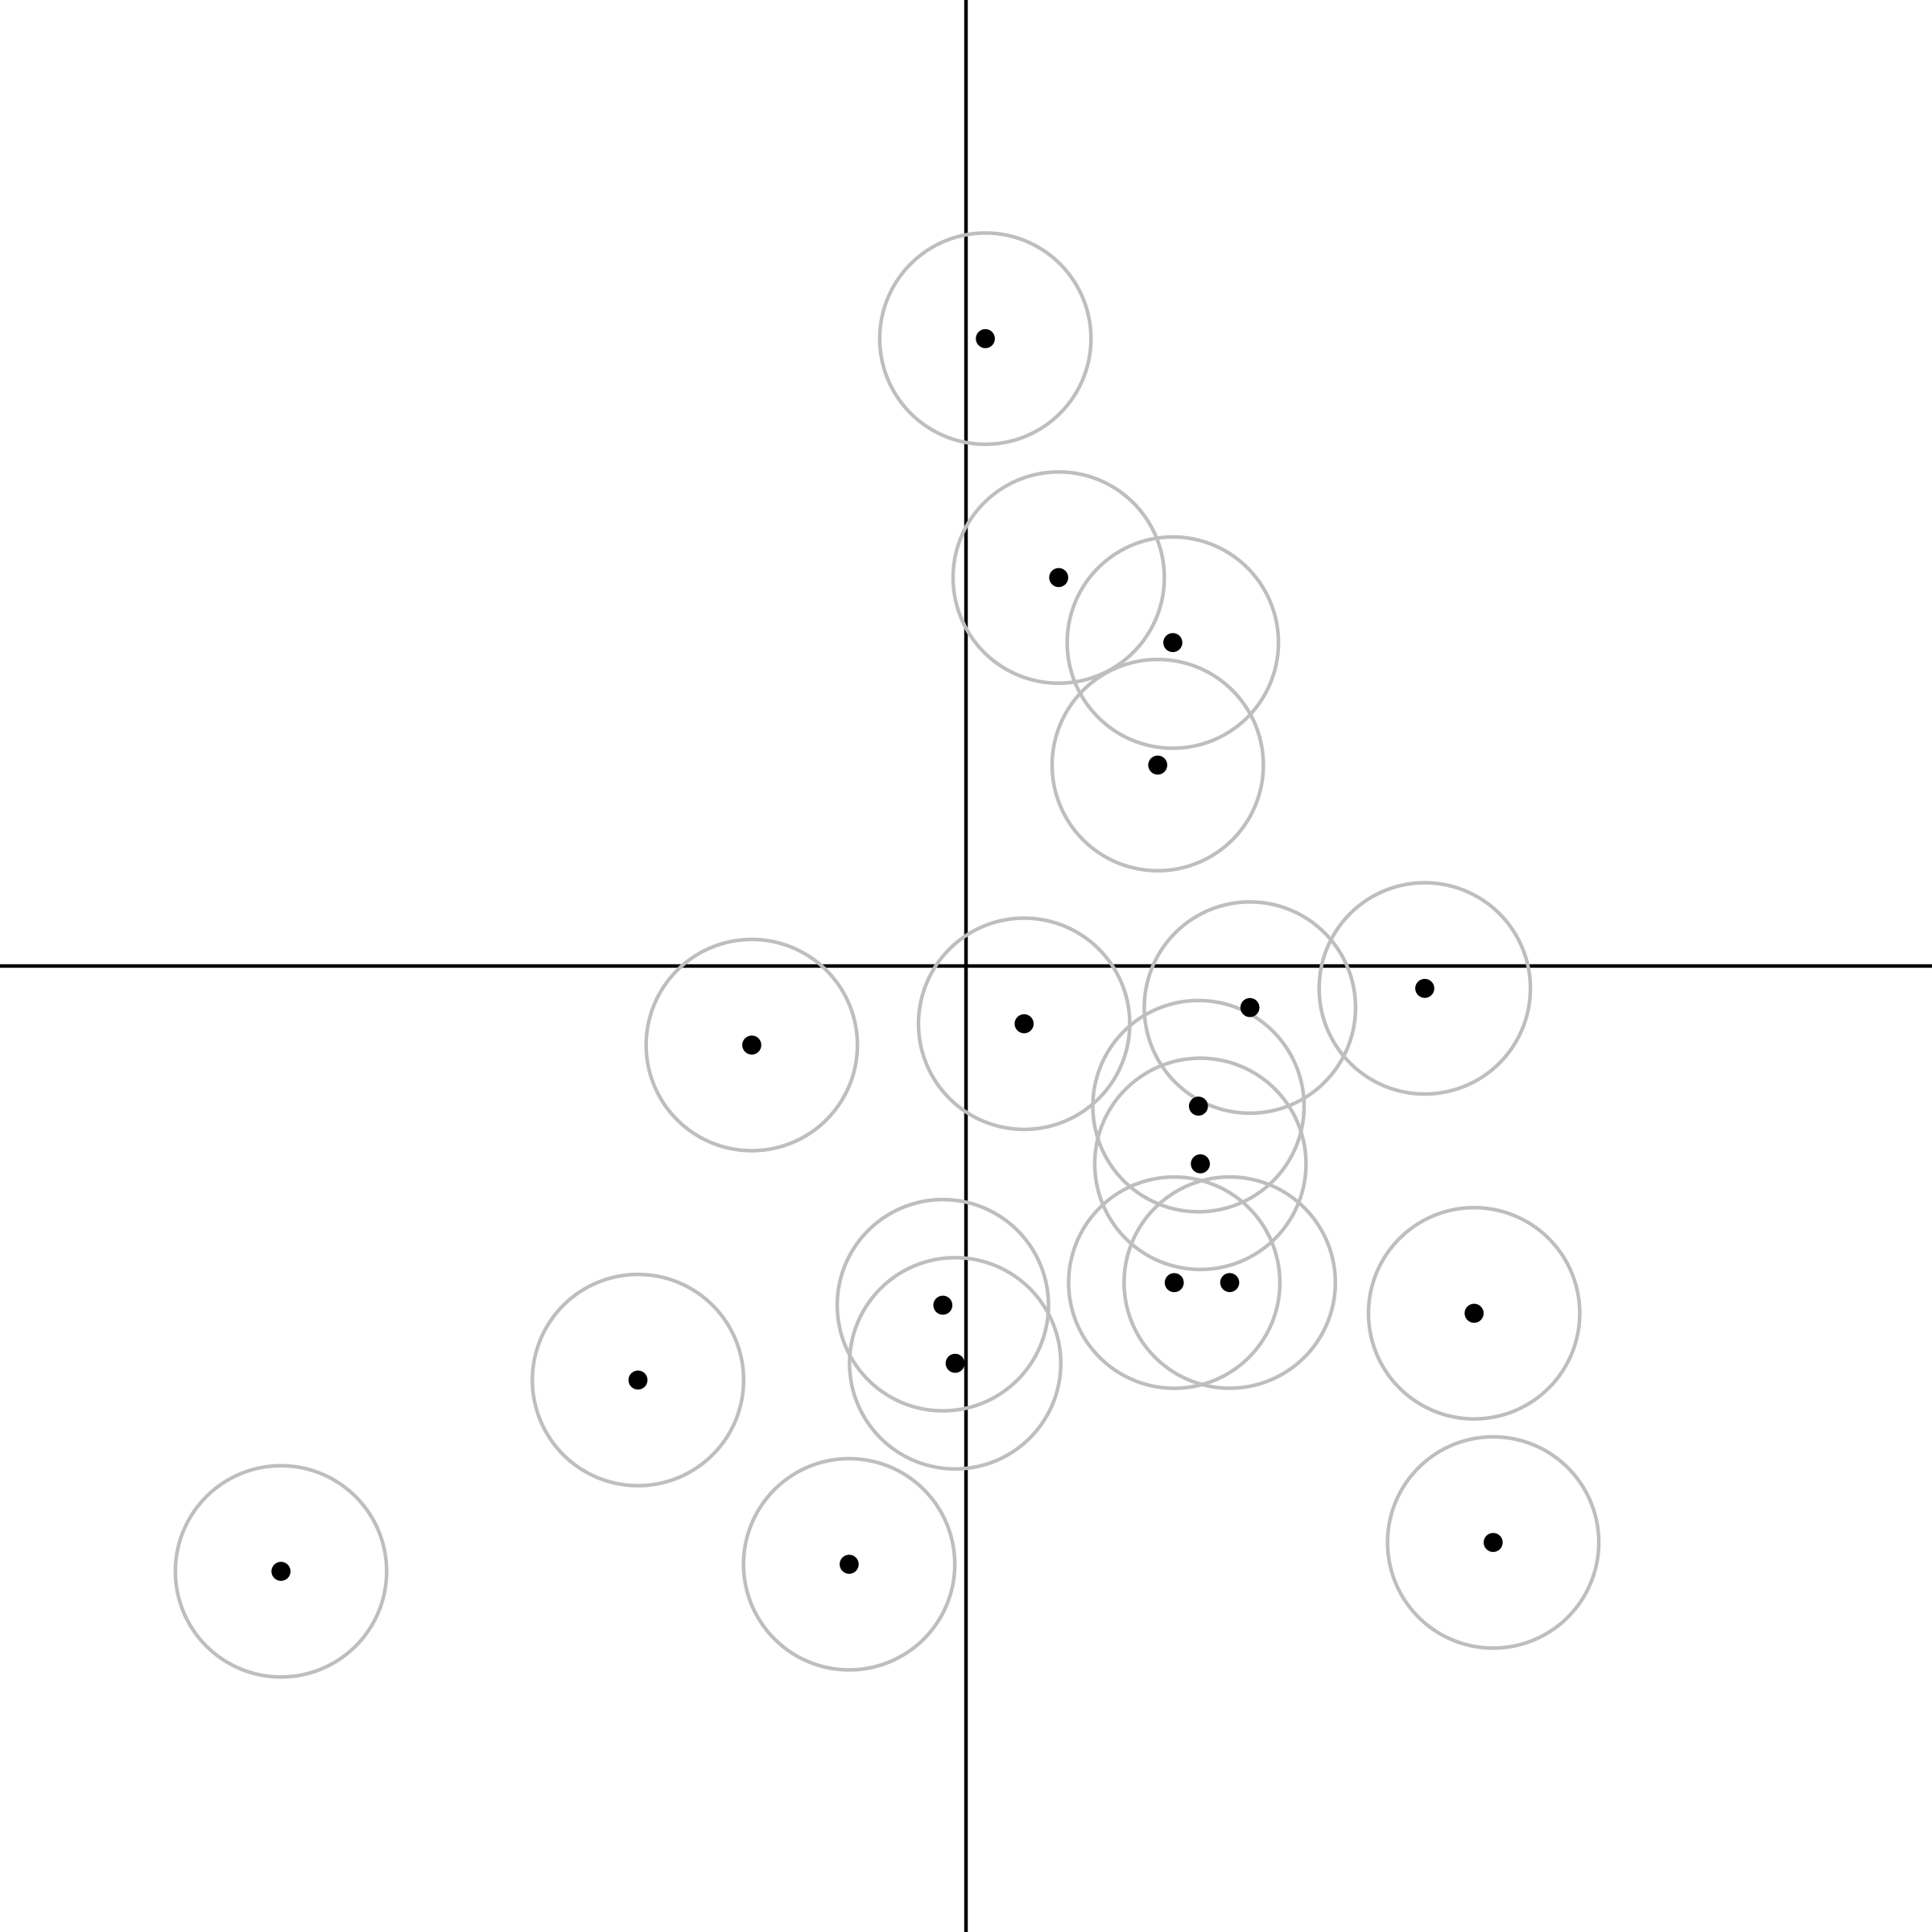
NP _ed about XP
NP _ed

Slide 61
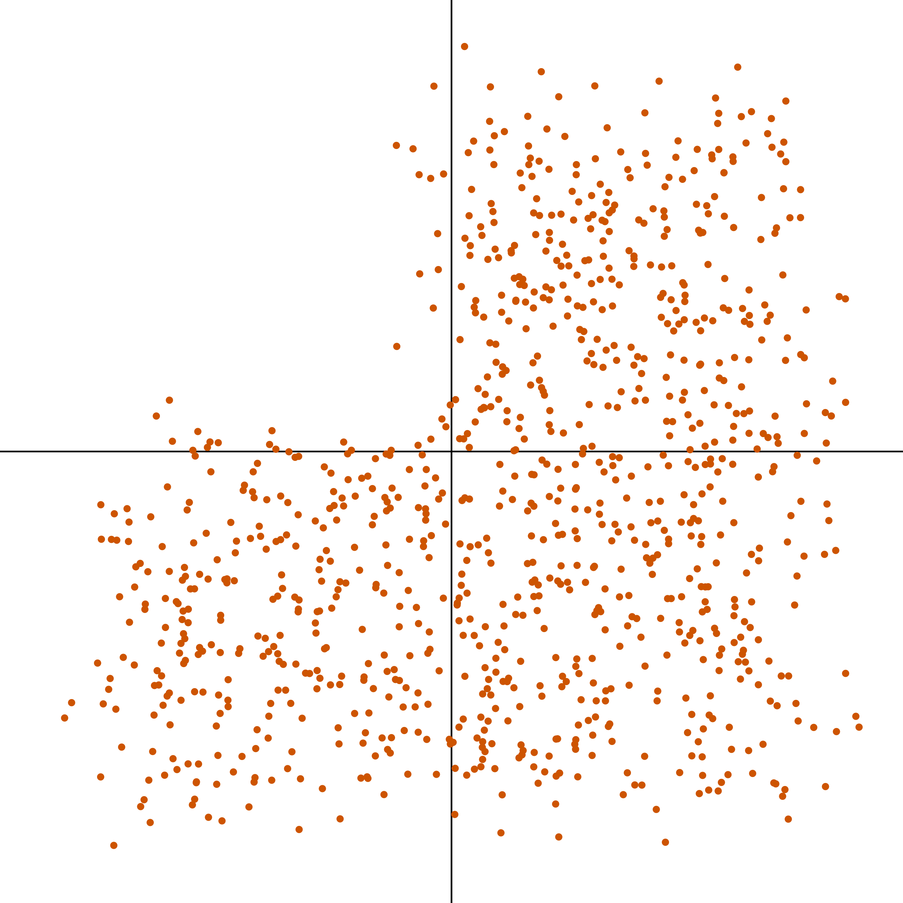
NP _ed about XP
NP _ed

Slide 62
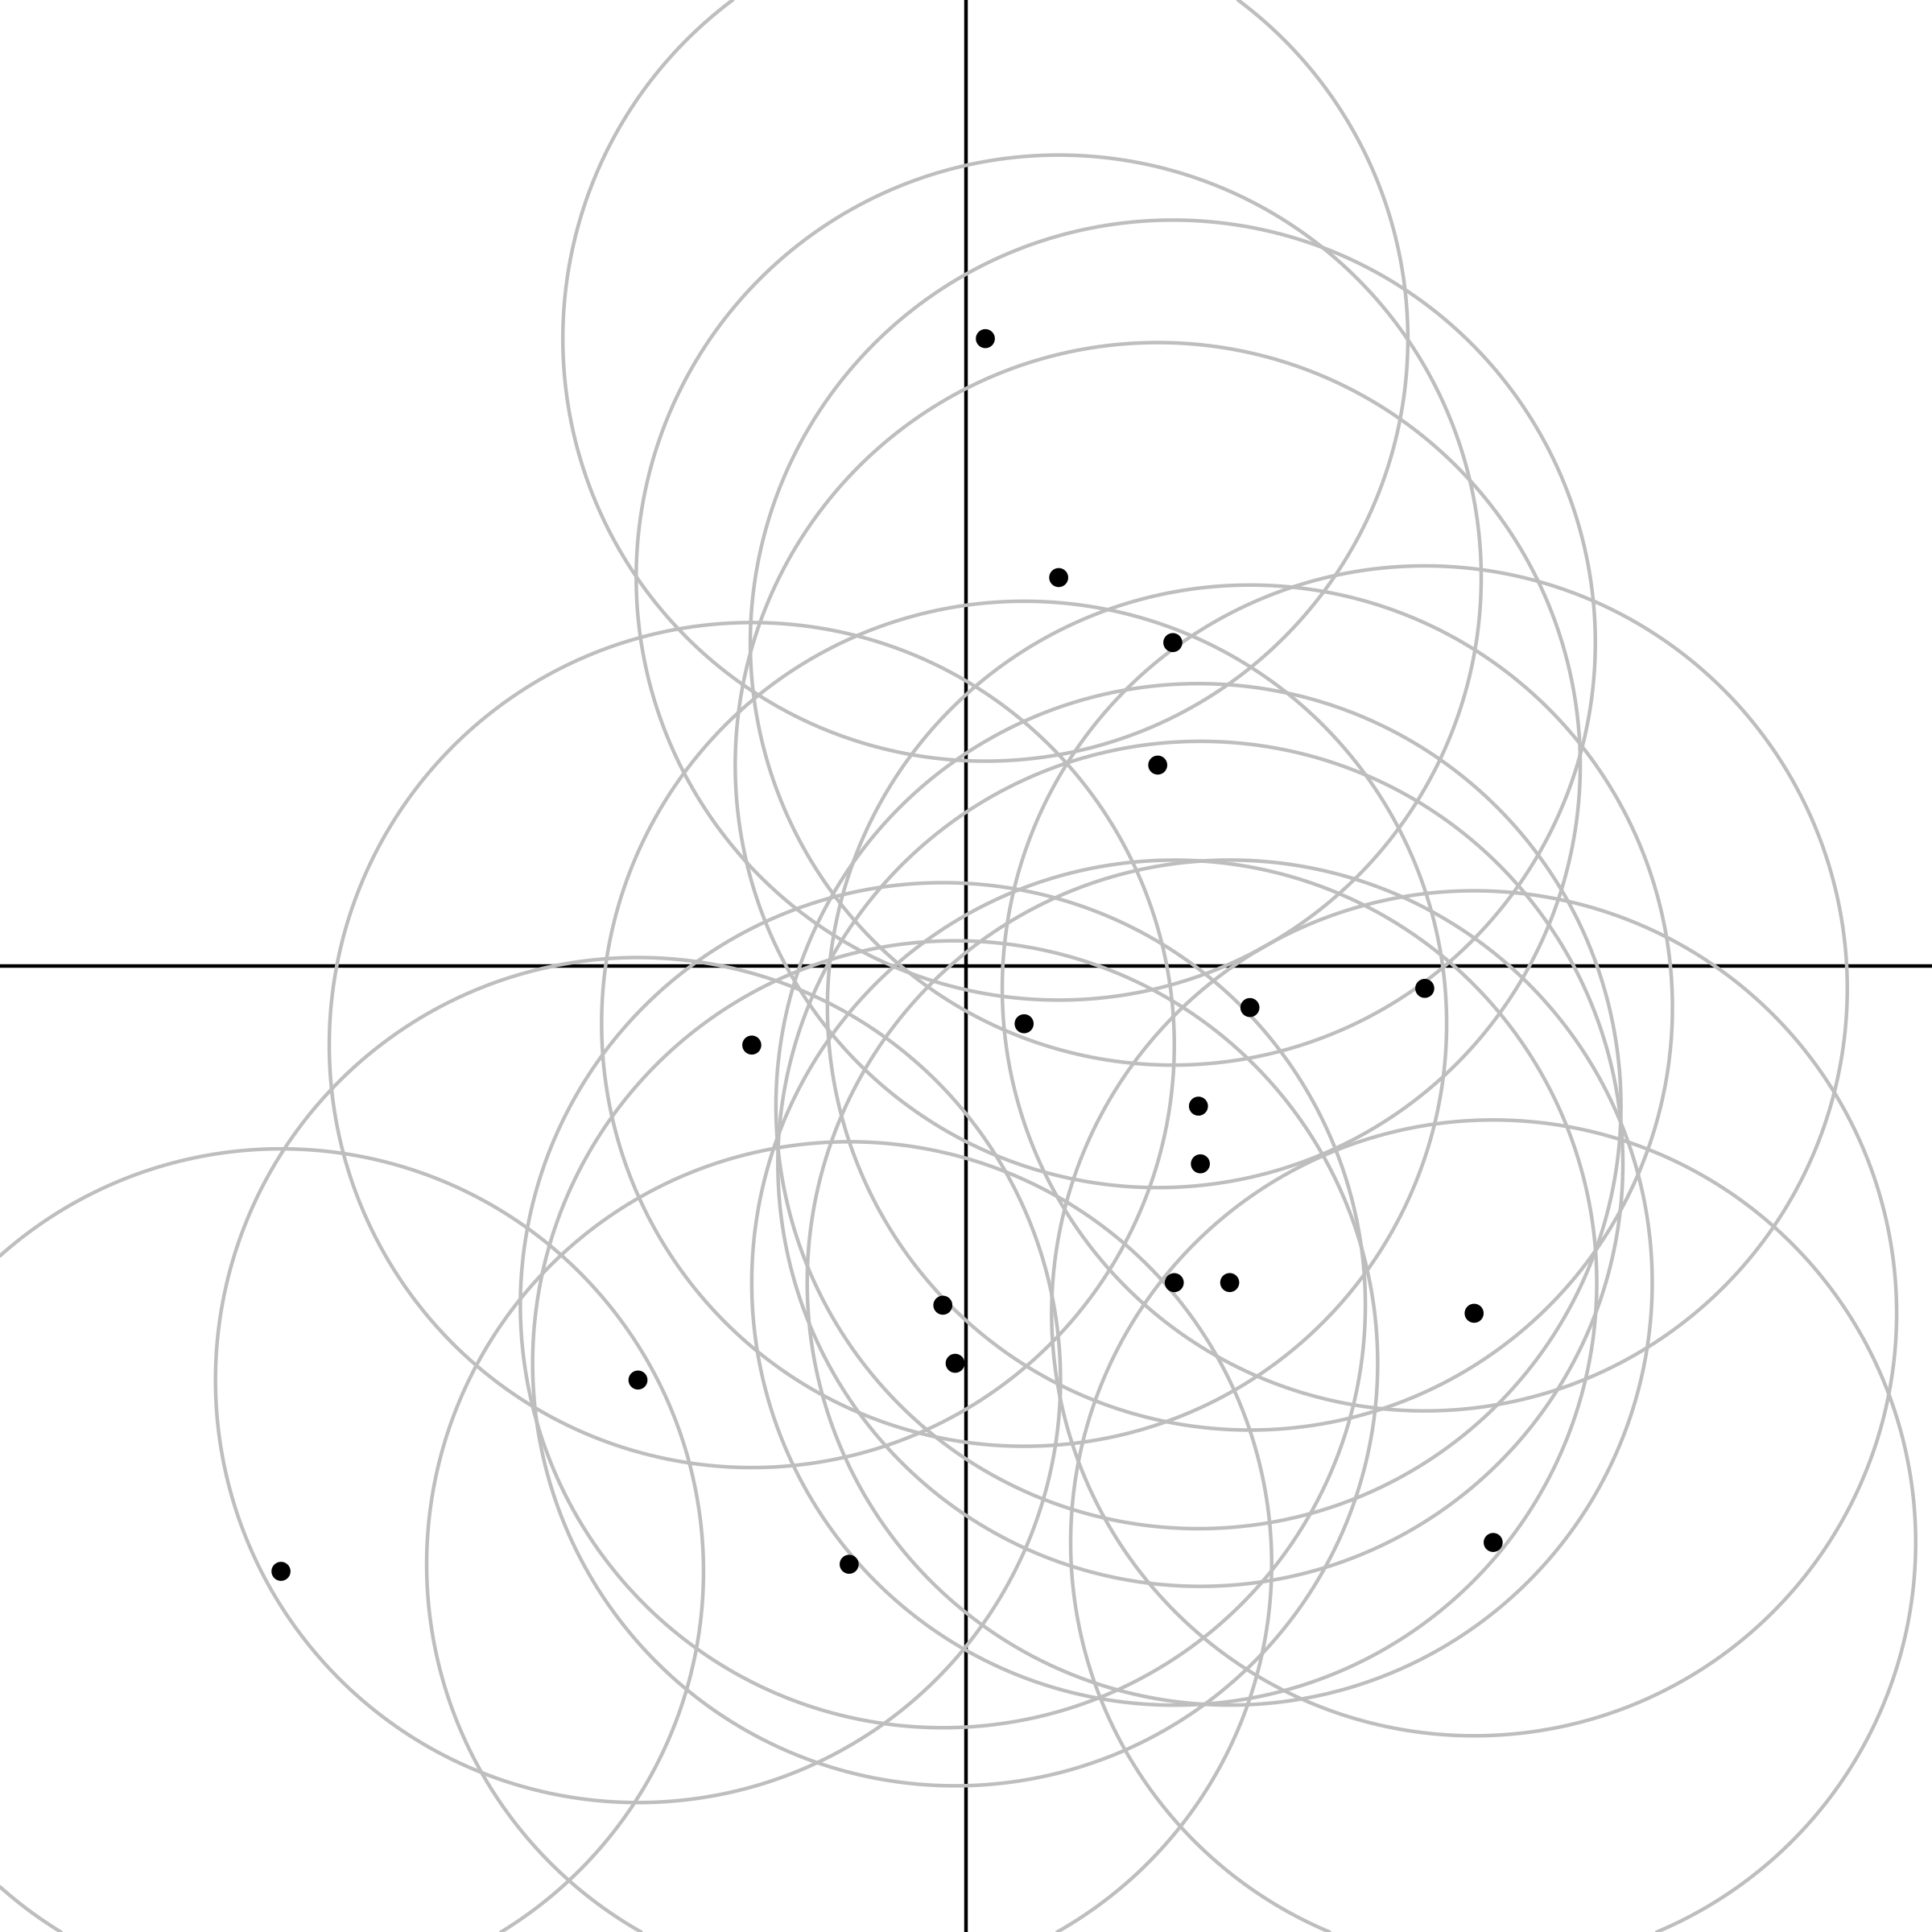
NP _ed about XP
NP _ed

Slide 63
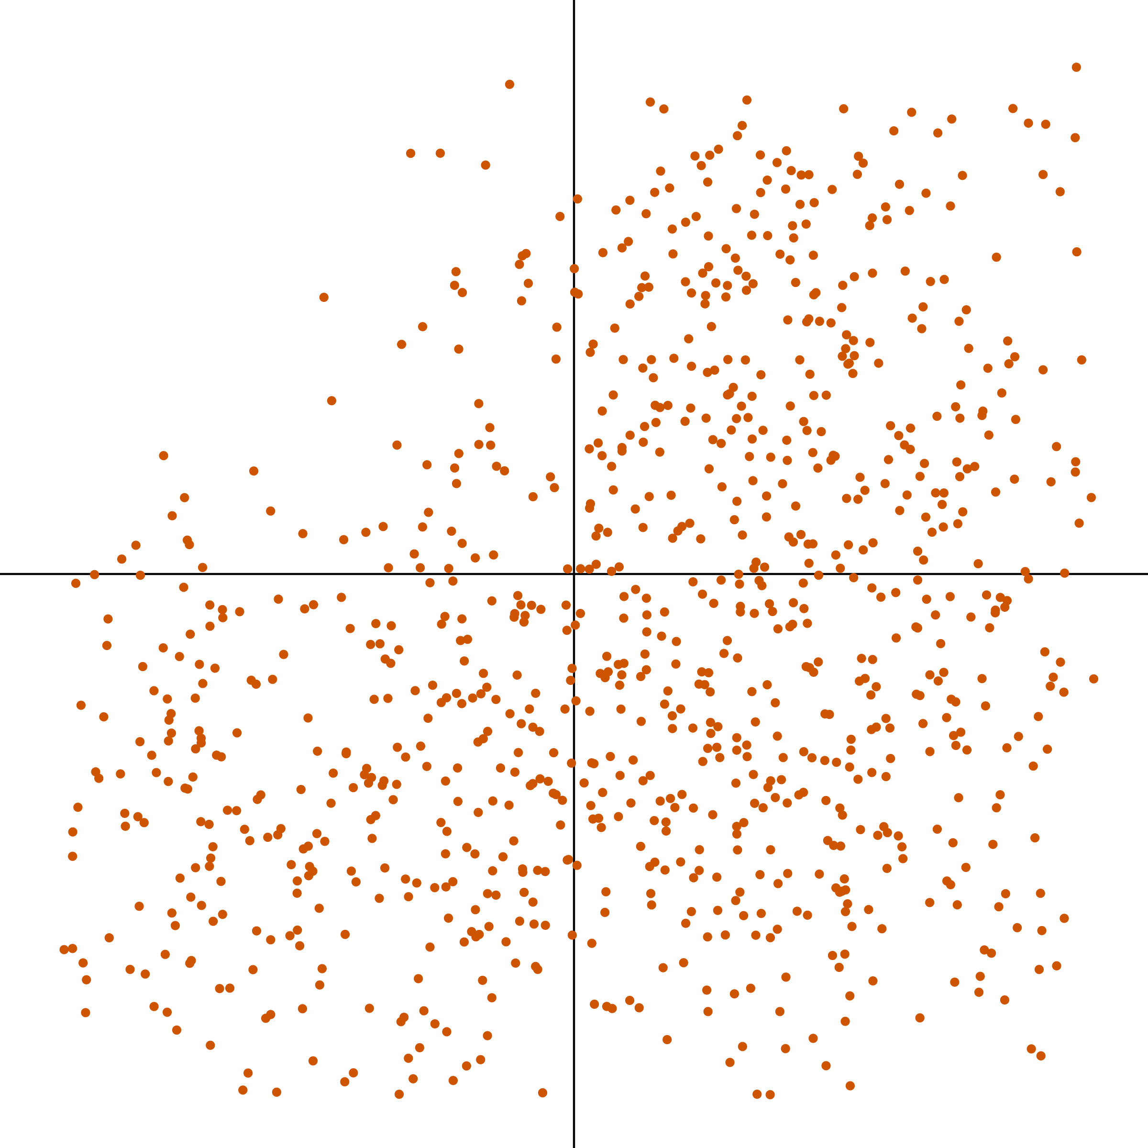
NP _ed about XP
NP _ed

Slide 64
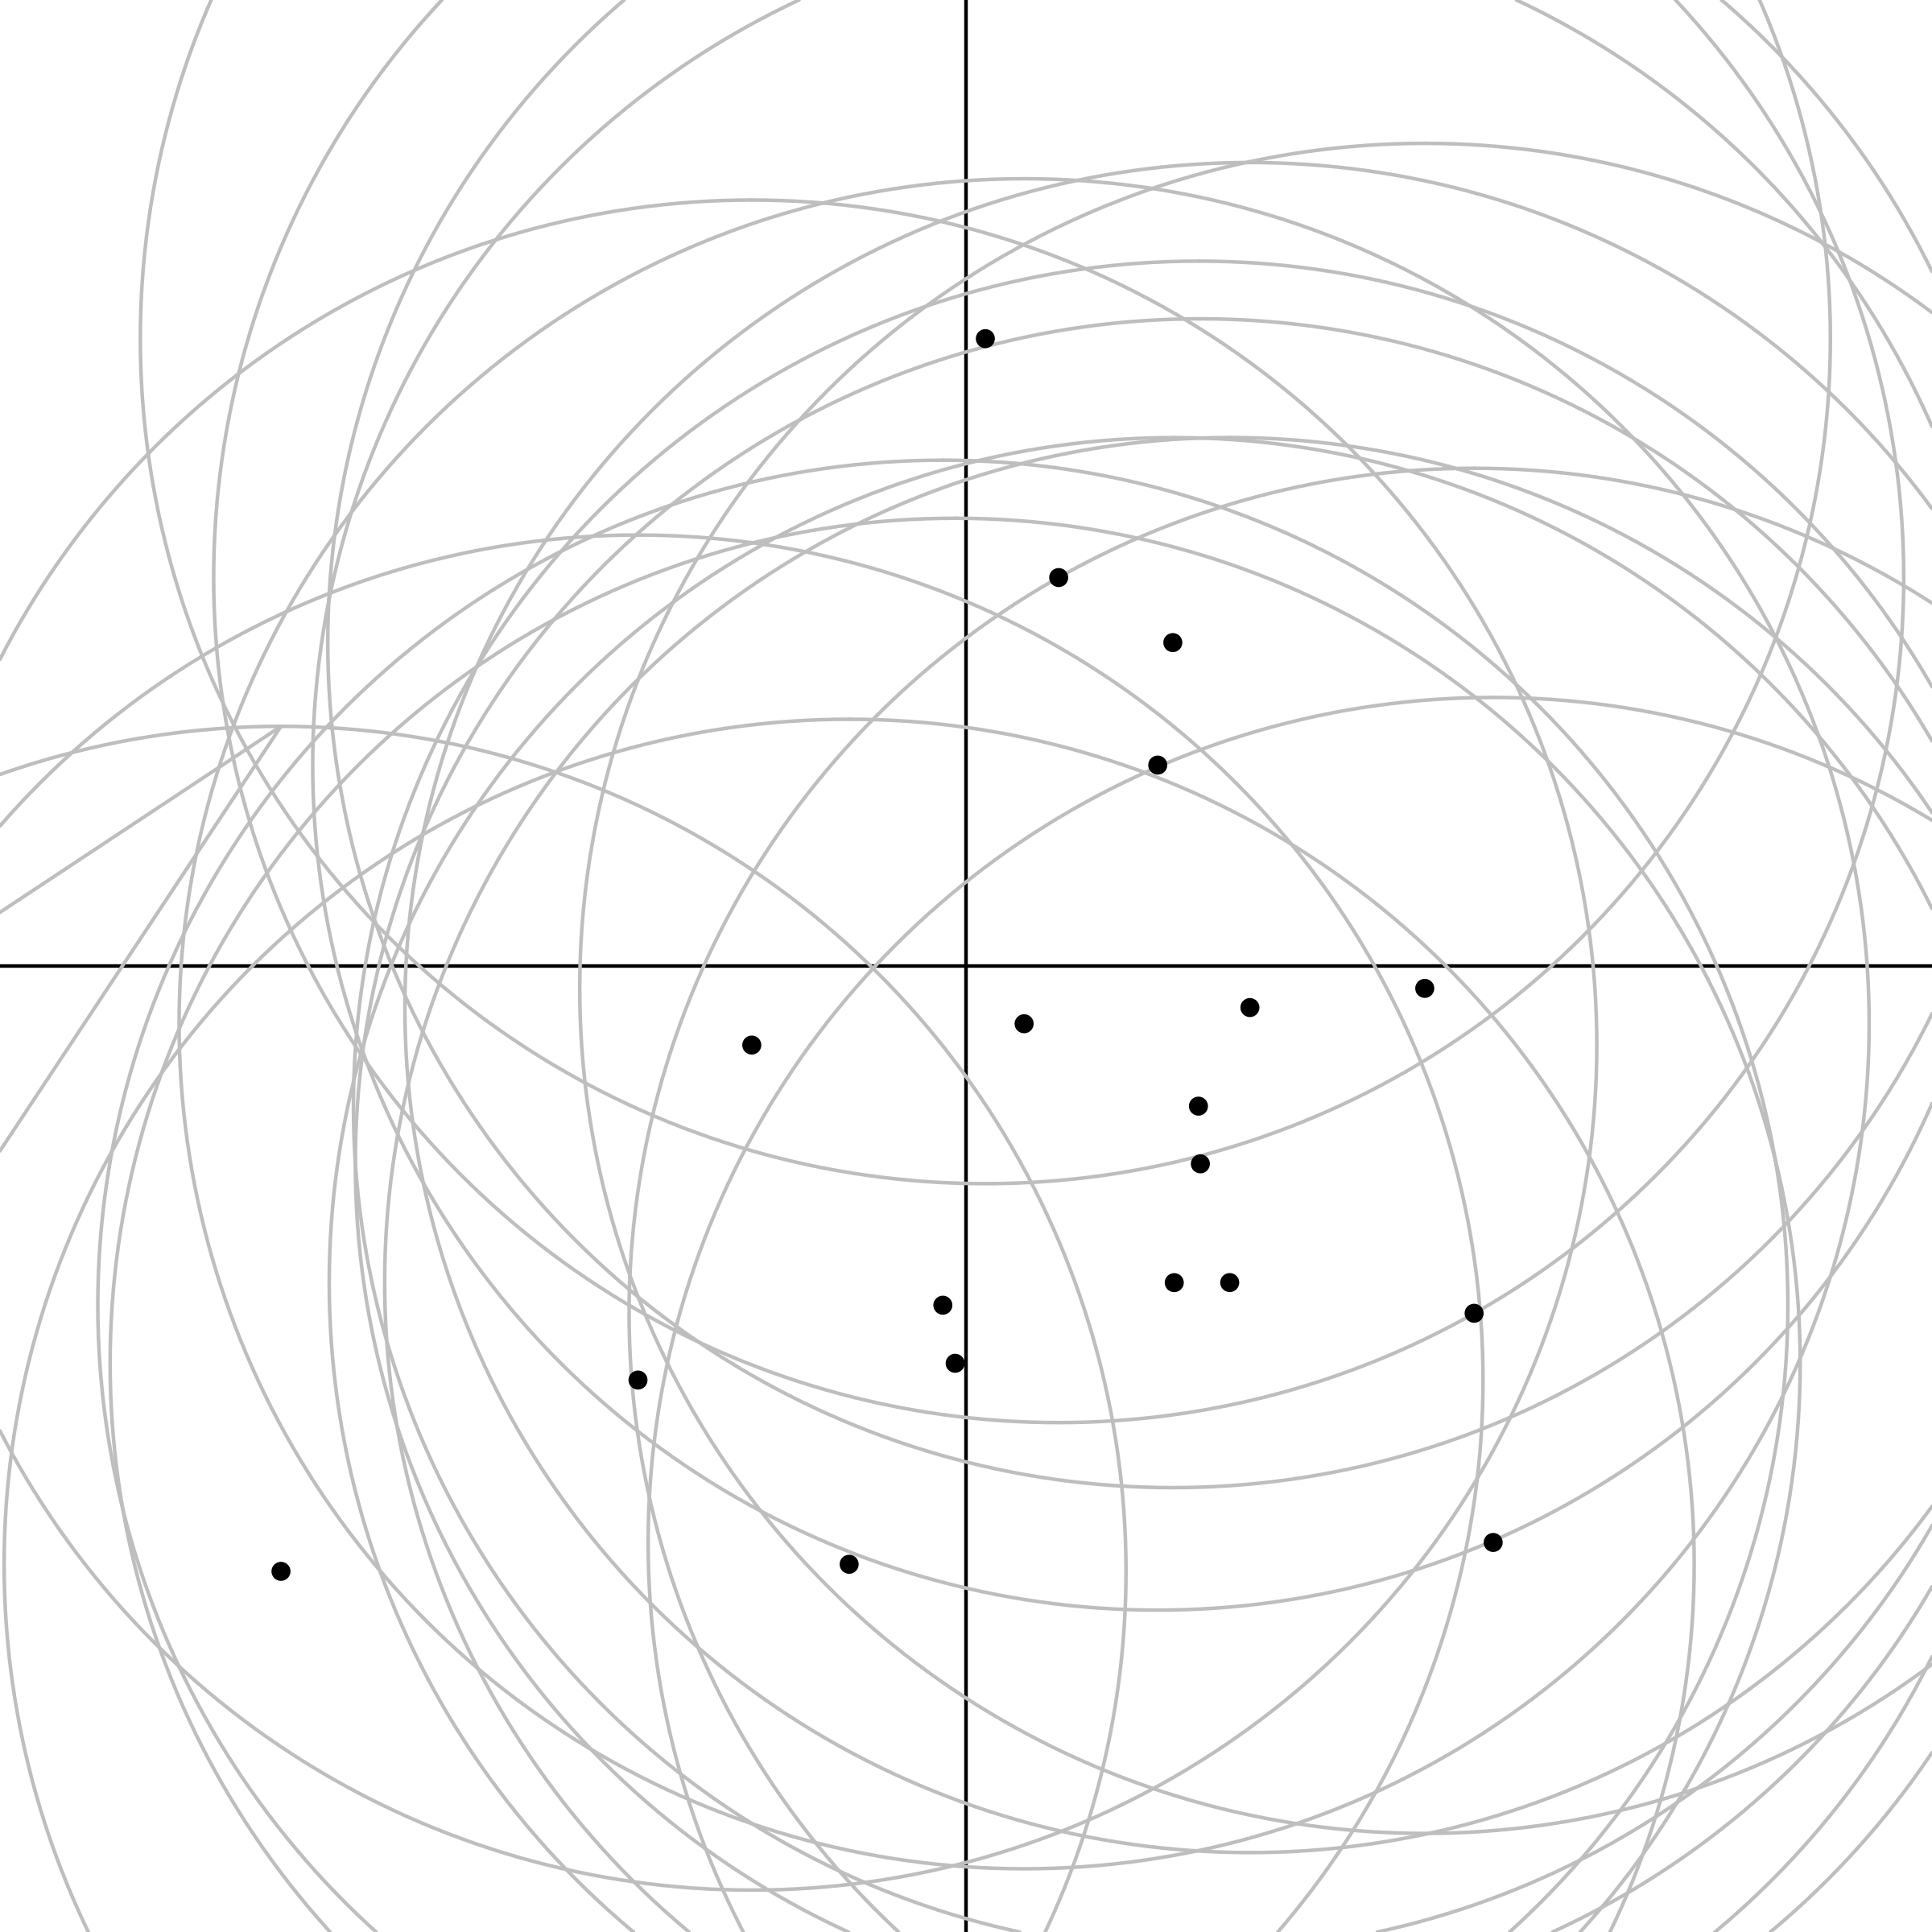
NP _ed about XP
NP _ed

Slide 65
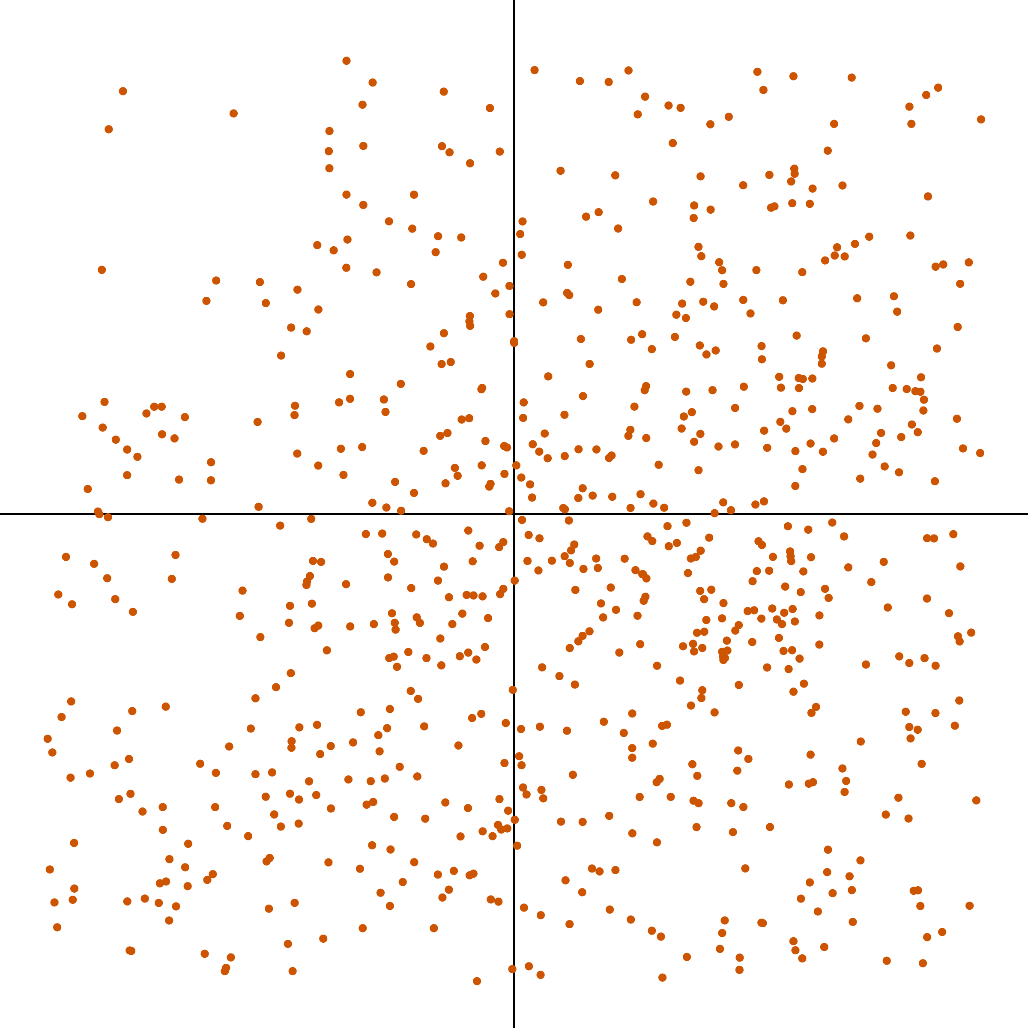
NP _ed about XP
NP _ed

Slide 66
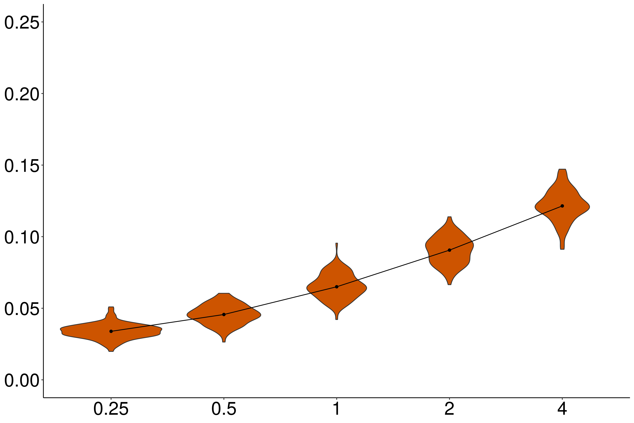
Independence
Proportion violations
Noise variance / acceptability variance

Slide 67
Independence
Proportion violations
Noise variance / acceptability variance

Slide 68
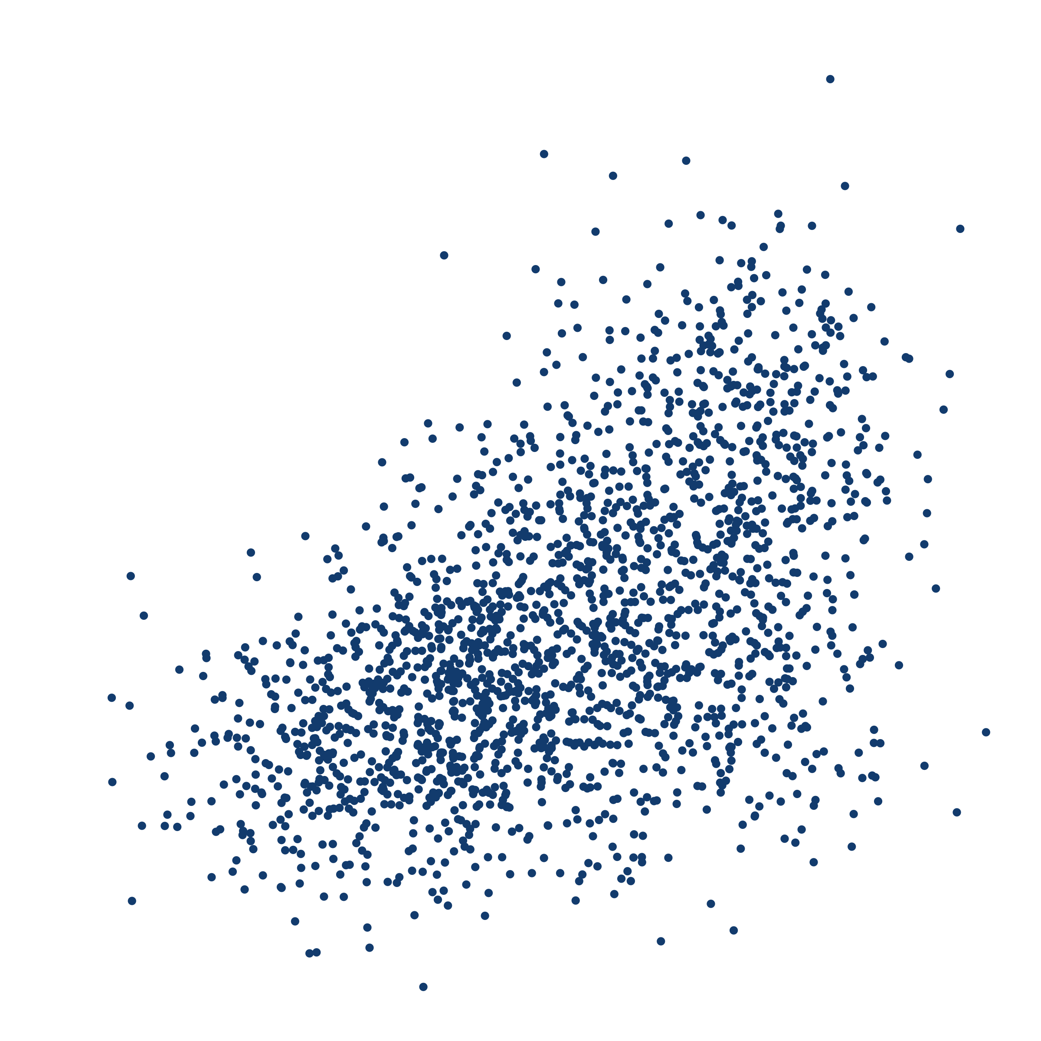
NP (was) _ed about whether S
NP (was) _ed

Slide 69
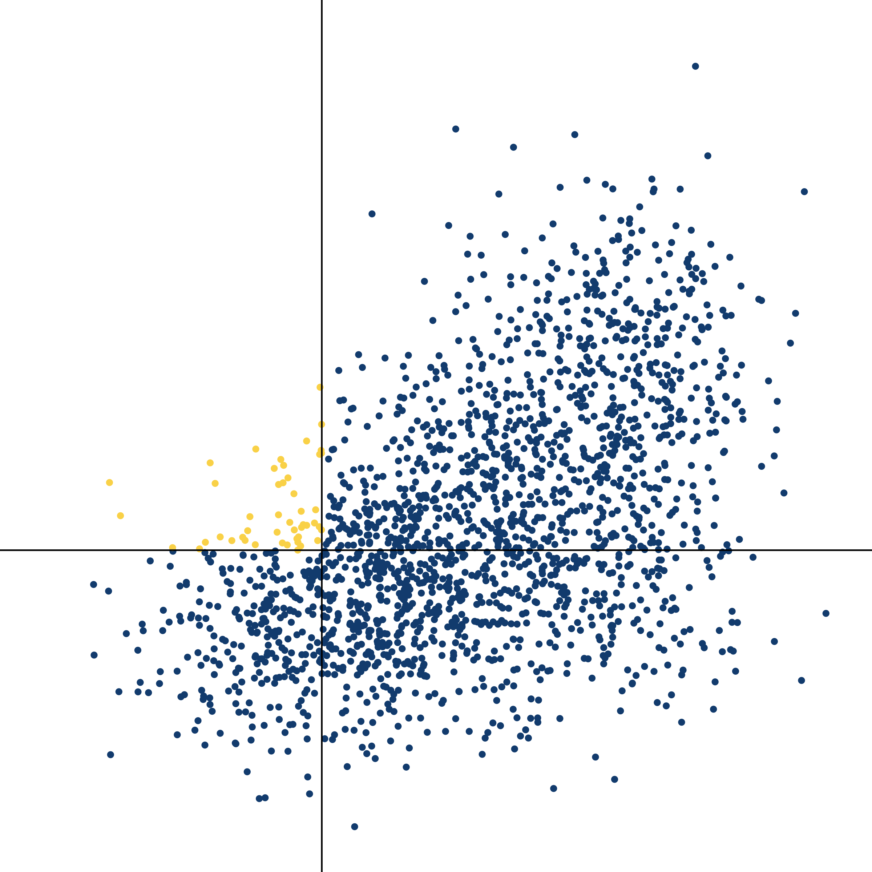
NP (was) _ed about whether S
NP (was) _ed

Slide 70
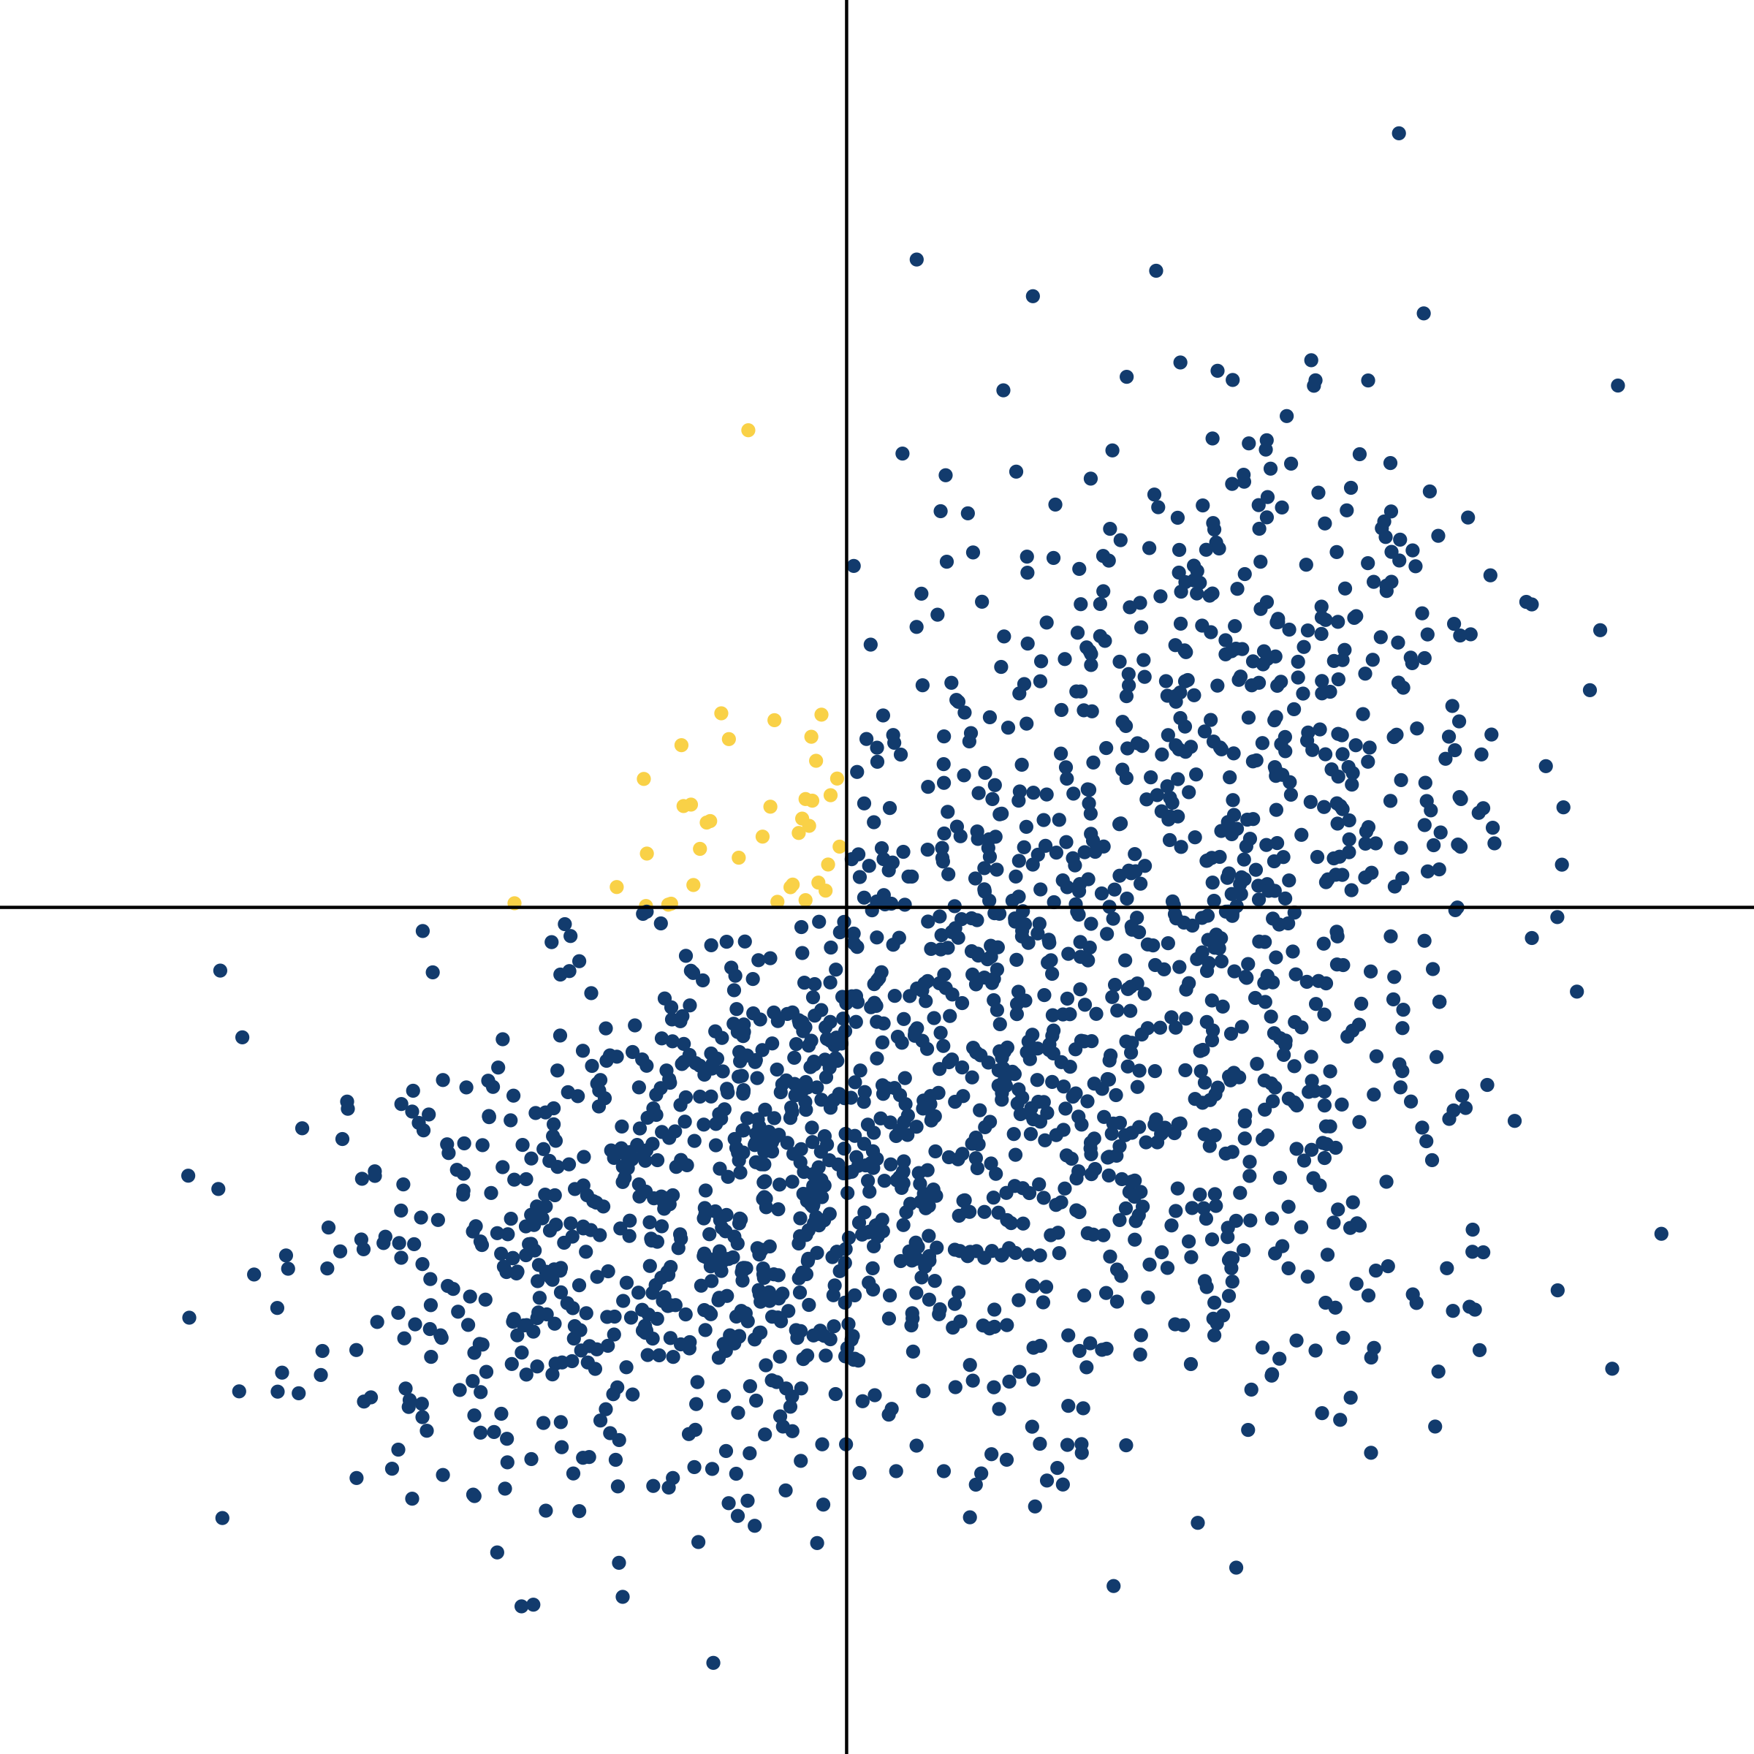
NP (was) _ed about whether S
NP (was) _ed

Slide 71
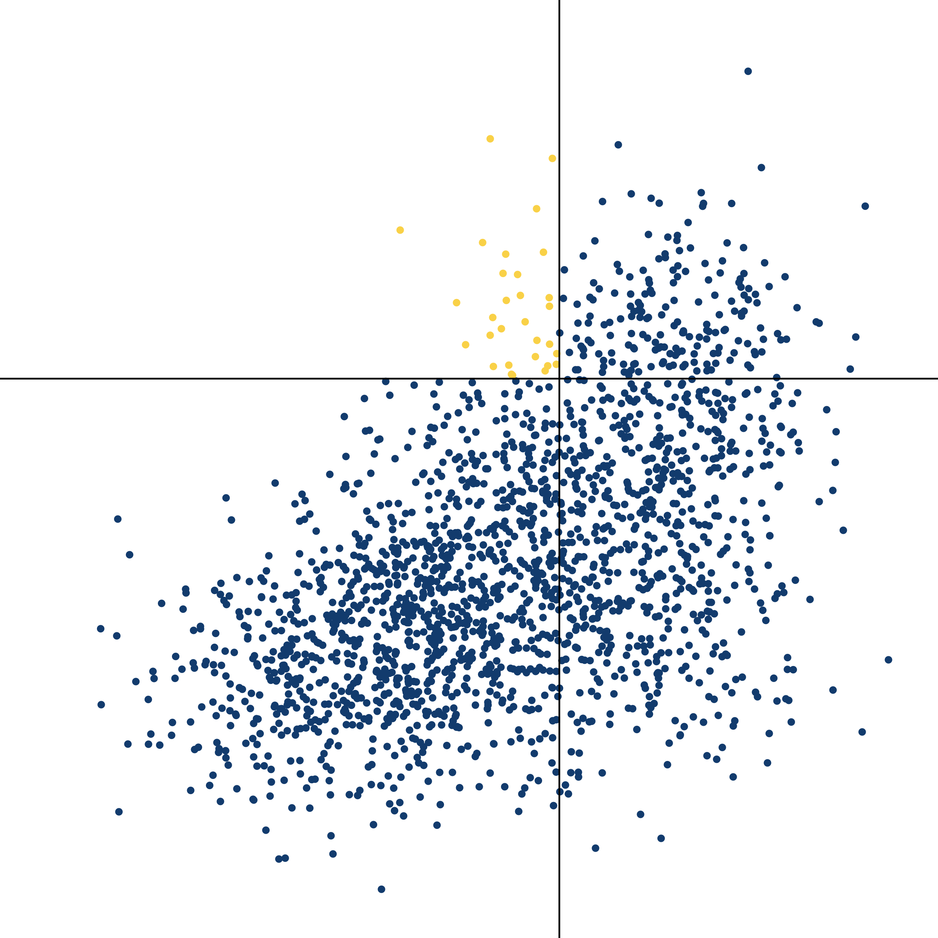
NP (was) _ed about whether S
NP (was) _ed

Slide 72
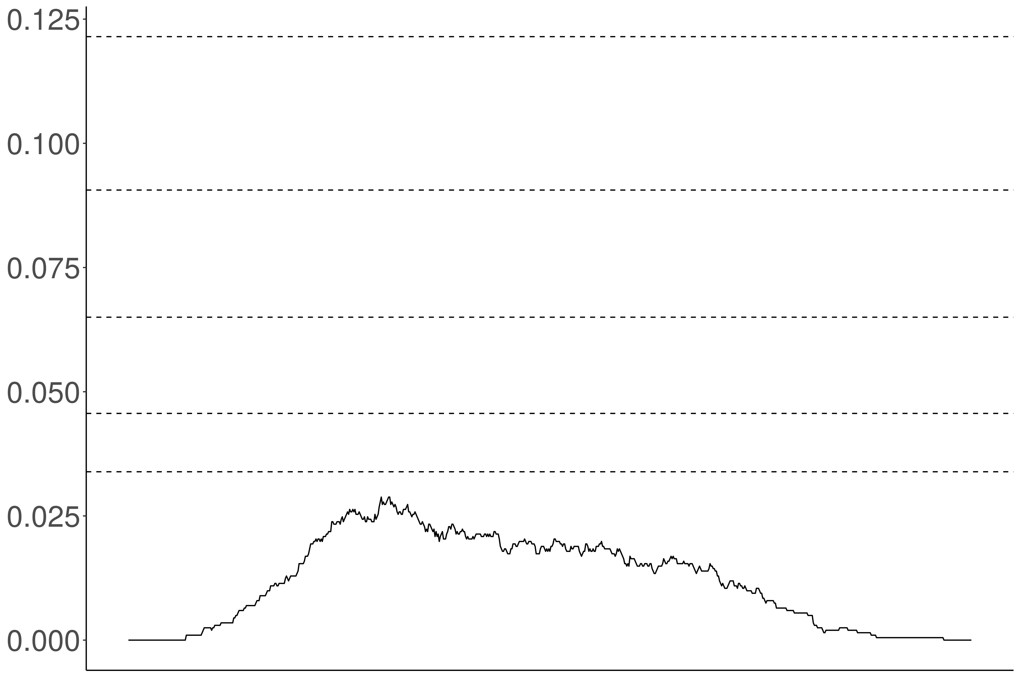
Proportion violations
Acceptability threshold

Slide 73
Independence
Proportion violations
Noise variance / acceptability variance

Slide 74
Proportion violations
Acceptability threshold

Slide 75
Proportion violations
Acceptability threshold

Slide 76
Conclusion
Safe to use bleaching to collect acceptability judgments focused on capturing selection.

Slide 77
Measuring Inference

Slide 78
Veridicality inference
(not)
NP V S ⇝ S
NP not V S ⇝ (not) S
Doxastic inference
NP V S ⇝ NP believe S
NP not V S ⇝ NP (not) believe S
(not)
Bouletic inference
NP V S ⇝ NP want S
NP not V S ⇝ NP (not) want S
(not)
Neg-raising inference
NP not V S ⇝ NP V not S

Slide 79
Recipe
Validate a bleaching paradigm for collecting judgments for an inference type.
Select a set of frames of interest.
Select predicates acceptable in those frames using MegaAcceptability.
Collect judgments using the paradigm.

Slide 80
Veridicality task
White & Rawlins 2018

Slide 81
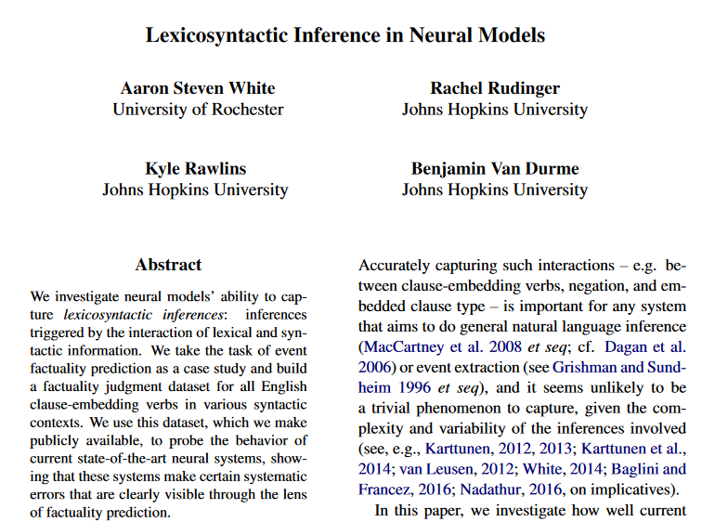
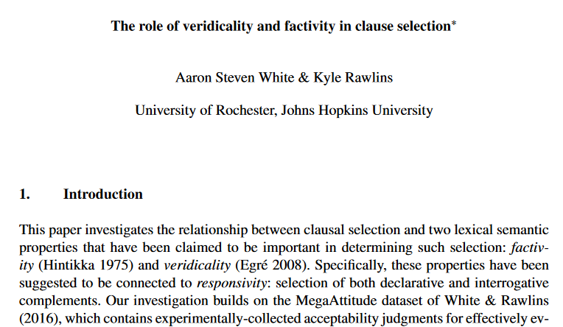
Kyle Rawlins
Johns Hopkins University
Rachel Rudinger
University of Maryland
Ben Van Durme
Johns Hopkins University

Slide 82
Someone was irritated that a particular thing happened.
Veridicality task
White & Rawlins 2018
Did that thing happen?
no maybe or maybe not yes

Slide 83
NP _ that S
Someone {knew, didn't know} that a particular thing happened.
NP be _ that S
Someone {was, wasn't} surprised that a particular thing happened.
NP _ for NP to VP
Someone {needed, didn’t need} for a particular thing to happen.
NP _ NP to VP[+/-eventive]
Someone {told, didn’t tell} a particular person to do a particular thing.
Someone {believed, didn’t believe} a particular person to have a particular thing.
NP be _ to VP[+/-eventive]
A particular person {was, wasn’t} excited to do a particular thing.
A particular person {was, wasn’t} suspected to have a particular thing.
NP _ to VP[+/-eventive]
A particular person {managed, didn’t manage} to do a particular thing.
A particular person {seemed, didn’t seem} to have a particular thing.

Slide 84
Neg-raising task
An & White 2020

Slide 85
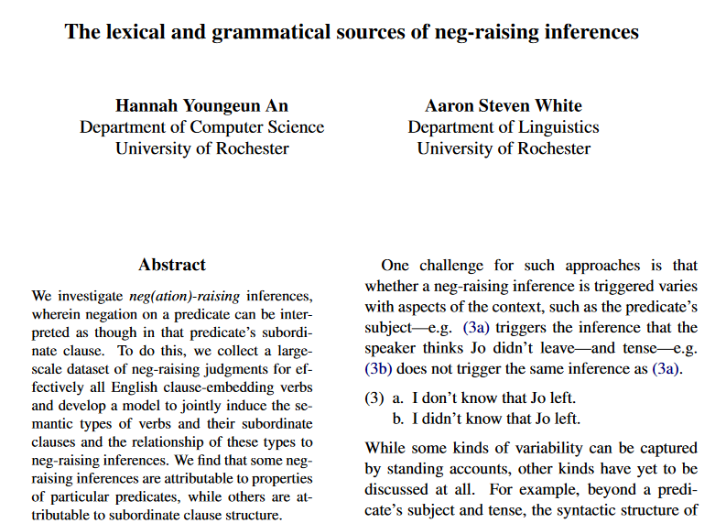
Hannah An
University of Rochester

Slide 86
If I were to say I don’t think that a particular thing happened, how likely is it that I mean I think that that thing didn’t happen?
Neg-raising task
An & White 2020
Extremely unlikely
Extremely likely

Slide 87
NP _ that S
I {didn’t, don’t}
know that a particular thing happened.
A particular person {didn’t, doesn’t}
NP be _ that S
I {wasn’t, ‘m not}
surprised that a particular thing happened.
A particular person {wasn’t, isn’t}
NP be _ to VP[+/-eventive]
I {wasn’t, ‘m not}
told to do a particular thing.
A particular person {wasn’t, isn’t}
believed to have a particular thing.
NP _ to VP[+/-eventive]
I {didn’t, don’t}
managed to do a particular thing.
A particular person {didn’t, doesn’t}
seemed to have a particular thing.

Slide 88
If A knew that C happened, how likely is it that A believed that C happened?
Doxastic task
Kane et al. 2021
Extremely unlikely
Extremely likely

Slide 89
If A persuaded B that C happened, how likely is it that B believed that C happened?
Doxastic task
Kane et al. 2021
Extremely unlikely
Extremely likely

Slide 90
If A was appalled that C happened, how likely is it that A wanted C to have happened?
Bouletic task
Kane et al. 2021
Extremely unlikely
Extremely likely

Slide 91
If A apologized to B that C happened, how likely is it that B wanted C to have happened?
Bouletic task
Kane et al. 2021
Extremely unlikely
Extremely likely

Slide 92
NP _ that S
A {knew, didn't know} that C happened.
NP _ NP that S
A {told, didn't tell} B that C happened.
NP _ to NP that S
A {said, didn't say} to B that C happened.
NP _ that S
A {was, wasn’t} surprised that C happened.
NP _ that S[+future]
A {hoped, didn't hope} that C would happen.
NP _ NP that S[+future]
A {promised, didn't promise} B that C would happen.
NP _ to NP that S[+future]
A {predicted, didn't predict} to B that C would happen.
NP _ that S[+future]
A {was, wasn’t} excited that C would happen.

Slide 93
Question
Is bleaching a valid method for capturing inferences associated with verb in a frame?

Slide 94
Validation Strategy #1
Compare judgments for bleached items against judgments from trained linguists.

Slide 95
 | Neg-raising | Non-neg-raising
NP __ that S | think, believe, feel, reckon, figure, guess, suppose, imagine | announce, claim, assert, report, know, realize, notice, find out
NP __ to VP | want, wish, happen, seem, plan, intend, mean, turn out | love, hate, need, continue, try, like, desire, decide

Slide 96
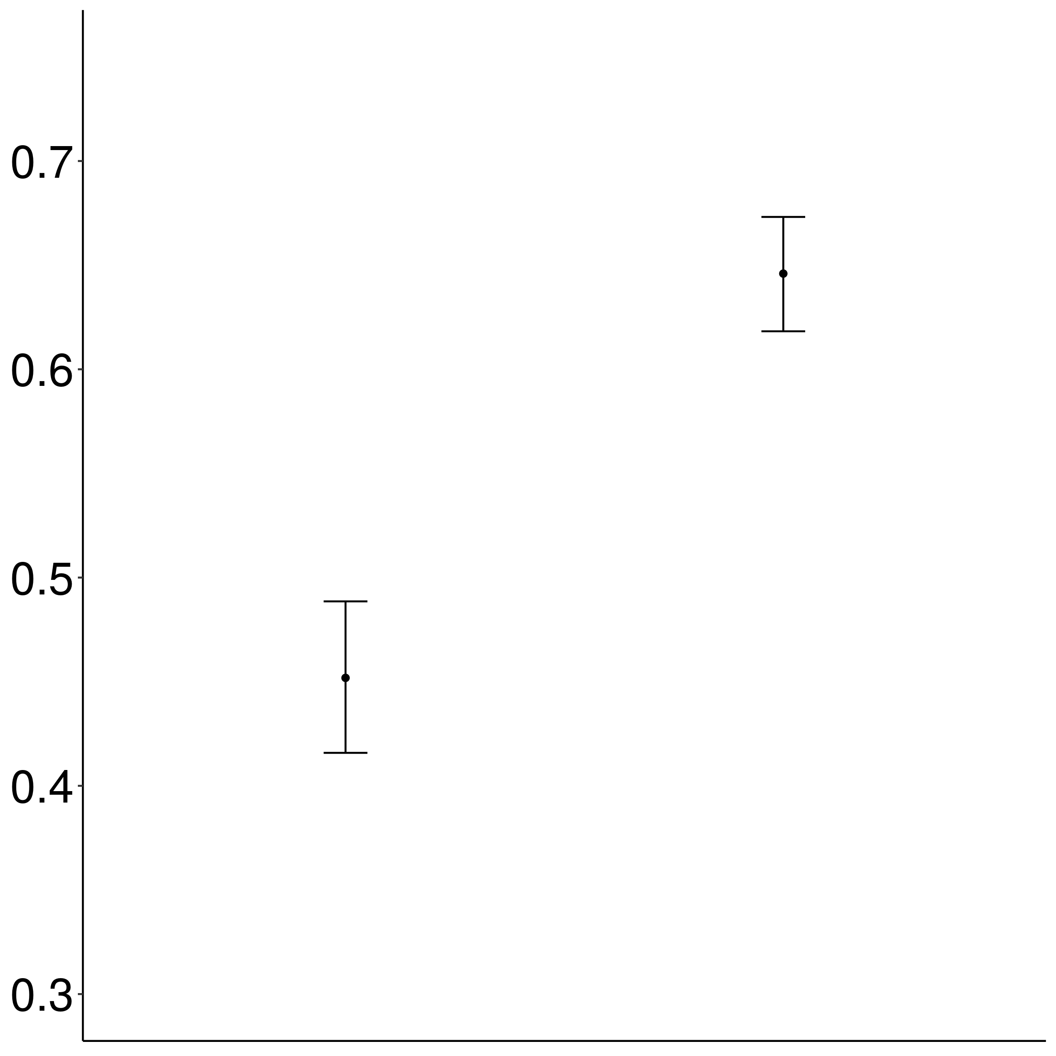
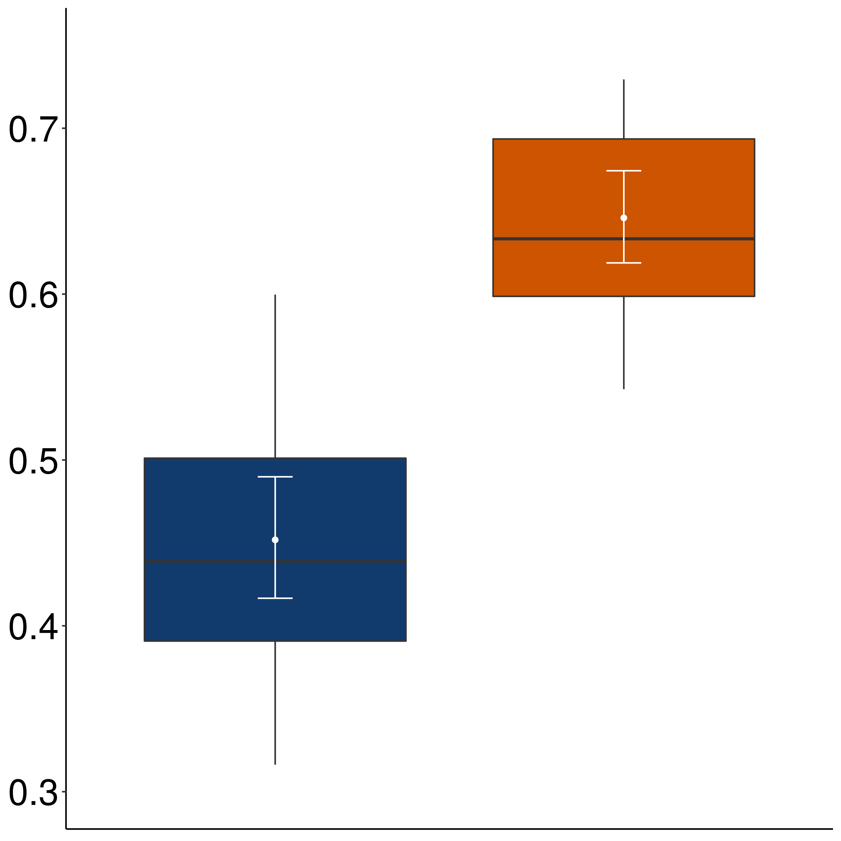
Mean rating of bleached example
Non-neg-raising
Neg-raising

Slide 97
Validation Strategy #1
Compare judgments for bleached items against judgments from trained linguists.
Validation Strategy #2
Compare judgments for bleached items to judgments for more contentful items.

Slide 98
Implementation
For each verb-frame pair in validation set, sample five items from corpus.

Slide 99
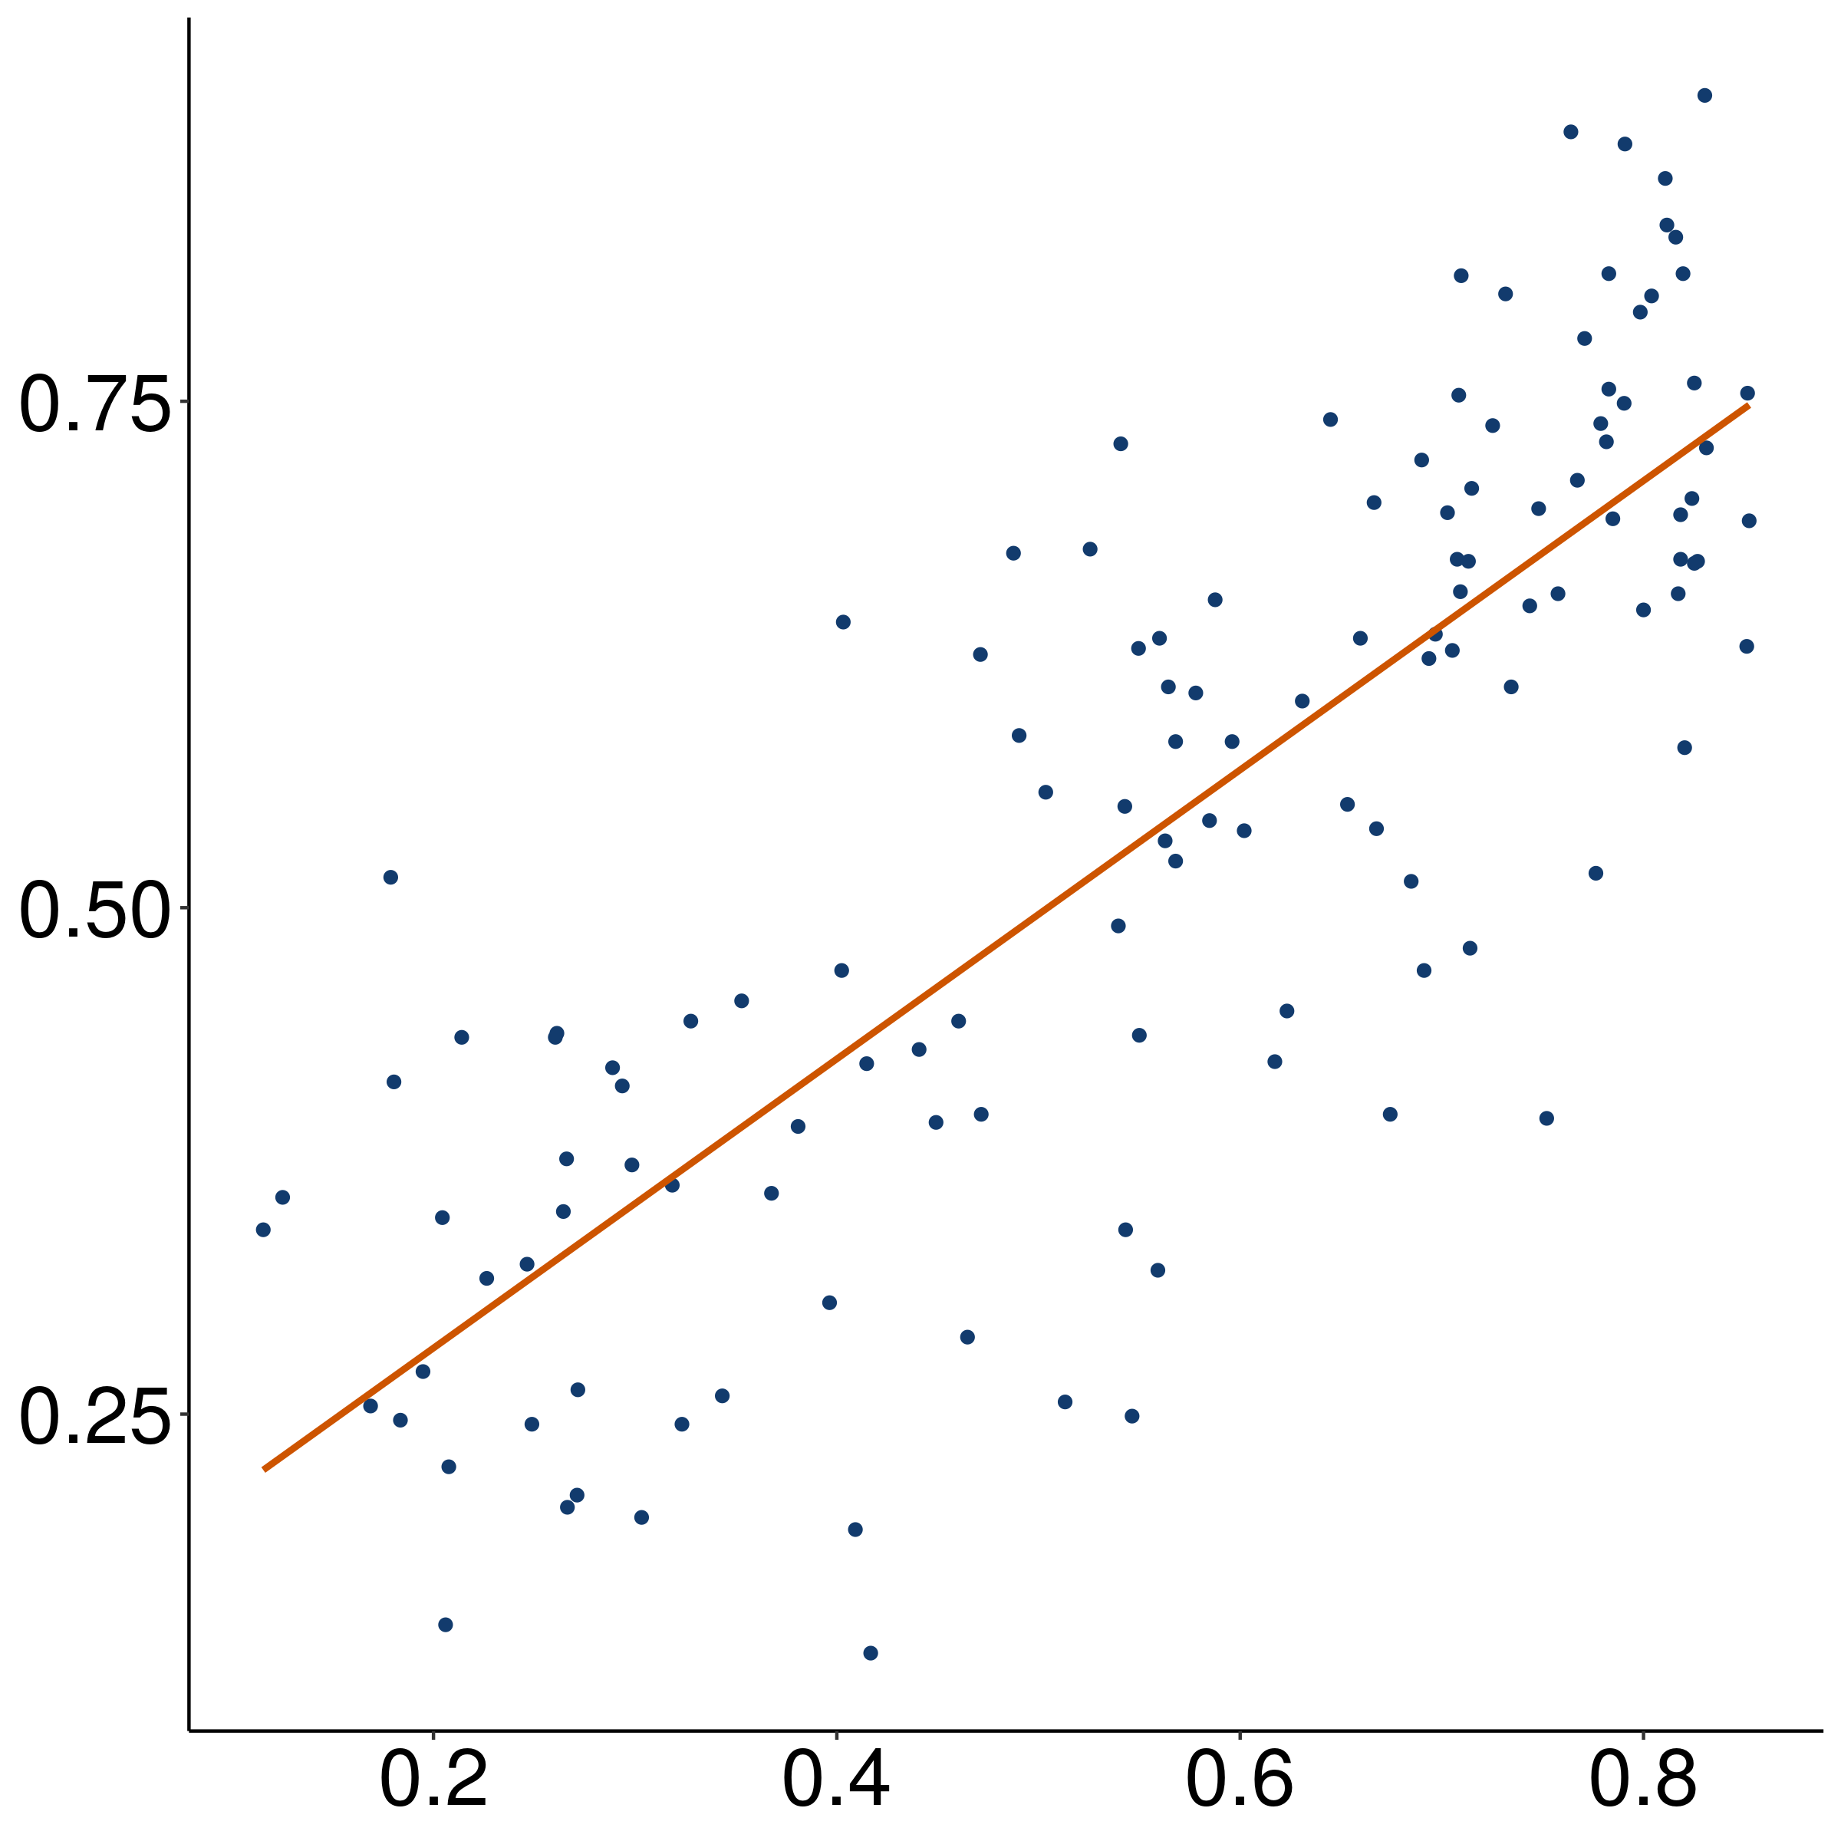
Mean rating of bleached example
r = 0.8
(p < 0.001)
Mean rating of corpus example

Slide 100
Validation Strategy #1
Compare judgments for bleached items against judgments from trained linguists.
Validation Strategy #2
Compare judgments for bleached items to judgments for more contentful items.
Validation Strategy #3
Compare inference judgments for bleached items to acceptability judgments for established distributional diagnostic.

Slide 101
Implementation
For each verb-frame pair in validation set, collect acceptability of strong NPI (additive either).
Jo didn’t do a particular thing, and…
…I don’t think that Bo did that thing either.
…I think that Bo didn’t do that thing either.

Slide 102
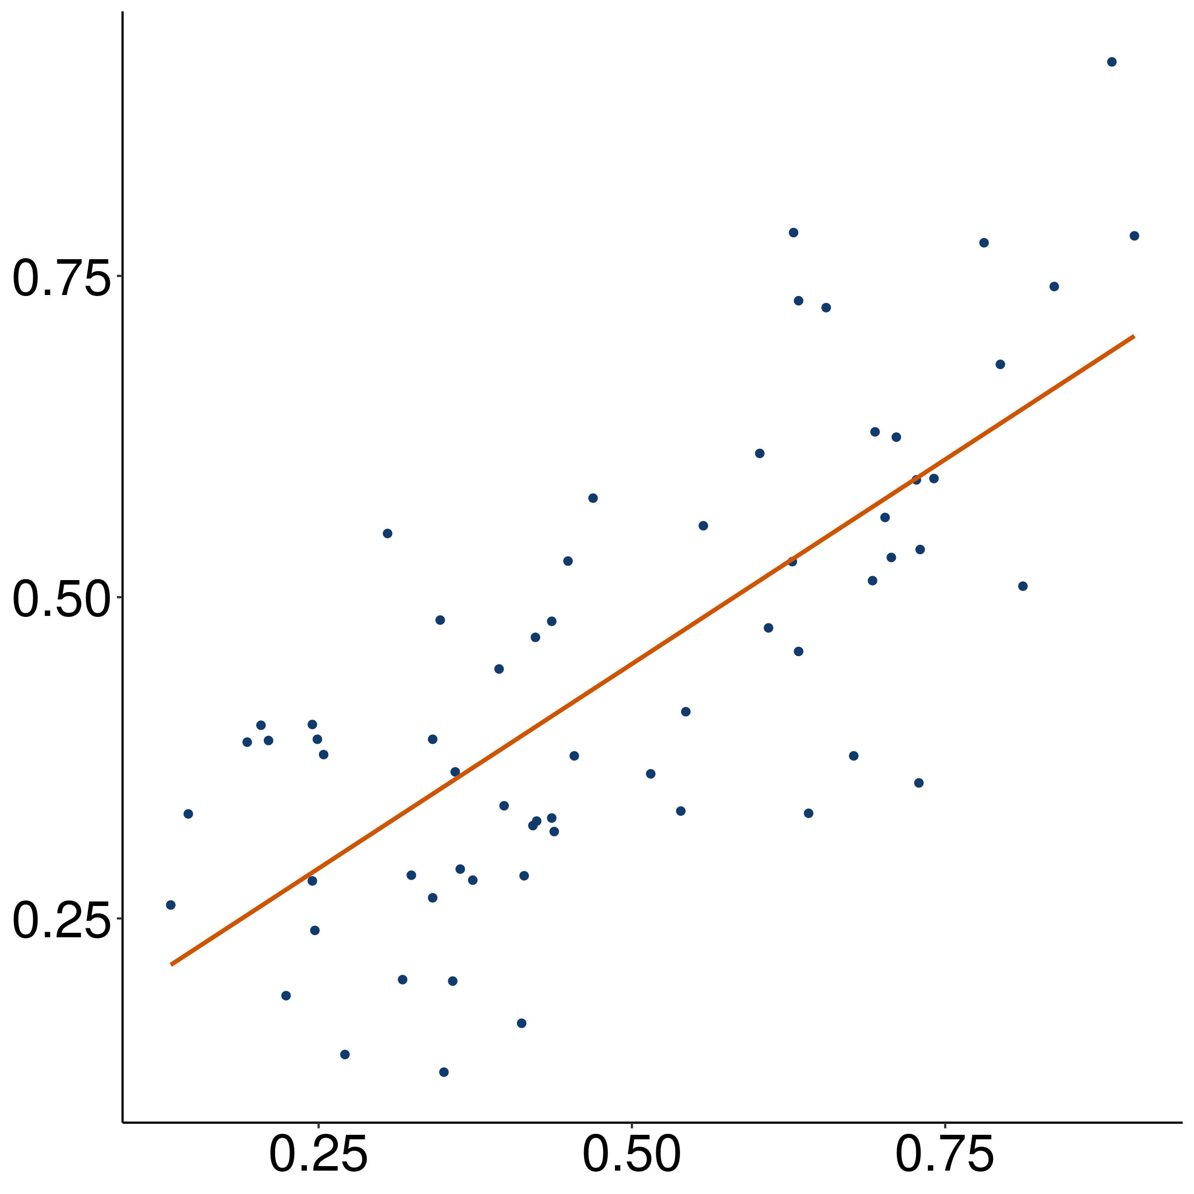
Mean acceptability of strong NPI
r = 0.77
(p < 0.001)
Mean rating of bleached example

Slide 103
Conclusion
Safe to use bleaching to collect at least these types of inference judgments.
Important Point (again)
Be cautious in using this dataset to investigate individual predicates.

Slide 104
Discovering Inference Patterns

Slide 105
Approach
Cluster predicate-frame pairs in inference space using a multiview mixed effects mixture model.

Slide 106
Predicate | NP V S ⇝ S | NP V S ⇝ NP believe S | NP V S ⇝ NP want S
think | 0 | + | 0
doubt | 0 | - | 0
hope | 0 | 0 | +
hate | + | + | -

Slide 107
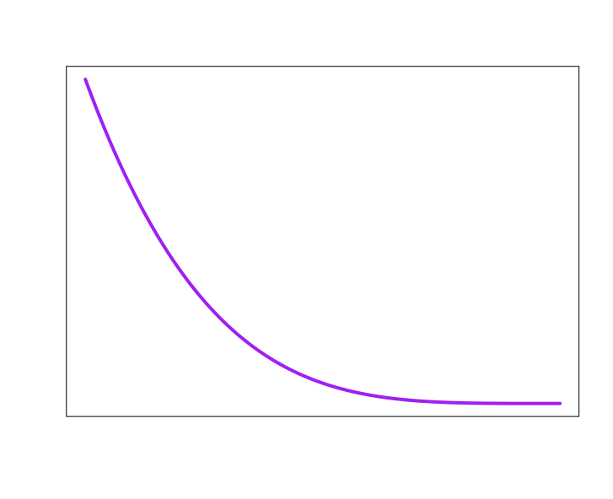
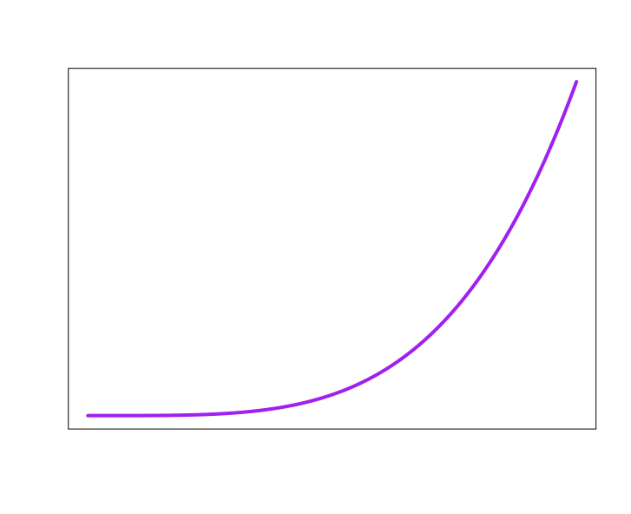
know + NP _ that S
Inference patterns
1
2
3
4
5
6
10
11
7
8
9
12
Neg-raising
Doxastic
Bouletic
Veridicality
0
1
0
1
0
1
no
maybe
yes

Slide 108
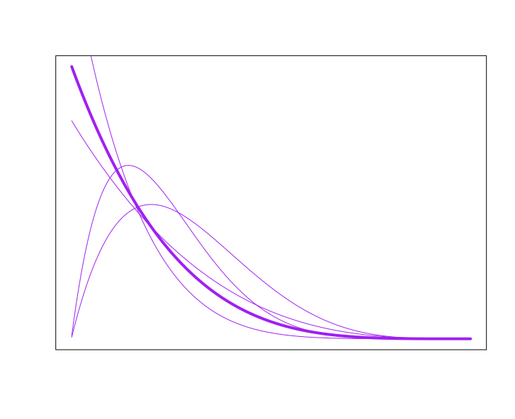
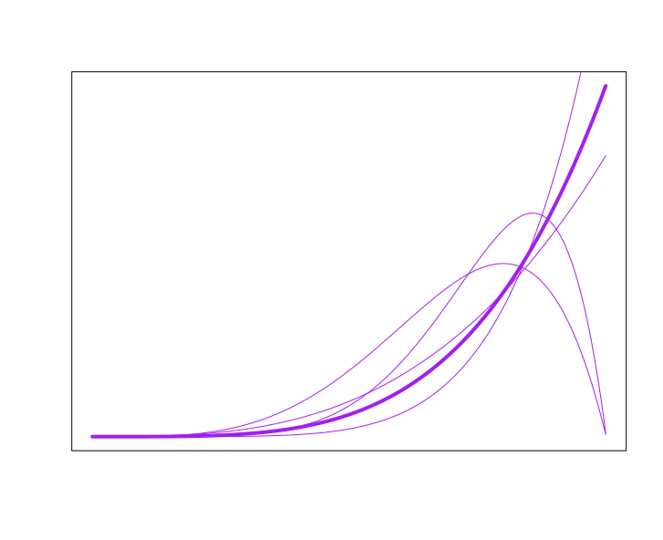
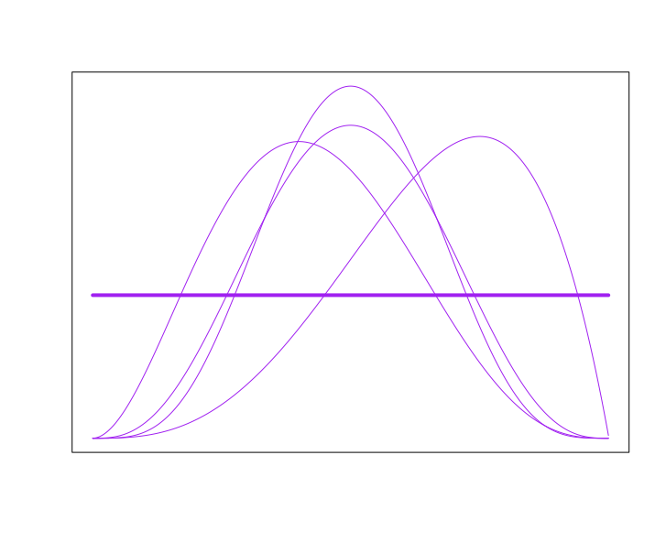
know + NP _ that S
Inference patterns
1
2
3
4
5
6
10
11
7
8
9
12
Neg-raising
Doxastic
Bouletic
Veridicality
0
1
0
1
0
1
no
maybe
yes

Slide 109
Finding clusters
Fit model to raw that-clause data in MegaVeridicality, MegaNegRaising, and MegaIntensionality using variational inference.

Slide 110
Output
A distribution over inference patterns for each verb-frame pair.

Slide 111
know + NP _ that S
Inference patterns
1
2
3
4
5
6
10
11
7
8
9
12
Neg-raising
Doxastic
Bouletic
Veridicality
0
1
0
1
0
1
no
maybe
yes

Slide 112
Output
A distribution over inference patterns for each verb-frame pair.
Distributions over judgments for each inference type and inference pattern

Slide 113
know + NP _ that S
Inference patterns
1
2
3
4
5
6
10
11
7
8
9
12
Neg-raising
Doxastic
Bouletic
Veridicality
0
1
0
1
0
1
no
maybe
yes

Slide 114
Question
How many inference patterns should we assume there are?
Idea
Only as many as we need to explain syntactic distribution.

Slide 115
Implementation
Select the smallest clustering for which no larger clustering improves prediction of the judgments in MegaAcceptability.

Slide 116
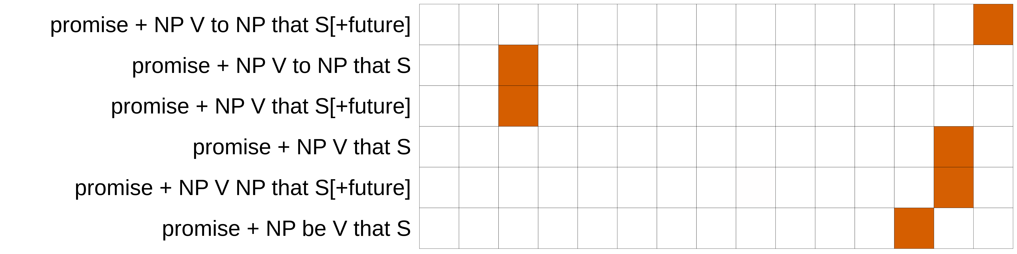
Cluster

Slide 117
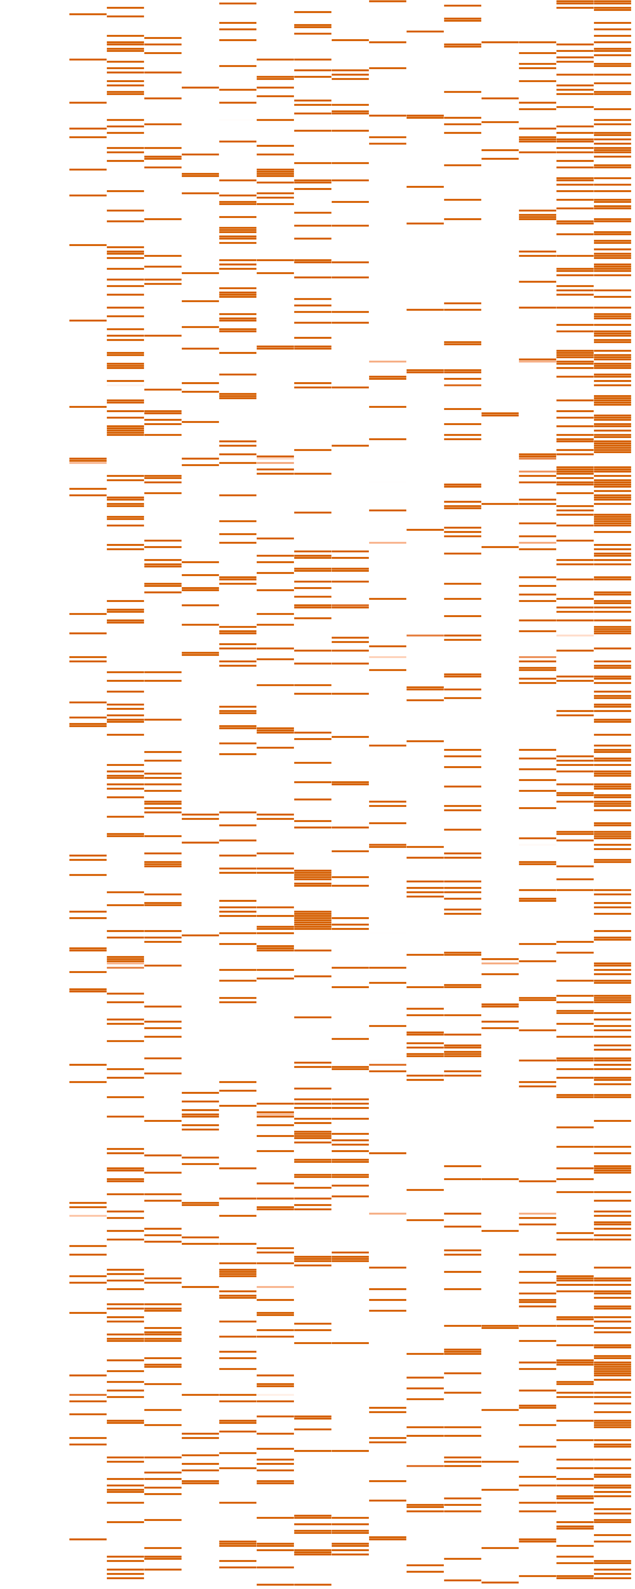
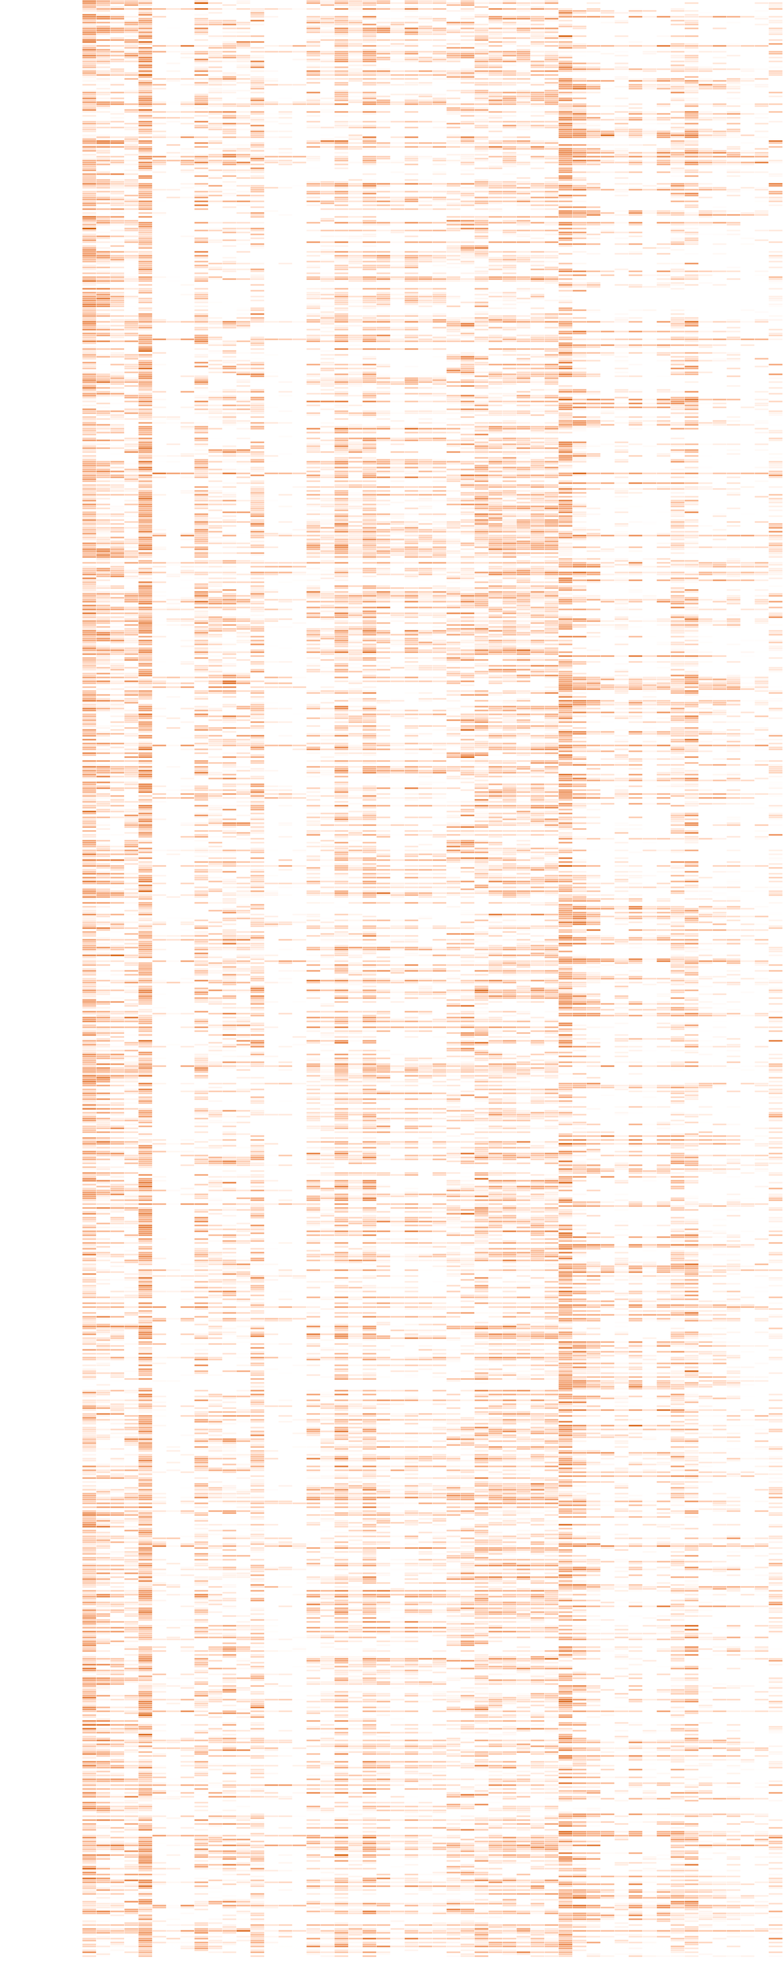
Cluster
Frame
Predicate
Predicate

Slide 119
Implementation
Select the smallest clustering for which no larger clustering improves prediction of the judgments in MegaAcceptability.
Result
Optimal number of inference patterns is 15.

Slide 121
Question
How good is this level of predictive accuracy?
Comparison #1
How well can acceptability be predicted from verb-subcategorization frame cooccurrences directly?

Slide 123
Question
How good is this level of predictive accuracy?
Comparison #1
How well can acceptability be predicted from verb-subcategorization frame cooccurrences directly?
Comparison #2
How well can acceptability be predicted from abstractions of verb-frame cooccurrences?

Slide 125
Interpretation
There are at least 15 distributionally correlated inference patterns.
Important Point #1
Not all inference patterns instantiated by particular predicates will get their own inference pattern.
Important Point #2
Enriching the distributional representation could increase the granularity of the patterns.

Slide 126
Investigating Inference Patterns

Slide 127
know + NP _ that S
Inference patterns
1
2
3
4
5
6
10
11
7
8
9
12
Neg-raising
Doxastic
Bouletic
Veridicality
0
1
0
1
0
1
no
maybe
yes
0
0.5
1

Slide 128
Cluster
Frame
Predicate
Predicate

Slide 130
Representiationals
doxastic mental states and mental processes
NP {thought, believed, suspected} that S

Slide 134
Preferentials
expressions of preference for a (future) situation.
NP {hoped, wished, demanded, recommended} that S[+/-future]​

Slide 138
Preferentials
expressions of preference for a (future) situation.
NP {hoped, wished, demanded, recommended} that S[+/-future]​
Positive internal emotives
positive emotional states
A was {pleased, thrilled, enthused} that C happened.

Slide 143
Preferentials
expressions of preference for a (future) situation.
NP {hoped, wished, demanded, recommended} that S[+future/-tense]​
Positive internal emotives
positive emotional states
NP was {pleased, thrilled, enthused} that S.
Negative internal emotives
negative emotional states
NP was {frightened, disgusted, infuriated} that S.​
Negative external emotives
expressions of negative emotion with behavioral correlates
NP {whined, whimpered, pouted} to NP that S[+future].​
Negative emotive miratives
expressions of surprise with negative valence
NP was {dazed, flustered, alarmed} that S[+future].
Positive external emotives
expressions of positive emotion with behavioral correlates
NP was {congratulated, praised, fascinated} that S.

Slide 145
Representiationals
doxastic mental states and mental processes
NP {thought, believed, suspected} that S
Speculatives
communication of uncertain beliefs.
NP {ventured, guessed, gossiped} that S
Future commitment
expressions of commitment to future action or result.
NP {promised, ensured, attested} S[+future]

Slide 147
Representiationals
doxastic mental states and mental processes
NP {thought, believed, suspected} that S
Speculatives
communication of uncertain beliefs.
NP {ventured, guessed, gossiped} that S
Future commitment
expressions of commitment to future action or result.
NP {promised, ensured, attested} S[+future]
Strong communicatives
communicative acts with strong doxastic inferences about the source.
NP {confessed, admitted, acknowledged} that S​
Weak communicatives
communicative acts with weak doxastic inferences about the source.
NP {reported, remarked, yelped} to NP that S
Discourse commitment
communicative acts committing the source to the content’s truth.
A {maintained, remarked, swore} that C would happen.

Slide 148
Preferentials
expressions of preference for a (future) situation.
NP {hoped, wished, demanded, recommended} that S[+/-future]​
Positive internal emotives
positive emotional states
A was {pleased, thrilled, enthused} that C happened.
Negative internal emotives
negative emotional states
A was {frightened, disgusted, infuriated} that C happened.​
Negative external emotives
expressions of negative emotion with behavioral correlates
A {whined, whimpered, pouted} to B that C would happen.​
Negative emotive miratives
expressions of surprise with negative valence
A was {dazed, flustered, alarmed} that C would happen.
Positive external emotives
expressions of positive emotion with behavioral correlates
A was {congratulated, praised, fascinated} that C happened.
Negative emotive communicatives
communicative acts with broadly negative valence.
A {screamed, ranted, growled} to B that C would happen.​

Slide 150
Representiationals
doxastic mental states and mental processes
NP {thought, believed, suspected} that S
Speculatives
communication of uncertain beliefs.
NP {ventured, guessed, gossiped} that S
Future commitment
expressions of commitment to future action or result.
NP {promised, ensured, attested} S[+future]
Strong communicatives
communicative acts with strong doxastic inferences about the source.
NP {confessed, admitted, acknowledged} that S​
Weak communicatives
communicative acts with weak doxastic inferences about the source.
NP {reported, remarked, yelped} to NP that S
Discourse commitment
communicative acts committing the source to the content’s truth.
NP{maintained, remarked, swore} that S[+future].
Deceptives
actions involving dishonesty, deceit, or pretense.
NP {lied, misled, faked, fabricated} ((to) NP) that S.​

Slide 152
Interpretation
There are at least 15 distributionally correlated inference patterns.
Important Point #1
Not all inference patterns instantiated by particular predicates will get their own inference pattern.
Important Point #2
Enriching the distributional representation could increase the granularity of the patterns.

Slide 153
Interpretation
There are at least 15 distributionally correlated inference patterns.
Important Point #1
Not all inference patterns instantiated by particular predicates will get their own inference pattern.
Important Point #2
Enriching the distributional representation could increase the granularity of the patterns.

Slide 154
Conclusion

Slide 155
Question What types of concepts does language “see”?
Prior Work For some areas of the lexicon, we have a solid understanding what language ”sees”.
Challenge As we expand to larger and more open classes of words, generalizations tend to be harder to find.

Slide 156
Question Could this be because there are no lexical generalizations to be had for these inferences?
Possibility #1 (see Degen & Tonhauser 2022 on veridicality inferences) There is no discrete classification of concepts that determines these inferences. It’s all pragmatics.
Simons et al. 2010, 2017
Possibility #2 There is such a classification. It’s just obscured by noise in the measurement.
Possibility #2 There is such a classification. It’s just obscured by noise in the measurement.
But some patterns are associated with defeasible inferences.

Slide 157
Question What does it mean when a pattern contains a defeasible inference.
Possibility #1 Contextual uncertainty (e.g. vagueness) in the semantic content conditioning that pattern.
?
Possibility #2 Metalinguistic uncertainty (e.g. ambiguity) about the semantic content conditioning pattern.

Slide 158
Answer It depends on the kind of inference.
Projective Inferences In yesterday’s talk, I argued that projective inferences are subject to metalinguistic uncertainty.
Neg-raising inferences Of the inferences investigated, neg-raising would seem most likely to show contextual uncertainty.
…but it’s an empirical question.

Slide 159
Question Insofar as an inference is subject to metalinguistic uncertainty, what is that uncertainty about?
Possibility #2a Metalinguistic uncertainty is uncertainty about how to resolve formal indeterminacy.
Possibility #2b Metalinguistic uncertainty is knowledge about contexts that a lexical item is used in.

Slide 160
Semantic Discreteness
There is a discrete property of a sense of a lexical item or its linguistic context that necessarily triggers an inference.
X
Pragmatic Discreteness
There is a discrete property of the discourse contexts a lexical item occurs in that necessarily triggers an inference.

Slide 161
Question
How would we distinguish these two accounts of what metalinguistic uncertainty is uncertainty about?
Subquestion
Do we observe evidence that metalinguistic uncertainty is correlated with syntactic distribution?

Slide 162
Idea
If metalinguistic uncertainty is correlated with distribution, it may be associated with some linguistic representation.
Finding
There are strong correlations between distribution and semantically derived classes defined in terms of projective inferences.

Slide 163
Semantic Discreteness
There is a discrete property of a sense of a lexical item or its linguistic context that necessarily triggers an inference.
X
Pragmatic Discreteness
There is a discrete property of the discourse contexts a lexical item occurs in that necessarily triggers an inference.

Slide 164
Thanks!
Supported by NSF-BCS-1748969
The MegaAttitude Project: Investigating selection and polysemy at the scale of the lexicon

Slide 165
Appendix A: Distribution of Inference Judgments

Slide 169
Appendix B: Validation of MegaIntensionality

Slide 170
Question
Is bleaching a valid method for capturing doxastic and bouletic inferences associated with verb in a frame?

Slide 171
Challenge
Doxastic and bouletic inferences are highly sensitive to world knowledge.

Slide 172
Jo doubts that Bo left. ⇝ Jo doesn't believe that Bo left.
Jo doubts that Bo left. ⇝ Jo wants Bo to have left.
Trump doubts that he won in 2020.
Trump wants to have won in 2020.

Slide 173
Approach
Norm scenarios for likelihood of prior belief or desire not conditioned on a previous sentence

Slide 174
Norming
Executives generally believe that their deals will go through.
Executives generally want their deals to go through.

Slide 176
Approach
Norm scenarios for likelihood of prior belief or desire not conditioned on a previous sentence
Test those normed schenarios in an inference task focused 24 verbs.

Slide 177
Norming
Executives generally believe that their deals will go through.
Executives generally want their deals to go through.
Contentful
The executive knew that his deal had gone through.

Slide 178
Approach
Norm scenarios for likelihood of prior belief or desire not conditioned on a previous sentence
Test those normed schenarios in an inference task focused 24 verbs.
Compare to bleached variants.

Slide 179
Norming
Executives generally believe that their deals will go through.
Executives generally want their deals to go through.
Contentful
The executive knew that his deal had gone through.
Bleached
A knew that C happened.

Slide 181
Appendix C: Principal Component Analysis

Slide 182
95% of variance

Slide 183
The polarity of veridicality and doxastic inferences under negation is anti-correlated with neg-raising.
The polarity of a belief presupposition about a recipient is correlated with the polarity of a desire presupposition.
The valence of an emotive communicative is anticorrelated with veridicality.
Bouletic inferences about the source and the target of a communication are anticorrelated with veridicality.
Desire inferences about the source in a communication are anticorrelated with belief inferences about the target.
Veridicality is correlated with belief inferences in the target of a communication but anticorrelated with desire inferences.

